Slide 1
A beamer tutorial
LayoutBeamer, from Genisys GmbH
M. Rooks, Yale University

Slide 2
Beamer, or “LayoutBeamer” is a program which converts
pattern shapes to machine-specific formats, chopping
polygons into trapezoids, and cutting large patterns at
exposure field boundaries. Patterns will be stitched together
by writing each field, then moving the stage.
Many e-beam systems and mask writers can use the same
pattern fracturing software, and so a company such as GeniSys can provide better support for this common, essential software.
The only competitor to Beamer is “CATS” from Synopsys. CATS was once the defacto standard, and is still used on
many e-beam writers. Beamer is much more popular for use with research e-beam systems.

Slide 3
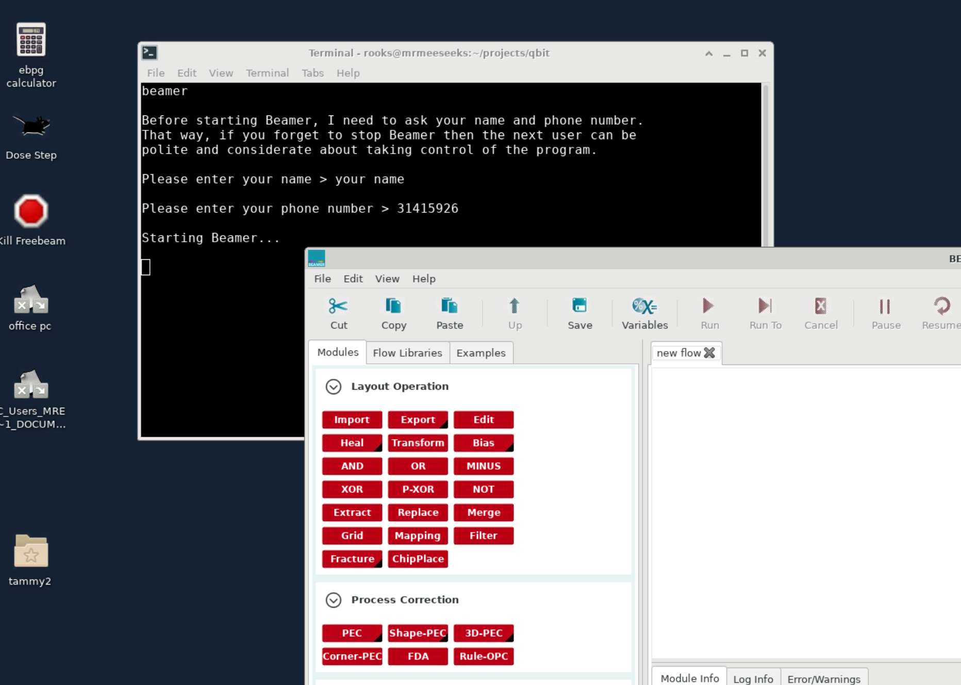
Start Beamer by firing up a terminal window on the e-beam server, then enter the command ‘beamer’. Our command ‘beamer’ asks for your name and number, because only one person at a time can use it.

Slide 4
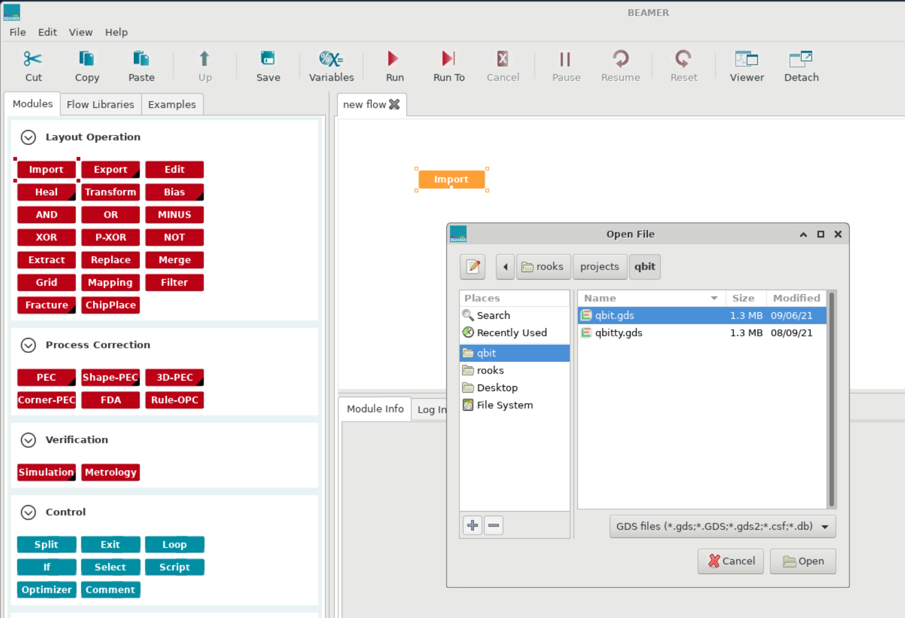
First drag an “input” module to the workspace. This module will read in your gds format CAD file.
Choose a gds file.

Slide 5
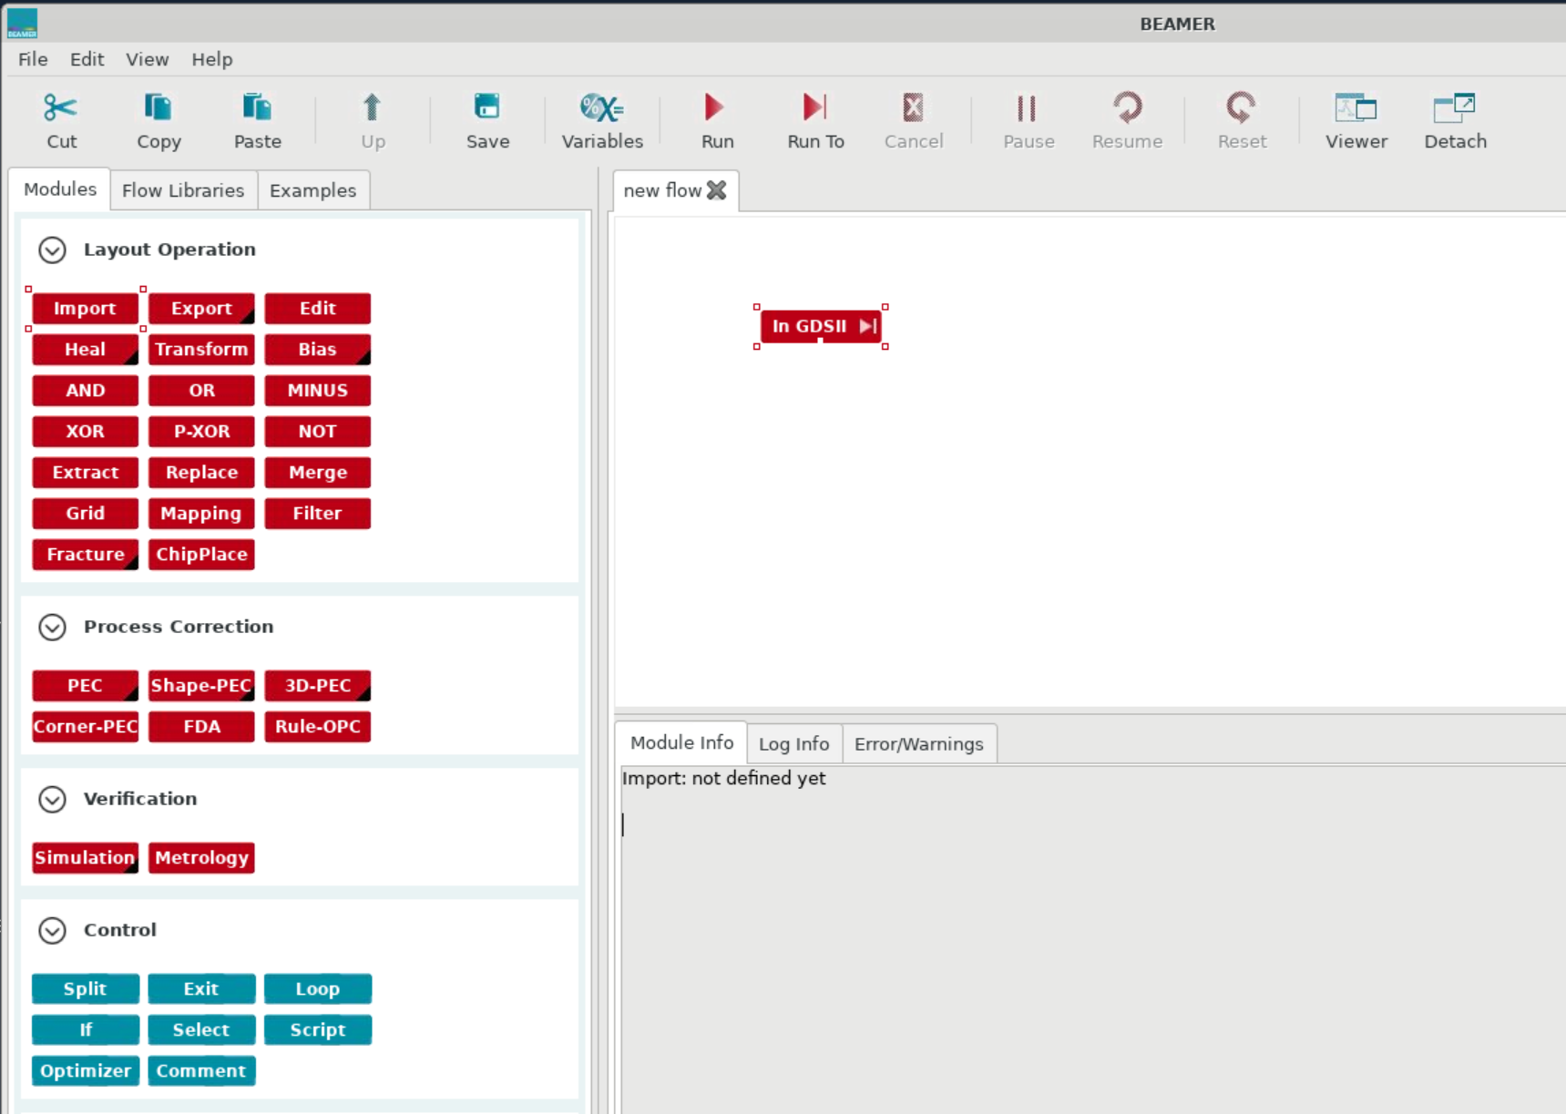
click on the “play” button
so that the next module
will see all the available
cells.

Slide 6
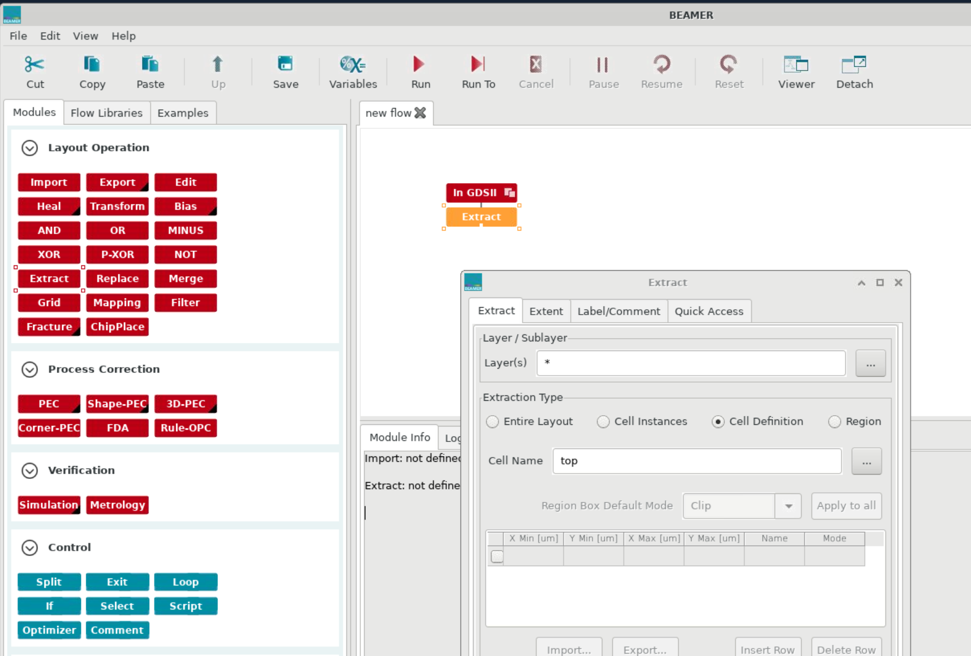
Drag “extract” over and connect it to “import”.
Click on “cell definition” and choose the top level cell (which is “top” in this example)

Slide 7
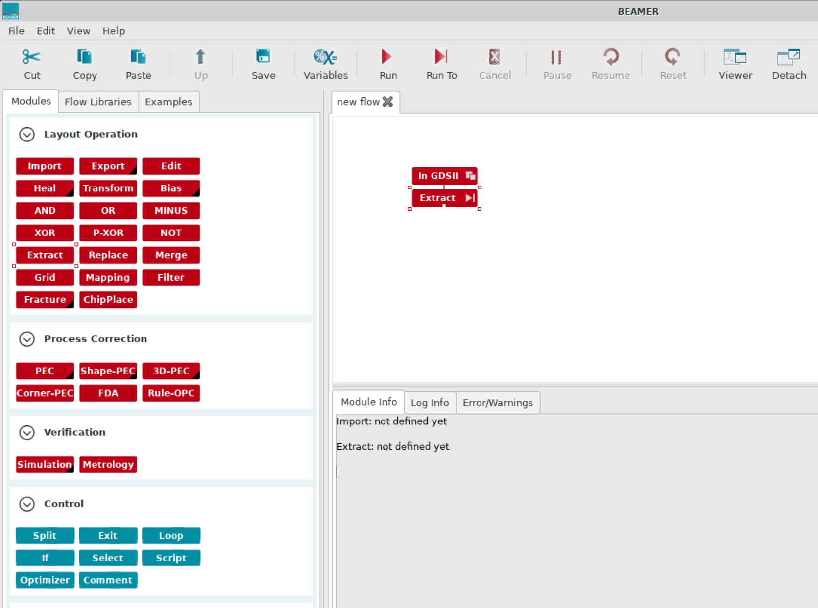
click on the play button

Slide 8
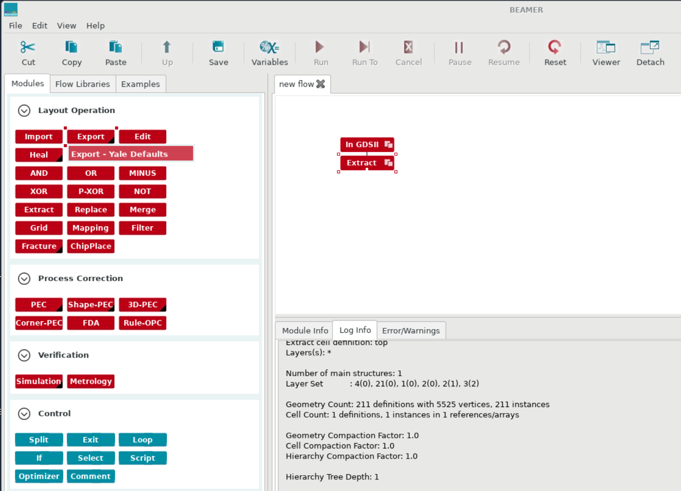
We need an “export” module to generate the output file. Notice the little black triangle in the corner
This means there are important defaults set up for our particular machine.

Slide 9
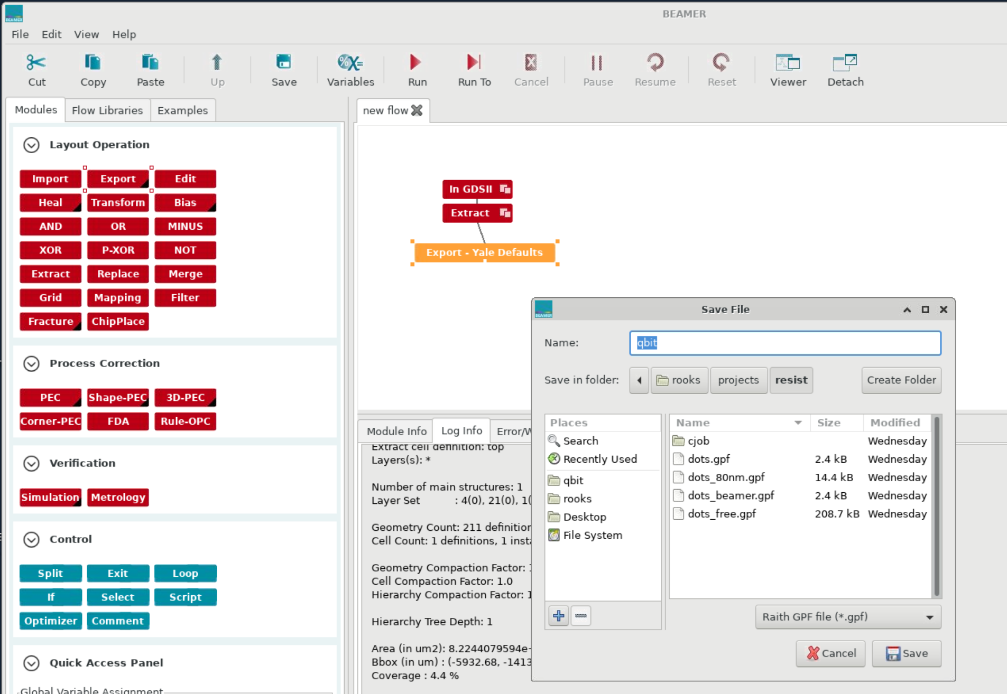
Drag “Export” to the work area and connect it to “extract”
The output format defaults to gpf, which is the correct choice.

Slide 10
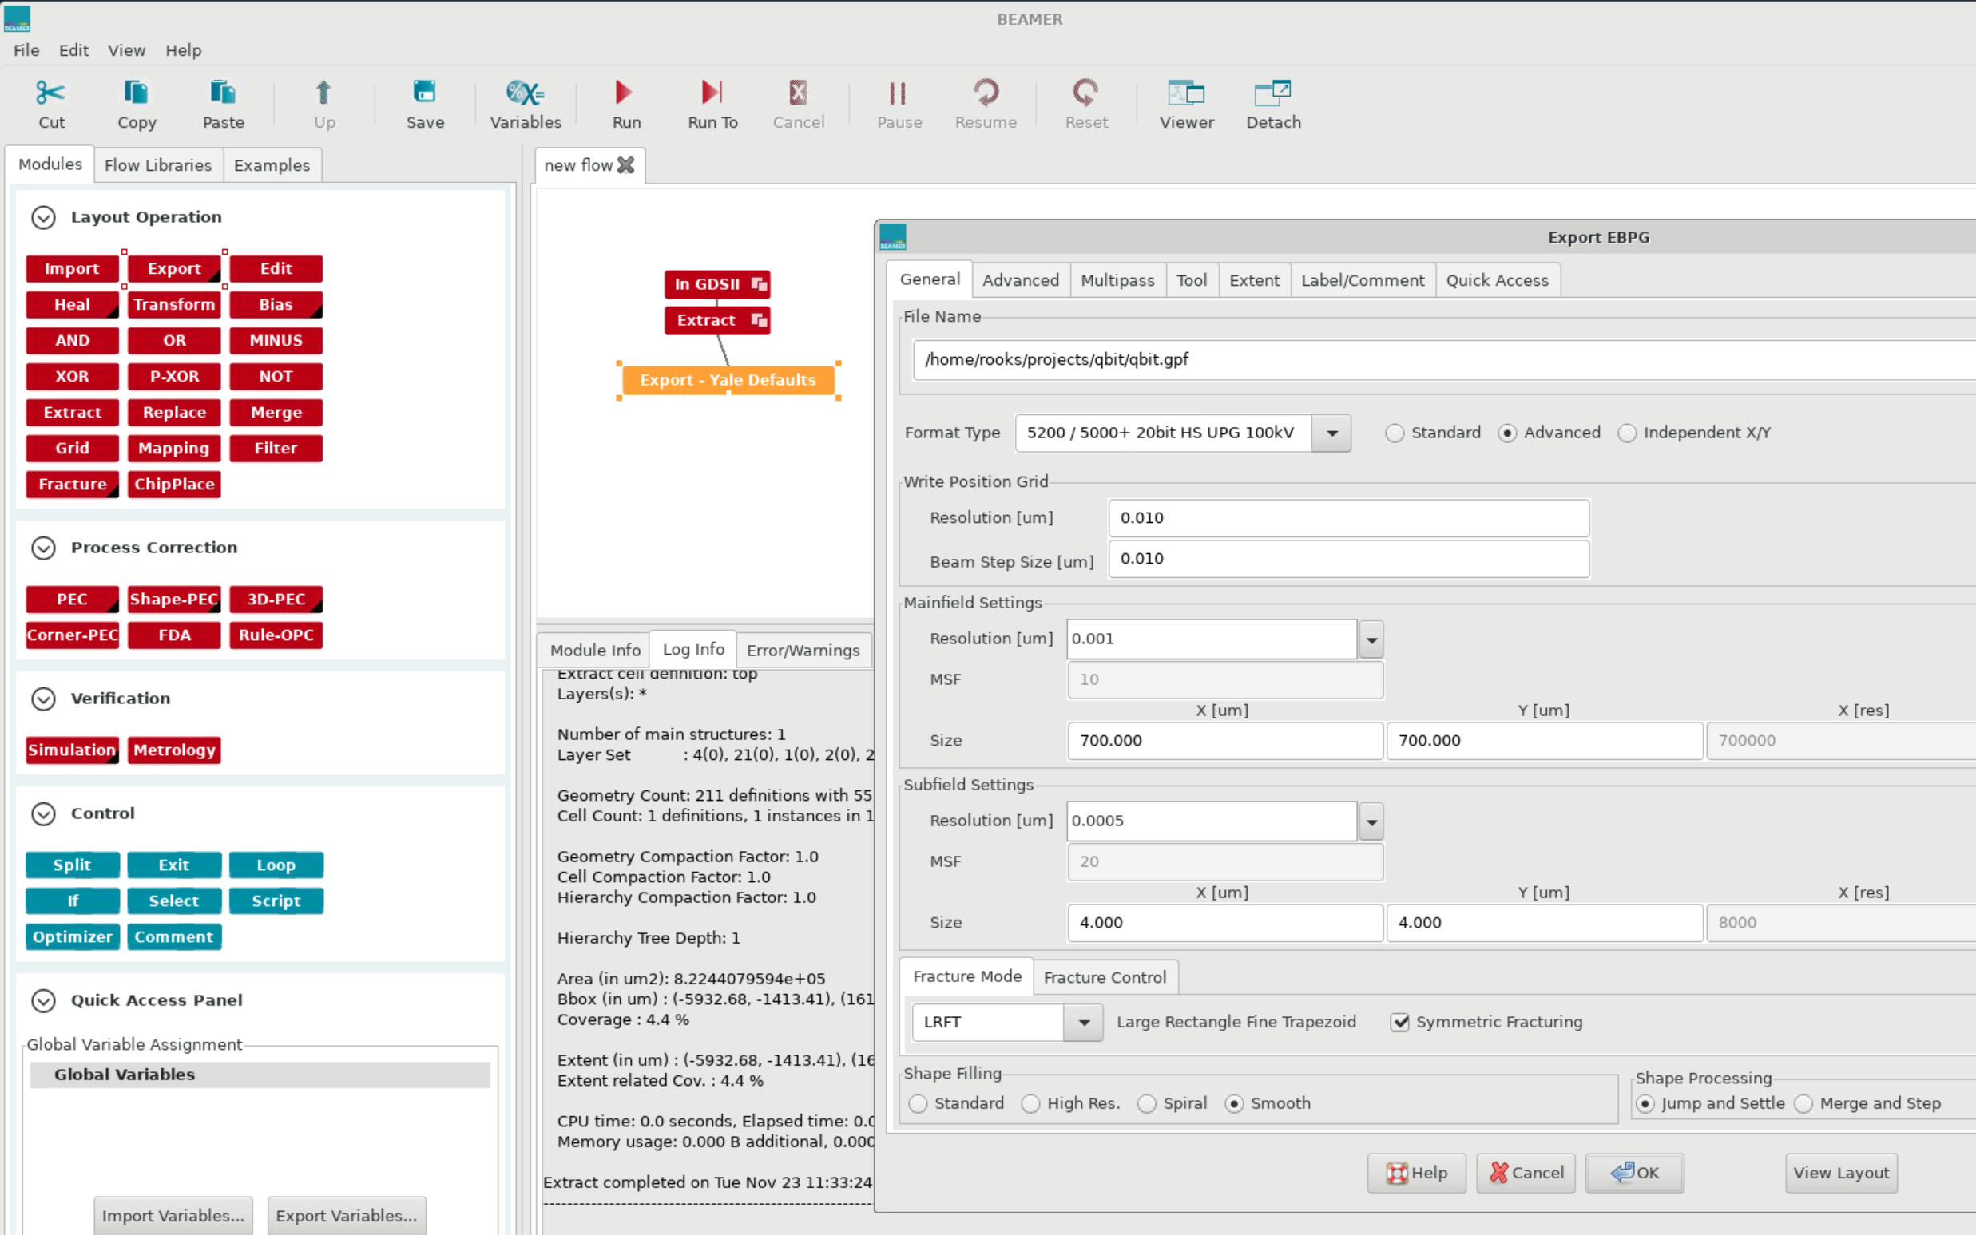
Now we have a menu with a lot of output options.

Slide 11
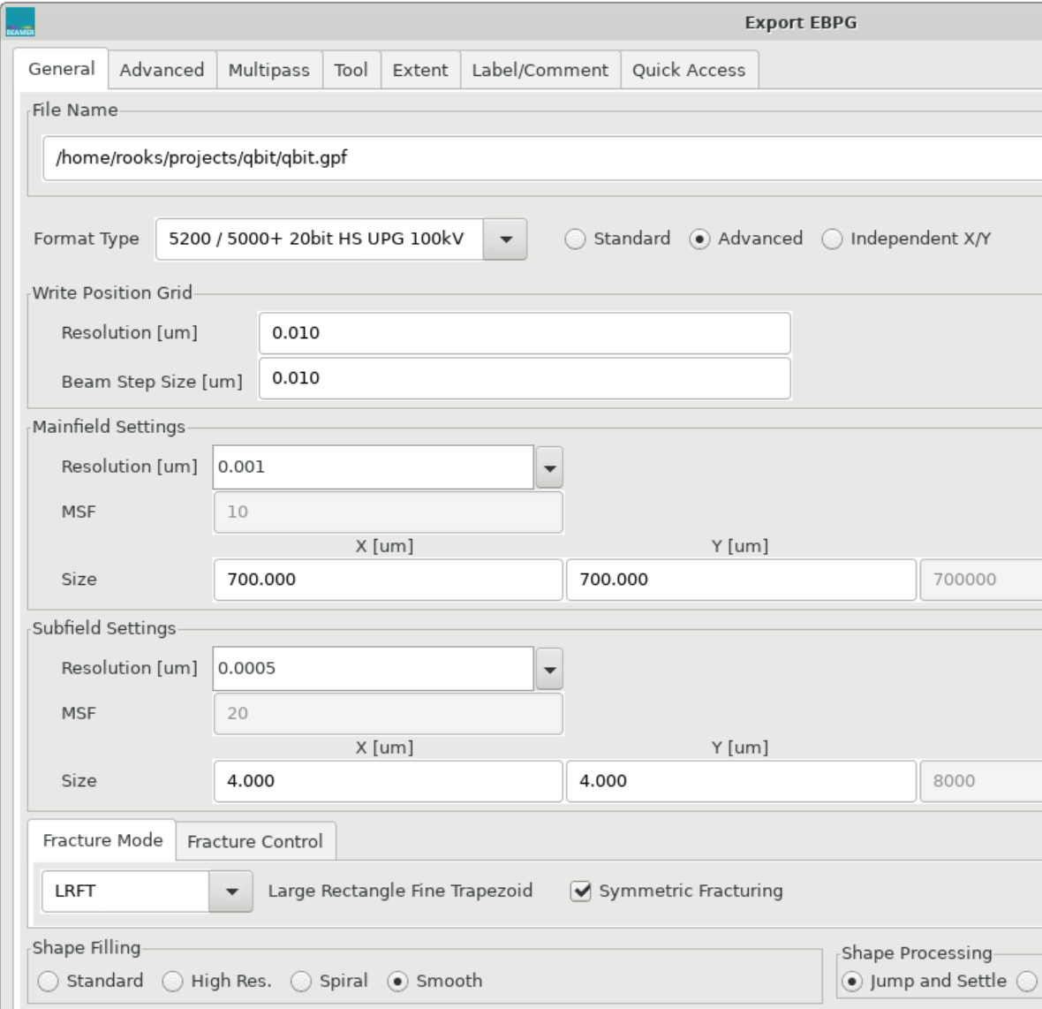
The default settings are
almost always the best choices.
The two things you will have to
choose: beam step size and field (or “block”) size.
Under “write position grid,” the word “resolution” means “placement accuracy”. It should equal the beam step size.*
You should calculate the best
beam step based on resist sensitivity
and resolution requirements.
One way to do this is to use the
EBPG calculator.
But really, you should have thought
about the beam step long ago,
before doing the CAD.
* There are some special cases where the shape placement accuracy is set equal to the LSB, while the beam step size is a larger multiple of the LSB. This happens when gratings or photonic bandgap structures need very fine pitch control. Try not to think about it for now. Just set it equal to the beam step size.

Slide 12
Let’s change the beam step
to 0.02 microns (20 nm).
Make sure the placement accuracy “resolution” is also 0.02 microns. It may or may not change by itself.
The block size will then change to the maximum value, which is pretty annoying. You must change it back to the size you want.

Slide 13
This “resolution” is the placement accuracy.
Over here the term “resolution”
means the EBPG’s bit size, also known as the LSB. On our system, we almost always set the mainfield LSB to 1 nm. That’s the default, and you should not change it.
Using the term “resolution” to mean two different things is a very poor design, but that’s what Beamer does.
Now look at the “Mainfield Size”.
This is a subset of the maximum
exposure field (1 nm)(2²⁰) ≈ 1 mm.
This is also called the “block size,”
because the pattern will be chopped
into blocks of this size.
The default block size was 700 μm,
but Beamer changed it to 1040 μm
when you changed the step size.
Why? It’s just another bad design choice.
Now you should change the block size to some
sensible numbers, such as (for example) 375 and 600 μm. Do not use the maximum field size.
LSB of the main deflector.
LSB of the subfield deflector

Slide 14
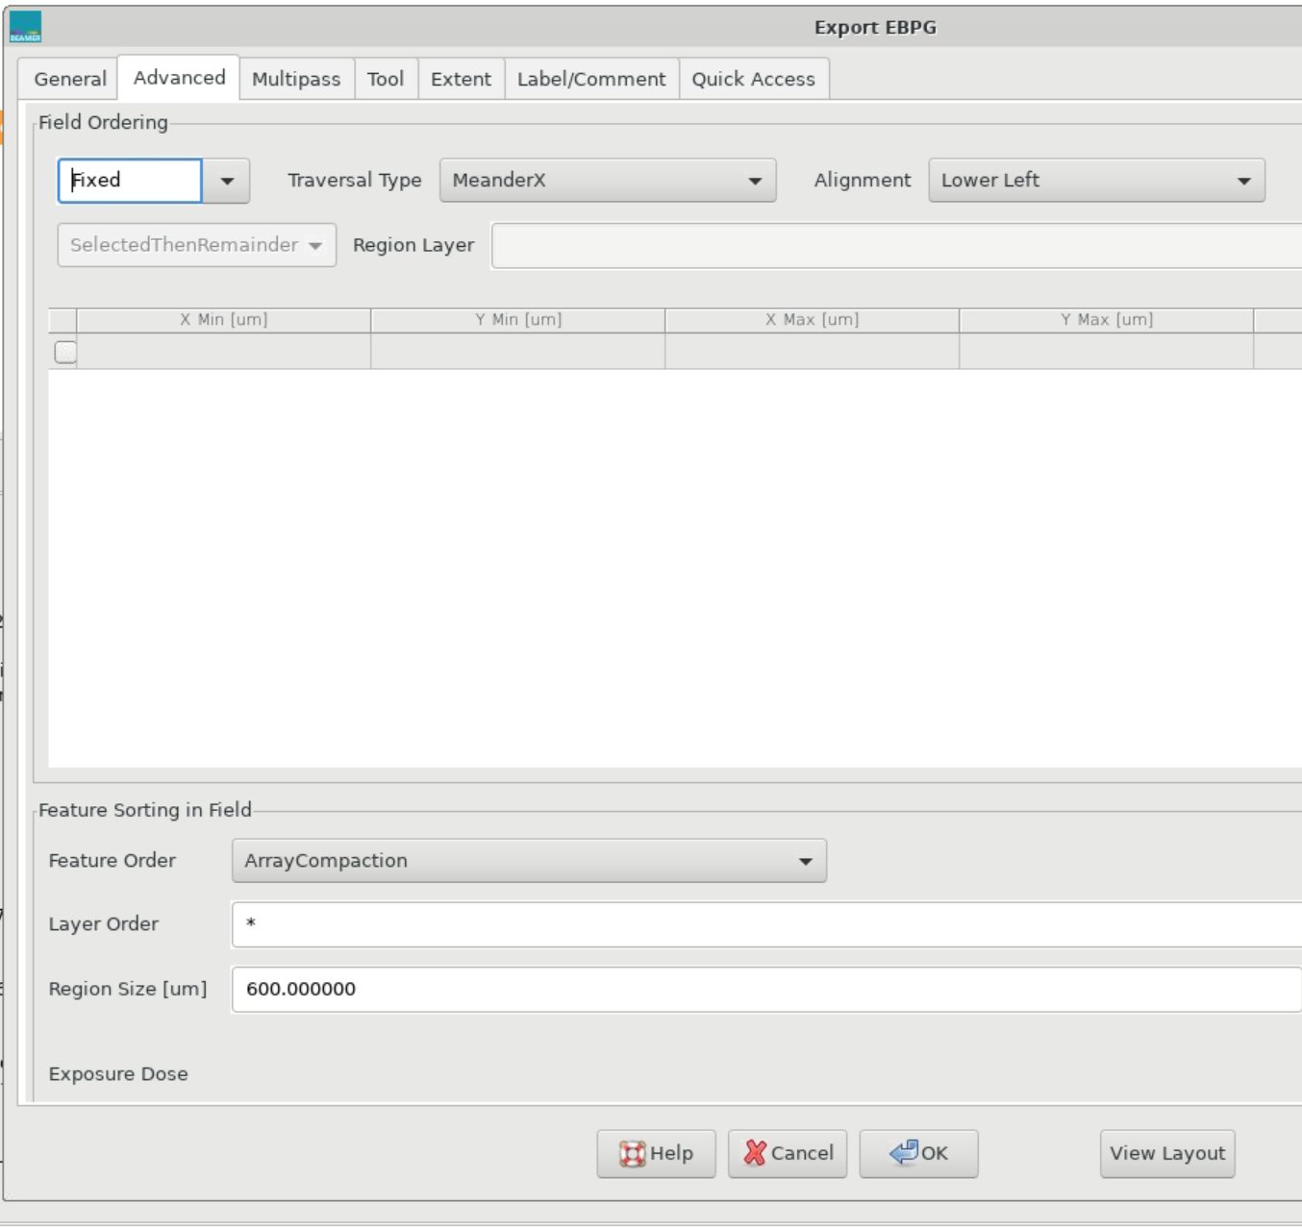
On the “advanced” tab of this menu, just use the defaults.
Fixed fields mean that the blocks will be tiled. That’s what you normally use.
Floating fields are useful for sparse patterns, where each part of the design can fit inside one block. Floating fields are not the right choice for patterns that span many blocks.

Slide 15
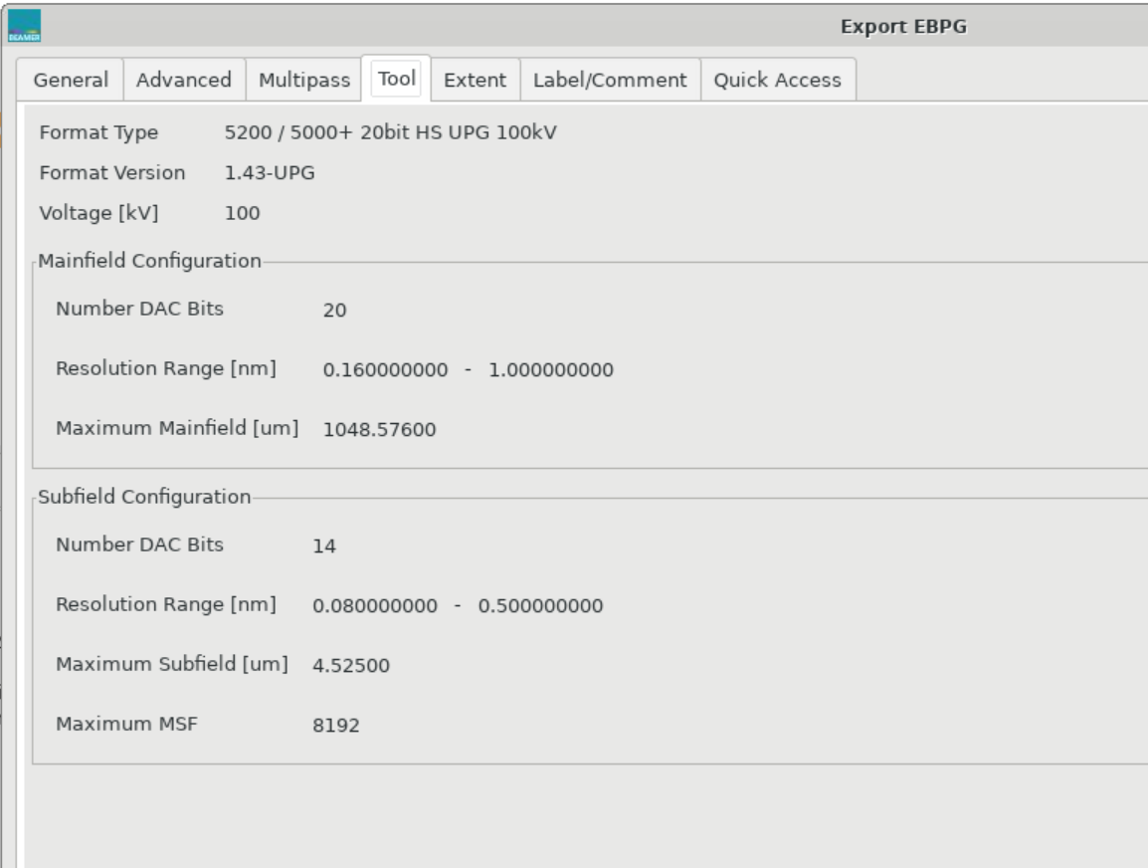
Thank goodness we can’t
change anything on the
“tool” tab.
For now we are also ignoring the “multipass” tab. That’s a more advanced topic, which is covered in a training video.

Slide 16
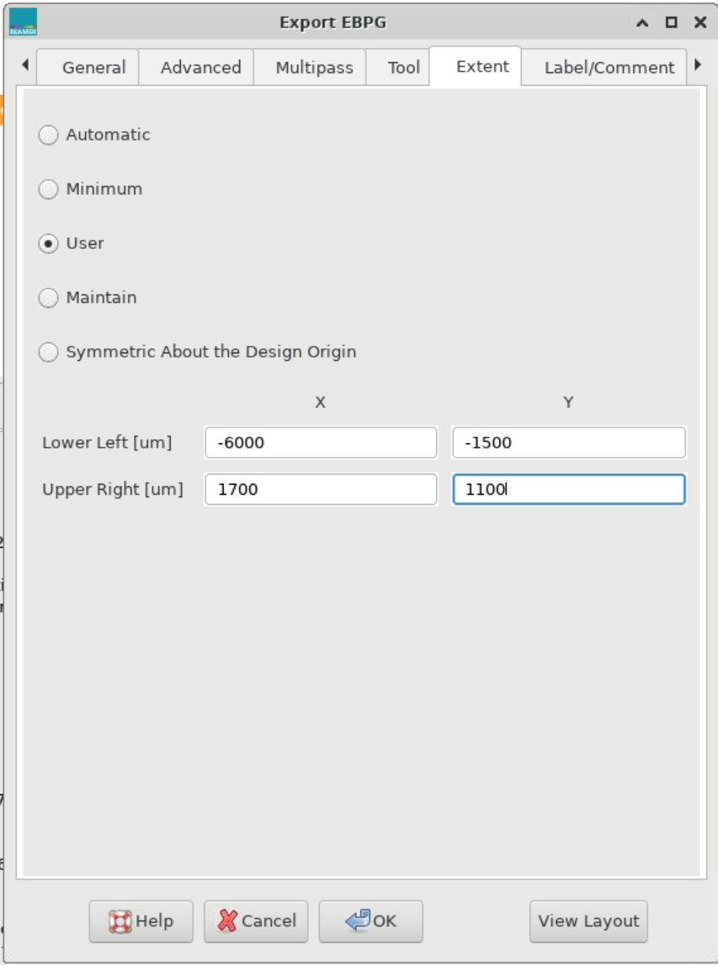
On the “extent” tab you should select “User” and then enter values for lower-left and upper-right.
The pattern will be cut into blocks starting at the lower left.
You should pay attention
to the upper-right corner,
since the average of these
coordinates will be the
“chip center”.
The “chip center” will be the
reference point for placement
and alignment in Raith’s
exposure job software. You really need to know where that center point is, so you really need to enter these numbers yourself.

Slide 17
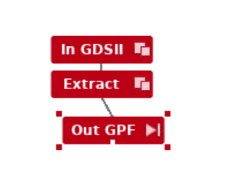
Click on the play button to start the fracturing process.
When that is done, click on the same spot to see
the fractured pattern

Slide 18
Choose the lower-left point and the block size
so that stitching boundaries will avoid critical features.
The sample stage will move at block boundaries,
causing stitching errors of 15-20 nm.
block height
lower-left
block width
Actually, you should think about field stitching while planning the design.
You may have to go back to the CAD program and start over.

Slide 19
Those are the three basic steps you always need:
Import
Extract
Export
But there are all sorts of other things you might need to do.
For example, suppose you need to crop the pattern.
You’ll find that you cannot simply set the lower-left and upper-right
corners in the “export” box. Instead, you’ll need an extra “extract” step.

Slide 20
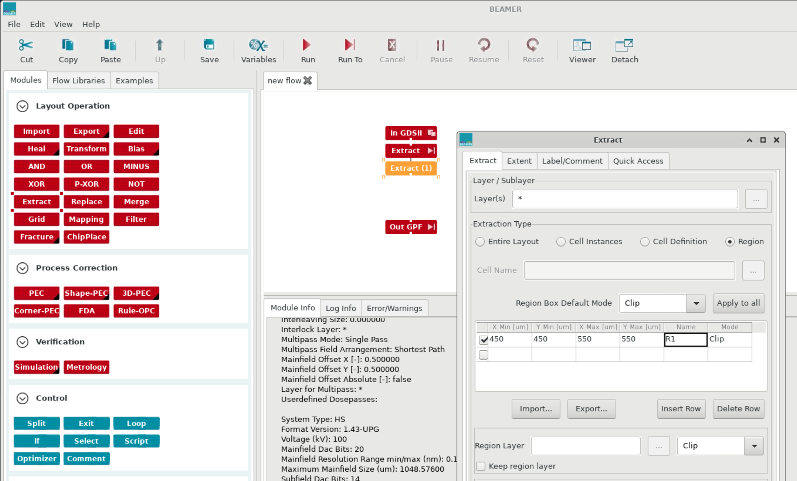
To crop a window out of the pattern, first disconnect the output module. Then drag another “extract” over and connect it to the other “extract.” Then choose “region” and enter the coordinates of the extraction window.

Slide 21
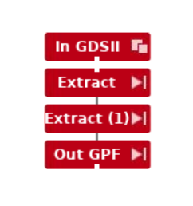
Reconnect the output module, then click on “play” at the bottom
to rerun the steps.
Then click there again to view
the pattern.

Slide 22
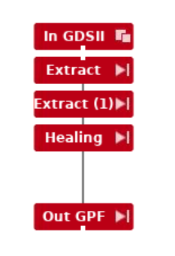
Another important function is
overlap removal, or “healing”.
Actually, healing and overlap
removal are two things, but
in practice you always want to
heal the shapes (merge them)
after removing overlaps.
If you remove overlaps and heal
the pattern, any information about
layers and datatypes will be lost.
So… healing is not allowed, if you
need to assign doses.
How do you assign doses?

Slide 23
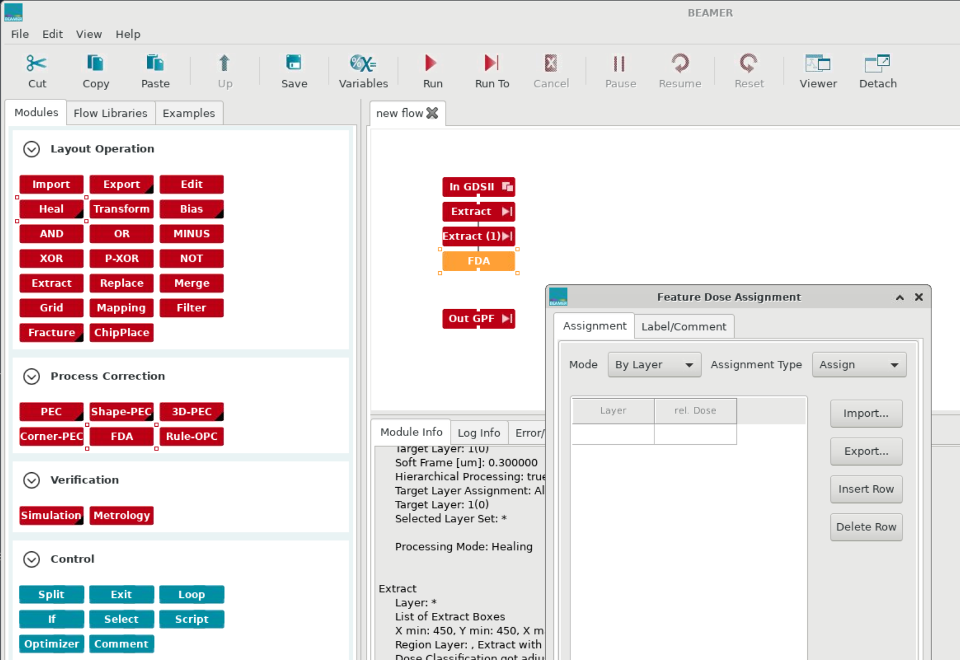
Delete the “healing” step, then
drag “FDA” over. This stands
for “feature dose assignment”.
Use the Feature Dose Assignment menu to map datatypes or layers onto relative dose values.

Slide 24
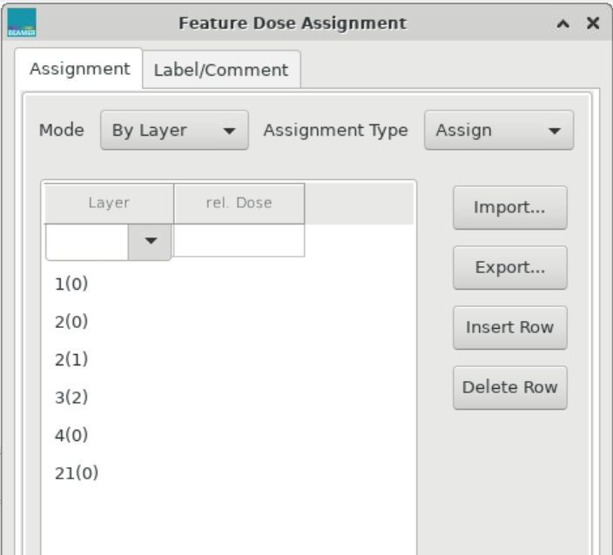
When you pull down the list box
under “layer”, you should see
a list of all the layers and datatypes
in your pattern.
They are listed as
layer (datatype)
In this pattern, layer 0 includes shapes
with datatypes 0, 1, 2.
The EBPG accepts only RELATIVE dose
values. (Some other e-beam writers let you set absolute dose values.)
The “assignment type” choice seems
to be irrelevant for the EBPG.

Slide 25
Checking the GPF file with Cview

Slide 26
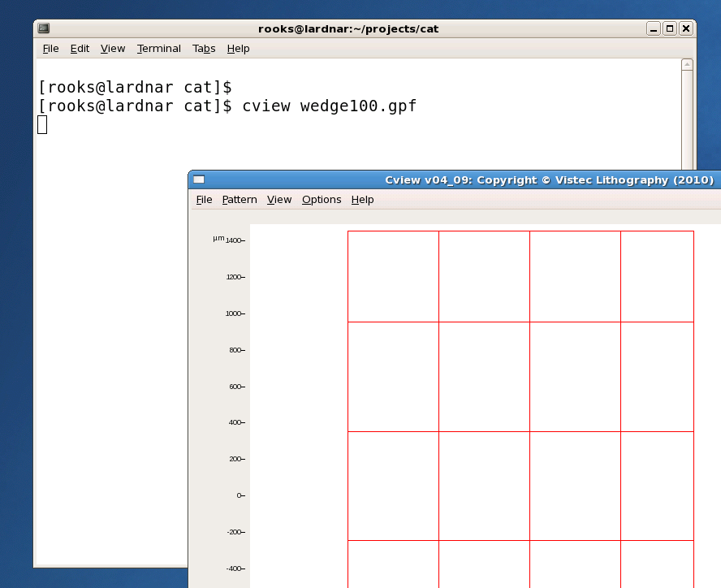

Slide 27
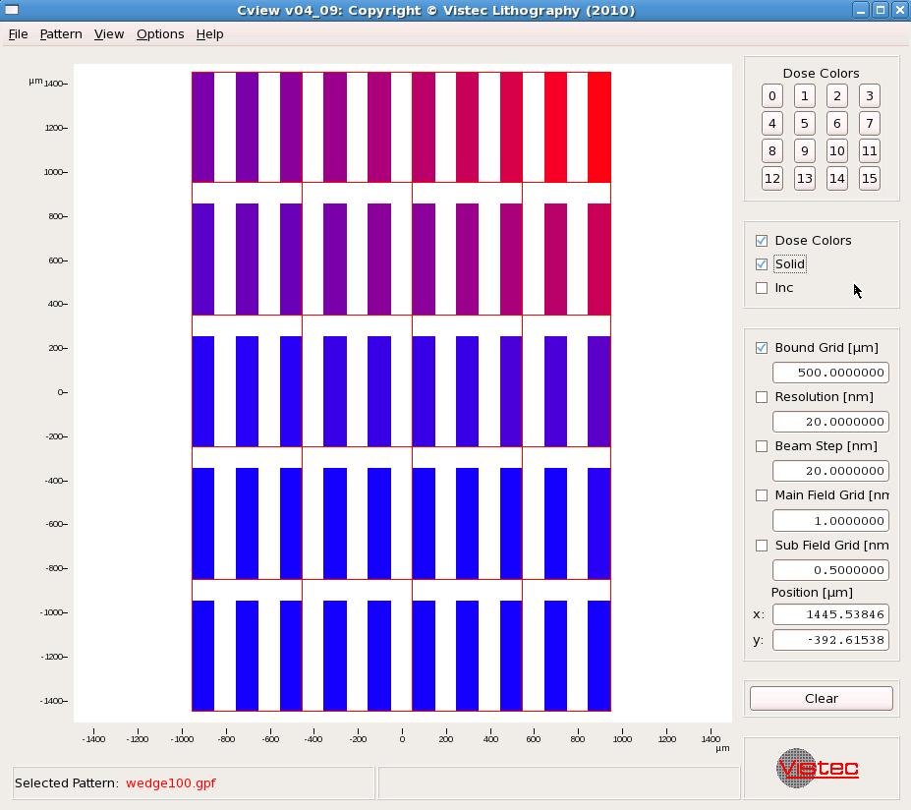
draw
button
Same zooming action: UL to LR zooms in, LR to UL zooms out

Slide 28
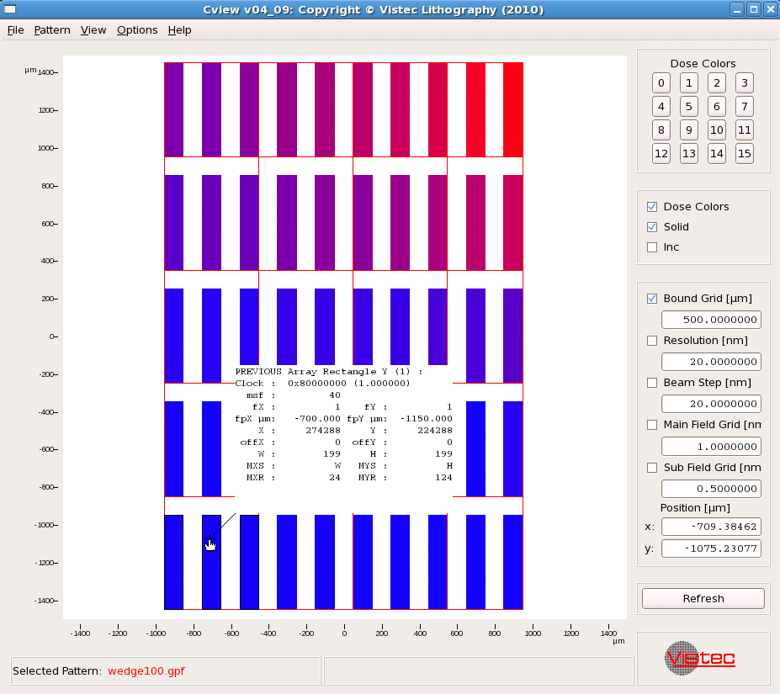
Hover over a
shape and press
the Ctrl key to
reveal details
of a shape.

Slide 29
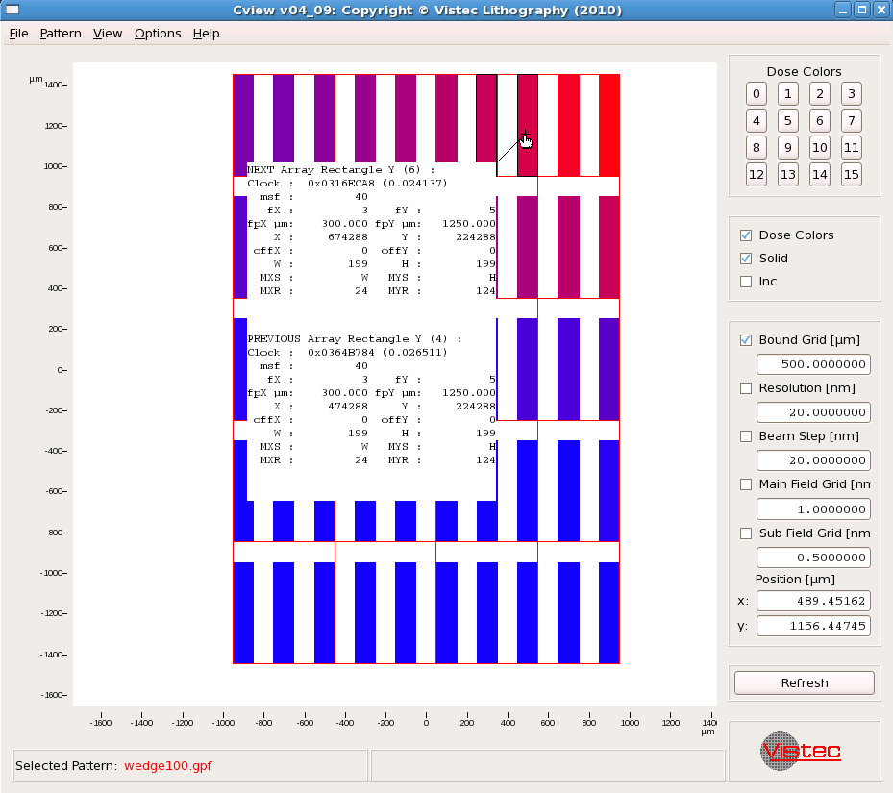
If you get a
double report,
that means
there are
overlapping
shapes.
In this example,
the overlap was
intentional. In
your pattern,
maybe not.

Slide 30
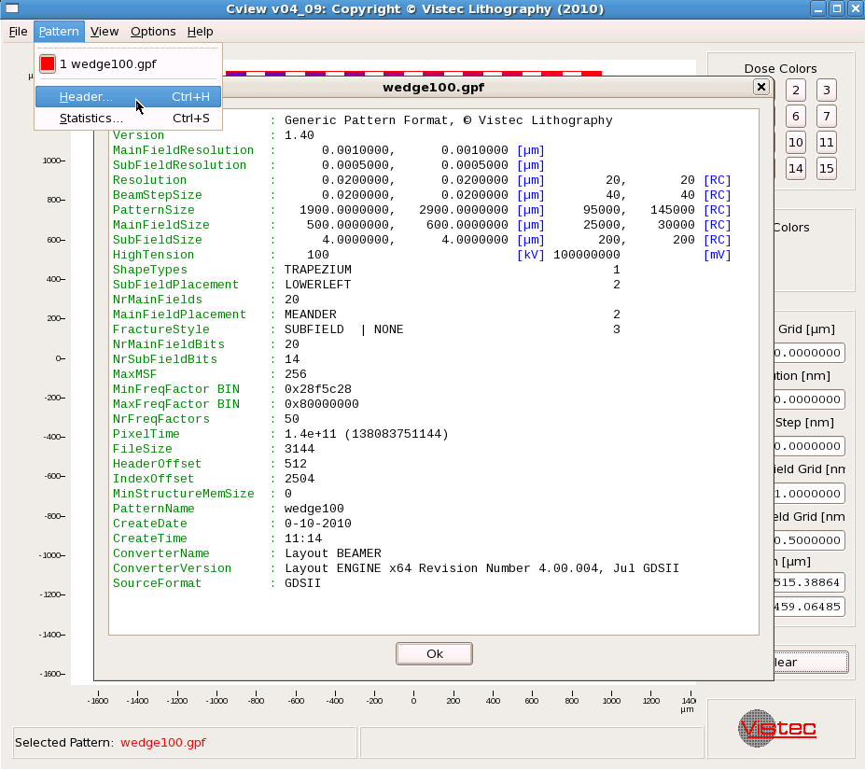
Use
pattern → header
to reveal all
the gory details.

