Slide 1
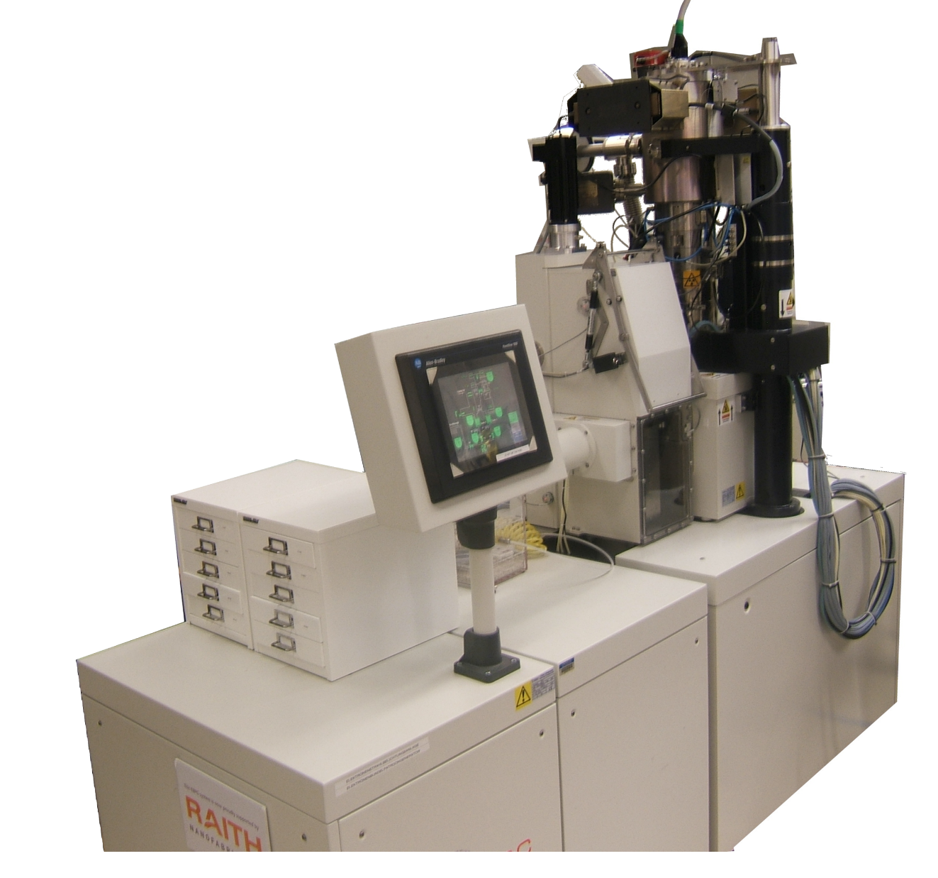
Electron-beam lithography with the Raith EBPG
Setting up exposures with cjob
M. Rooks, Yale University

Slide 2
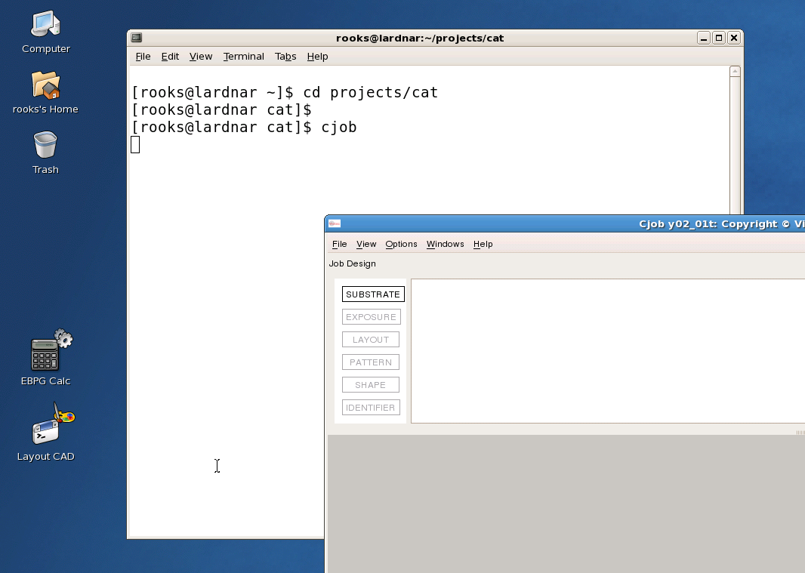
You have to “cd” to the directory containing your patterns.
Pattern and job files must be in the same directory.
… because we do not want any directory names
or relative directory paths to confuse the EBPG.

Slide 3
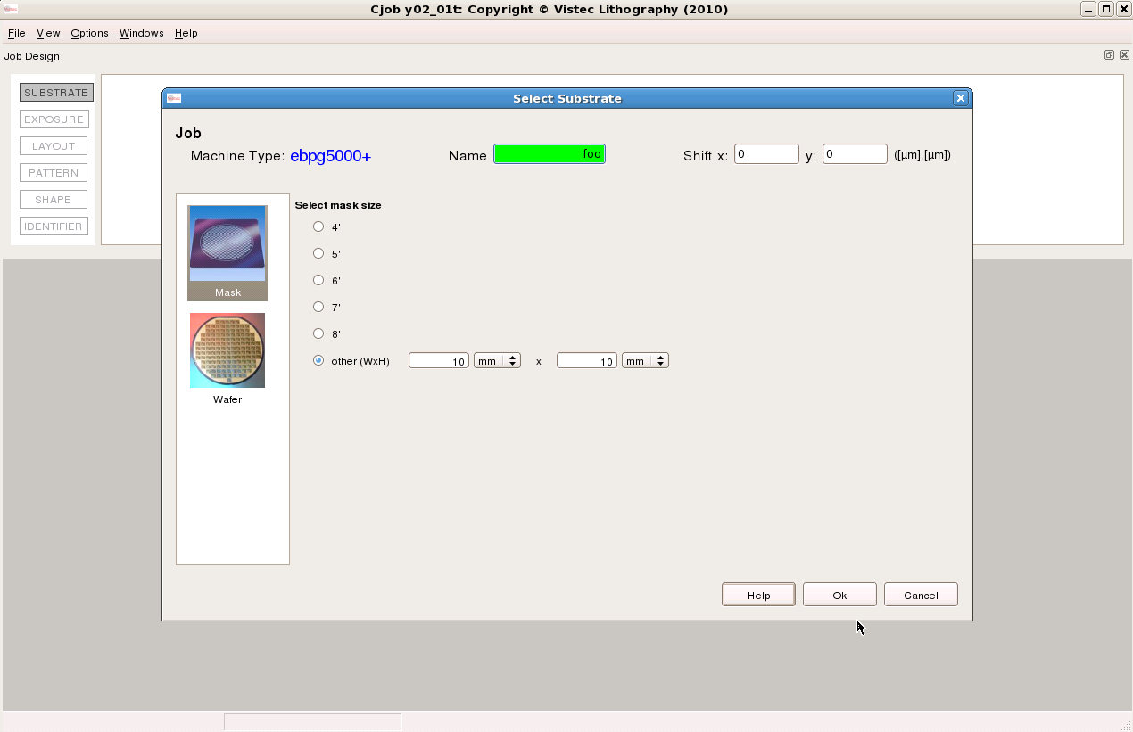
Drag “substrate to the right, then fill out the dialog box with substrate size and job name.

Slide 4
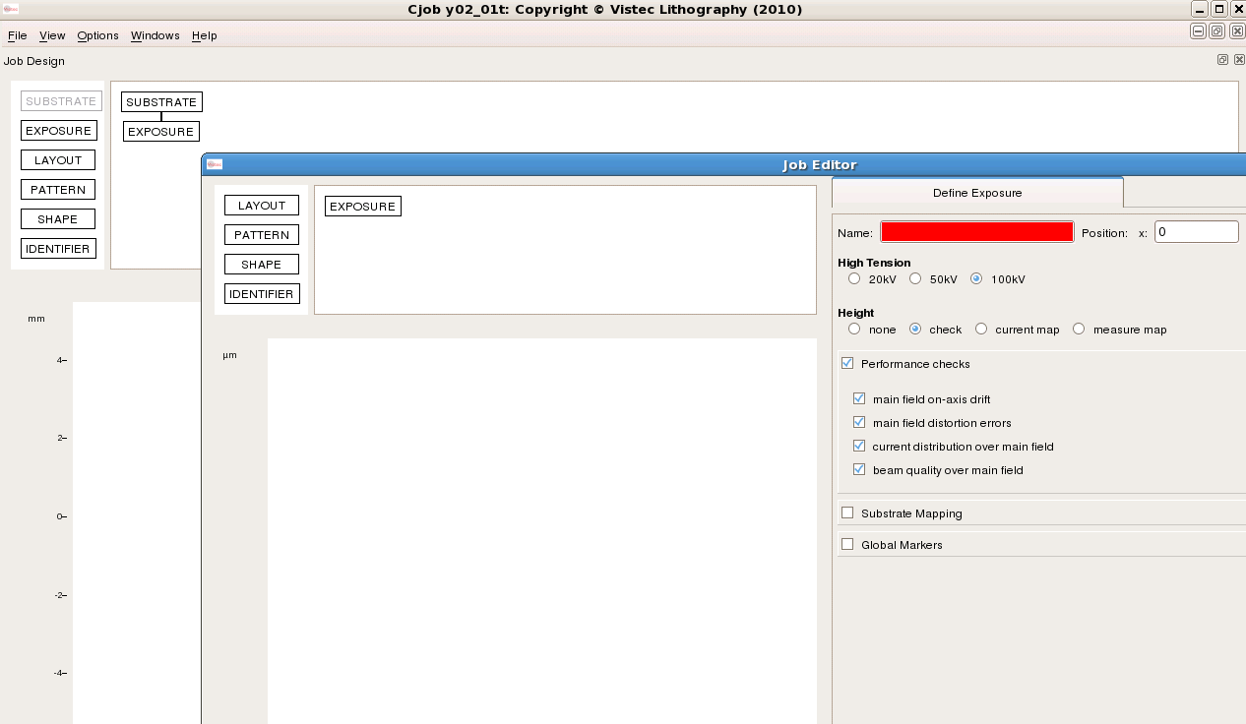
Drag “exposure” onto the “substrate” module. Supply a name.
Turn off the perfomance checks.

Slide 5
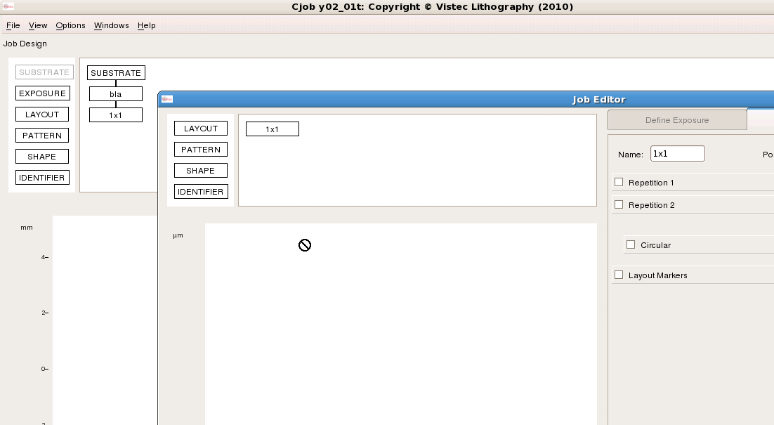
Watch out for these names!
They will end up in the job script.
If you use spaces or punctuation
marks then the job script will
fail in bizarre ways.
Drag “layout” onto the exposure box.
We are just moving down the list…
substrate… exposure… layout… pattern…

Slide 6
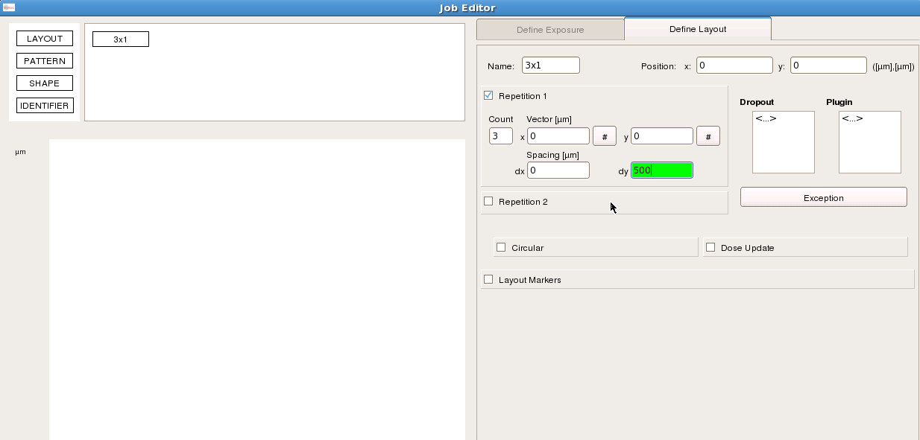
Fill out the number of repetitions and the spacing.
Or, move on to the “pattern” and leave this until later.
The “vectors” are always zero.

Slide 7
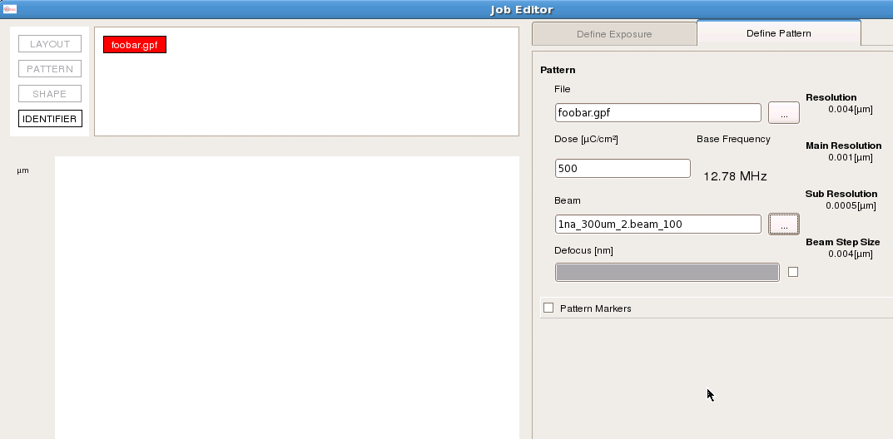
Drag a pattern onto the layout box, then select the pattern file, dose and beam (that is, current).
Notice that the program calculates the clock speed, which must be less than 50 MHz.
You don’t always get the current you expect, so it’s not wise to operate close to 50 MHz.

Slide 8
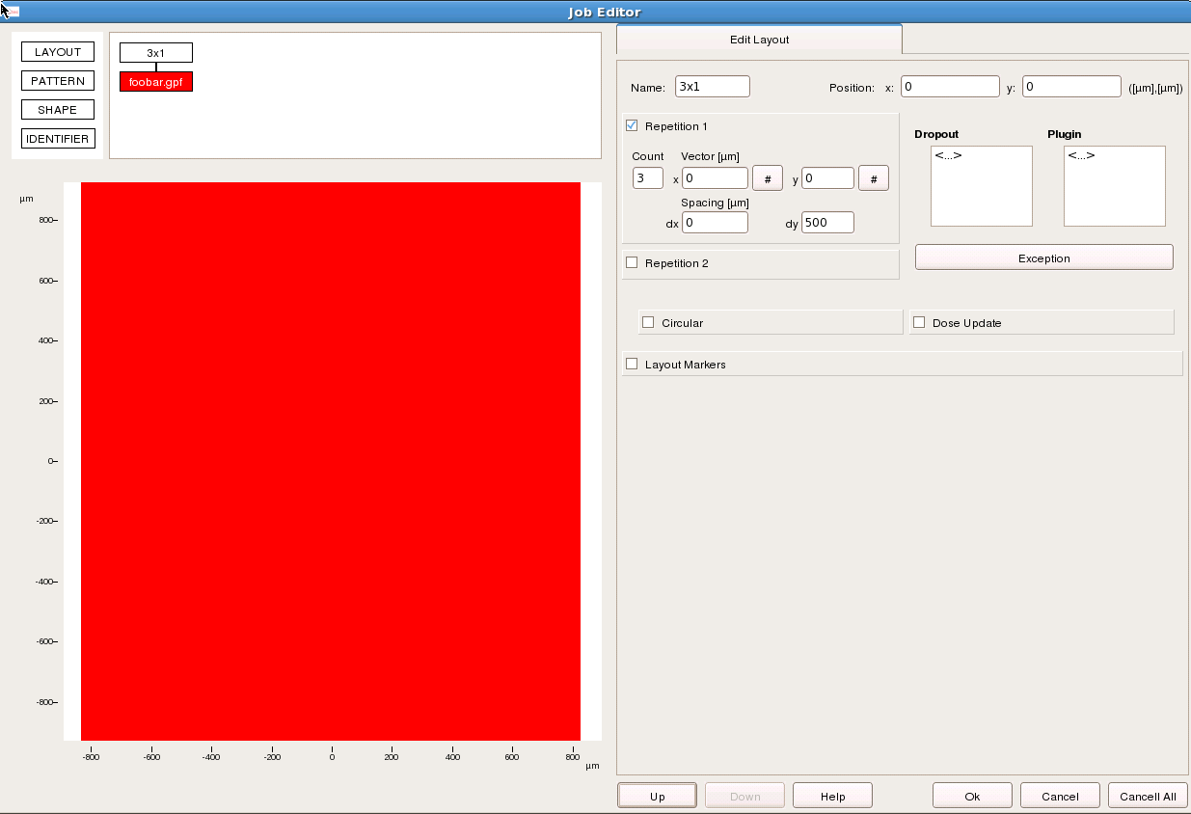
Let’s go back to the layout box “3x1” so that we can specify a dose update.

Slide 9
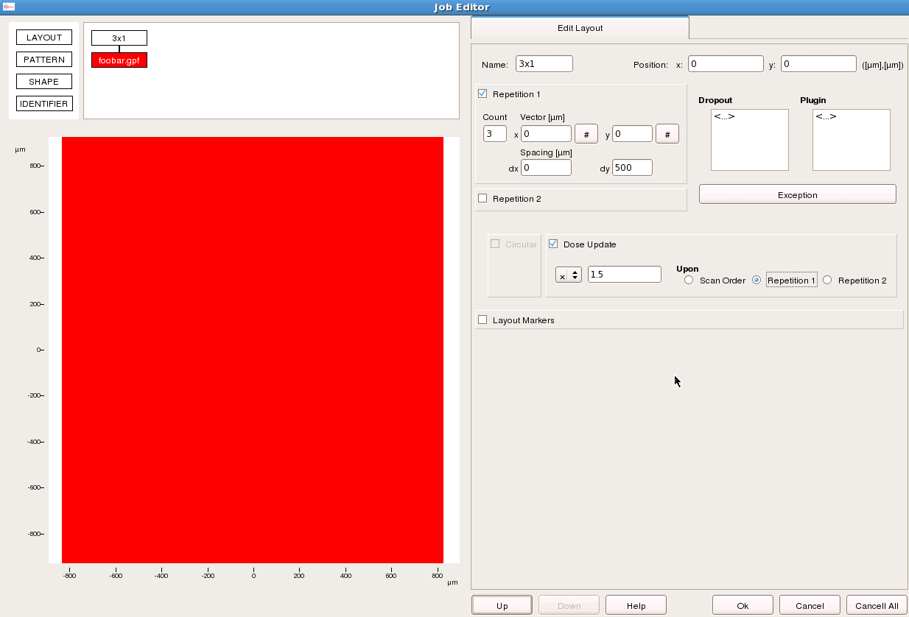

Slide 10
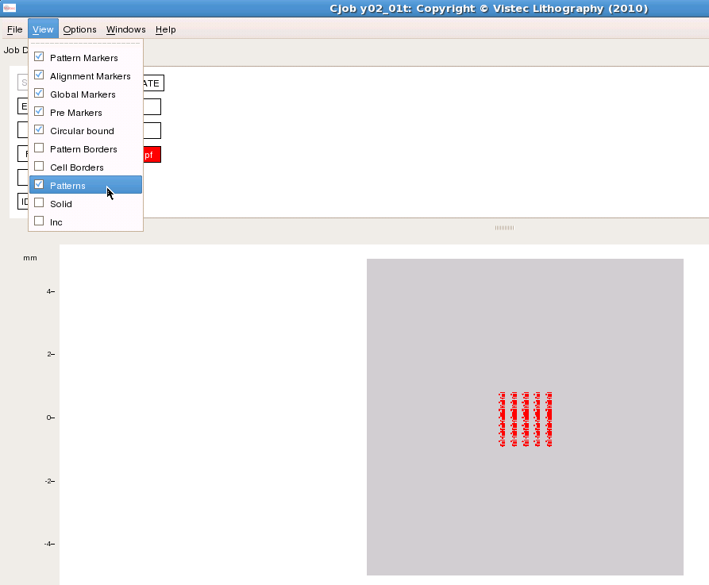
Go back to the main window to check the layout.
View → Patterns
Looks like the pitch is not right.
Go to the layout box to fix it.

Slide 11
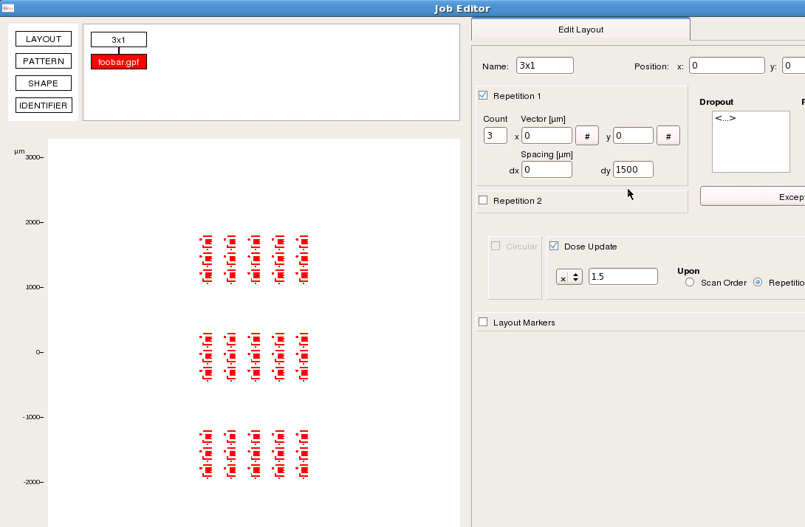
Change dy to 1500 μm so that the exposures do not overlap.
Note that zoom in/out uses the same convention as Cview and Beamer.

Slide 12
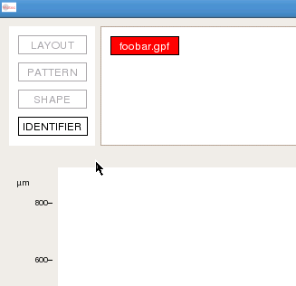
Let’s label each exposure
with the dose.
Go to the pattern box,
and drag an “identifier” onto
the pattern.

Slide 13
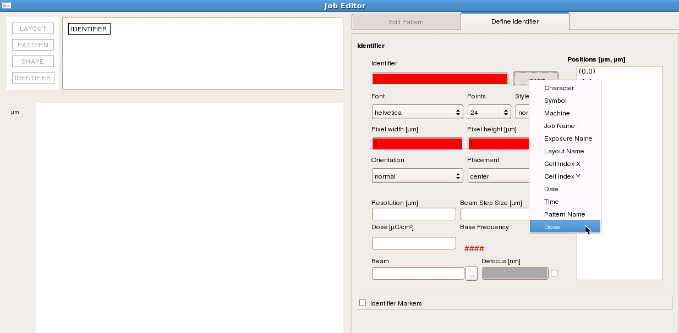
Insert the “dose”, and erase the useless “μC/cm²” bit.
Choose a font size, pixel size, resolution = beam step, dose and beam (current).
Note that the current can be very large.

Slide 14
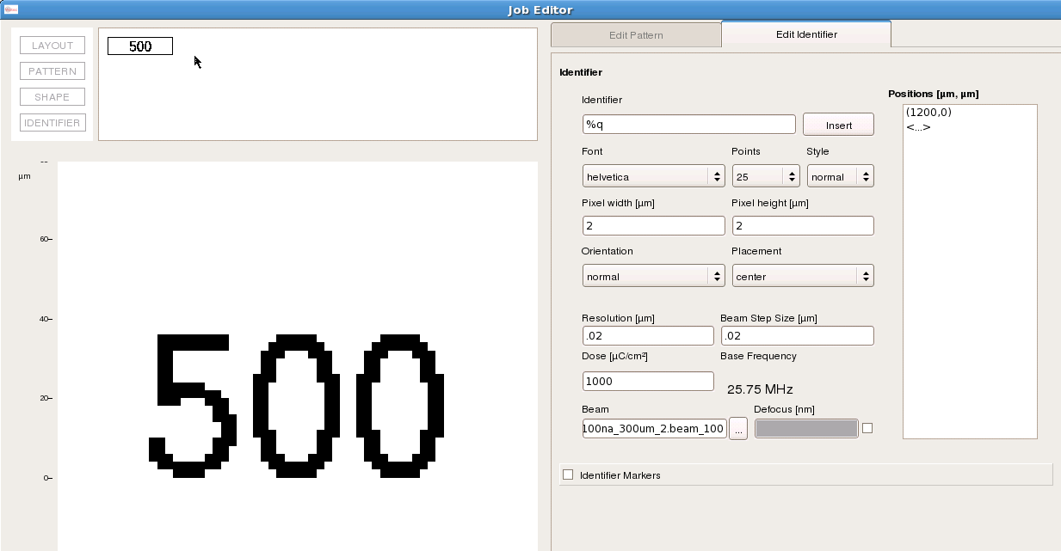
If the parameters result in a clock > 50 MHz, then the fields will be highlighted in red.
Set the position relative to the pattern’s center. Check it out on the main window,
and change the position vector if the label does not look good.

Slide 15
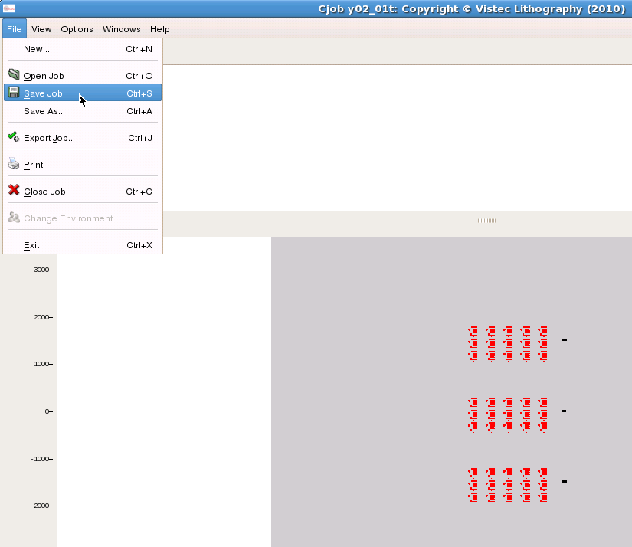
Back in the main
window, save the
job (as a .cjob file)
and then export
the job (as a .job file).
The .job file is the one
that will be used
for the exposure.

Slide 16
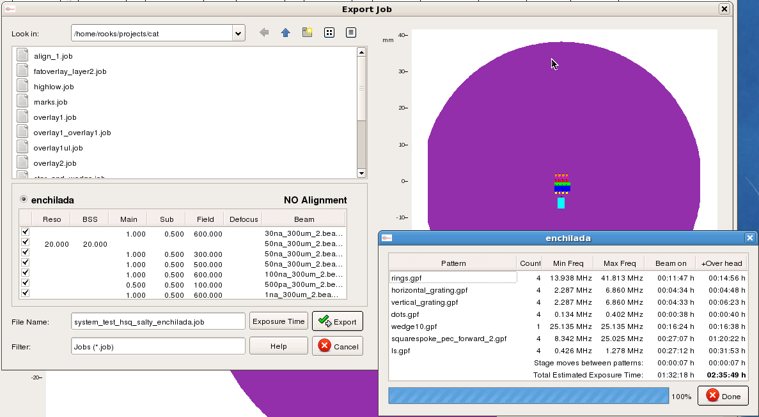
Calculate the expected exposure time from the “Export Job” box.
This estimate includes stage move time and shape settling overhead.

Slide 17
Over on the EBPG, the exposure will be started with the command
whatever.job 1 0 70mm,77mm
where “1” is the wafer chuck number, “0” is the loader slot number,
and the given coordinate is the center point of the exposure job.
Actually, we will use a little bash script to start the exposure,
so you will not have to type in this line.

Slide 18
Alignment jobs

Slide 19
Alignment example
The pattern is repeated over a wafer.
Alignment marks are first designed on
layer 1 and then printed
and etched (or liftoff)
Each pattern or “chip” has four marks.
Three of these chip marks will be
used for initial “global” alignment
EBPG will first do a global alignment
and then local “chip” alignment
But when setting it up with Cjob,
it’s easier to work on the chips first.
30mm
25mm
15mm
24mm
14mm

Slide 20
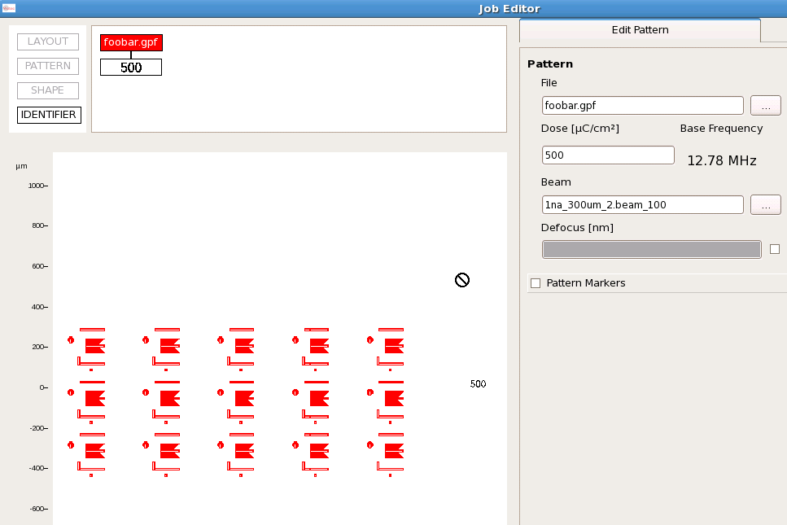
Start at the bottom: click on the pattern box, where we will set up pattern markers.

Slide 21
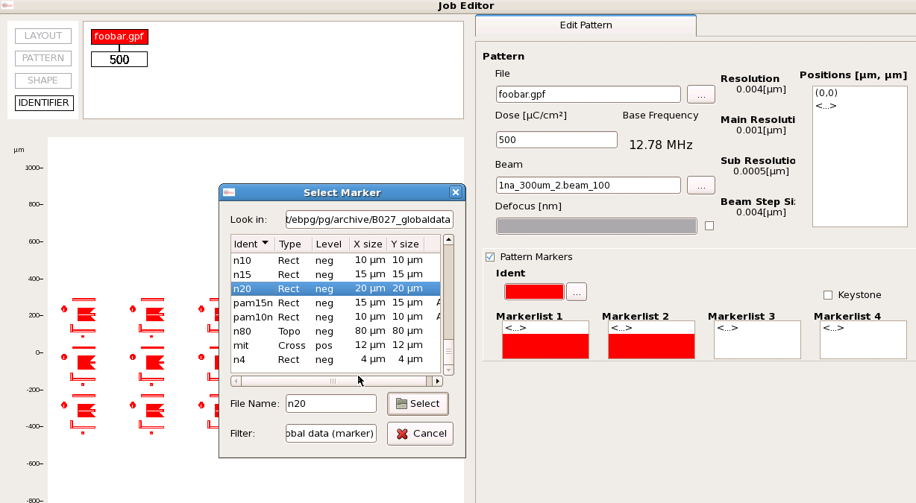
Choose an “ident” – that is, the name of the alignment mark.
This marker type has been defined previously on the EBPG.
If you do not see an appropriate mark definition, you can pick any mark and fix it later.
There is a simple command on the EBPG for defining new marks. Cjob will see the
new mark after it is saved on the EBPG.

Slide 22
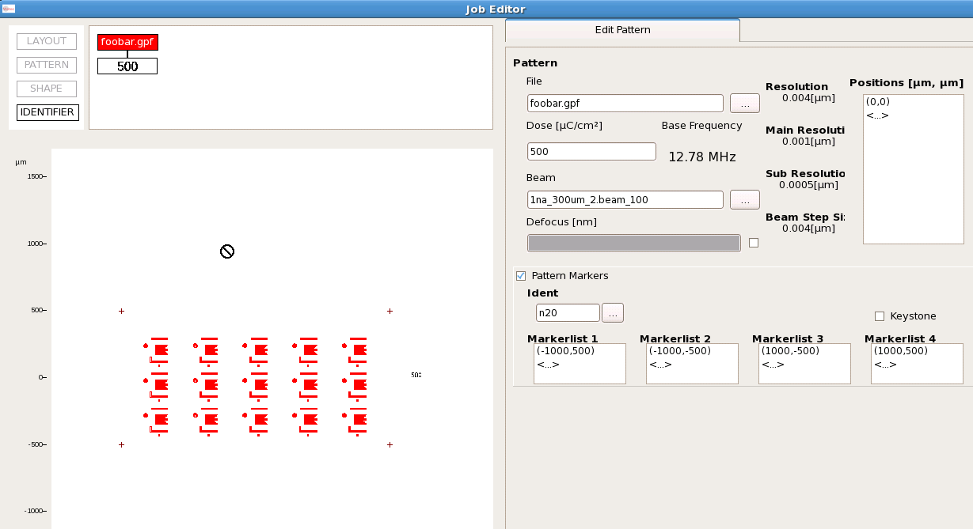
Type in the mark coordinates relative to the pattern’s center. Go back to CAD to
figure out the coordinates. Good thing you chose sensible, easy values!
Tip: If you include the mark layer along with your pattern layer (in Beamer) then
it will be easy to check the alignment mark vectors. Later, go back and delete the mark layer.

Slide 23
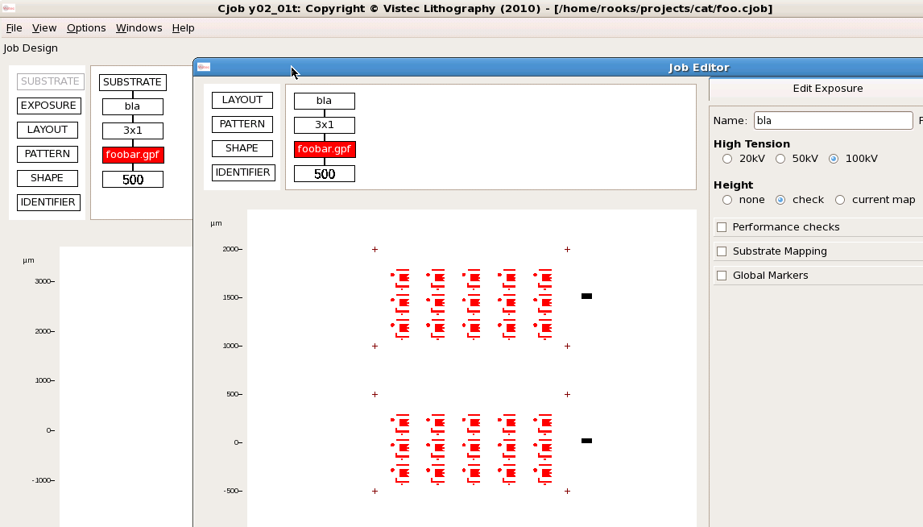
Global alignment: go back to the exposure box (“bla”) and click on “global markers”.
Do not define alignment markers in the layout box (“3x1”).

Slide 24
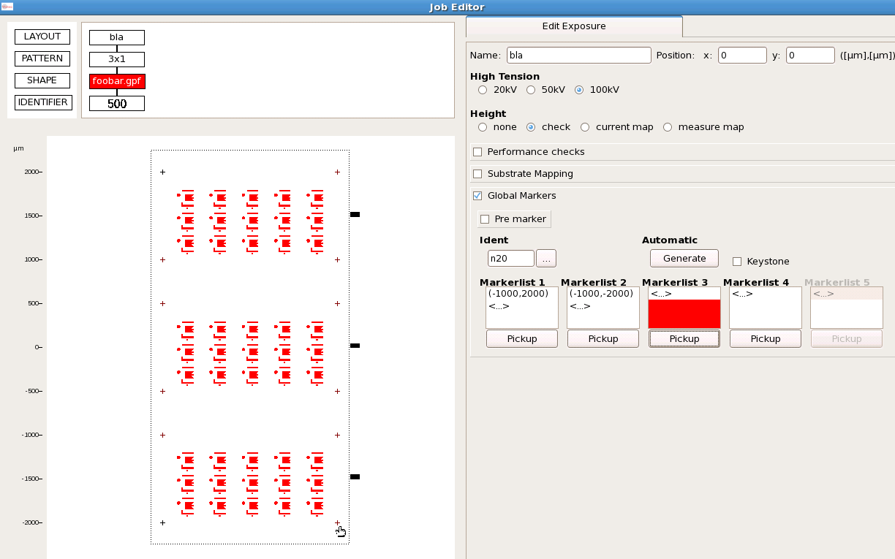
The simplest scheme is to use three
of the chip marks for global alignment.
Global alignment happens first, of course,
but it’s easier to set it up after the
chip marks.
You can type in the vectors to the global marks, or you can “pick them up”
by clicking on the appropriate chip mark. Actually, you have to click on “Pickup”
and then choose the mark with <ctrl> click.

Slide 25
Save and Export
the job, as before.
Note the order
in which the global marks
were specified.
You will need to find
those marks in the
same order once you
are sitting at the EBPG
console.

Slide 26
Over on the EBPG, the exposure will be started with the command
whatever.job 1 0 $upper_left $lower_left $lower_right
where “1” is the wafer chuck number, “0” is the loader slot number,
and the rest are symbols containing the stage coordinates of the
global alignment marks. You’ll find the marks first, and save their coordinates
in these variables.
Actually, we will use a little bash script to start the exposure,
so you will not have to type in this line.

Slide 27
Things you cannot do with Cjob
Trap alignment errors
Cjob dies upon encountering bad marks
Changing anything other than the dose
Focus, for example
Reacting intelligently to problems
Such as losing the mark after switching current
or asking for user intervention

