Slide 1
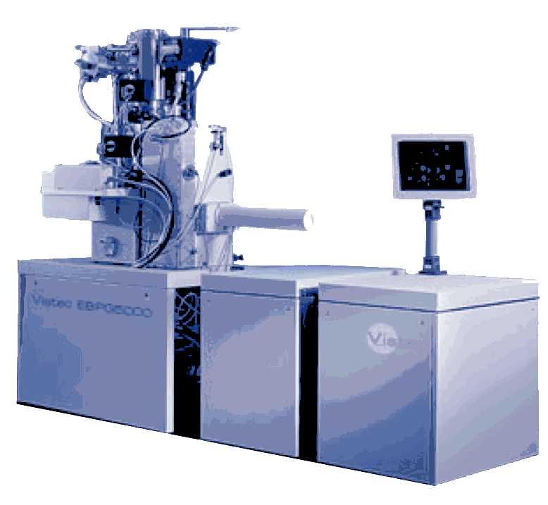
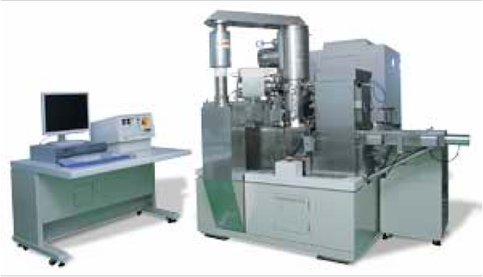
Analysis of electron-beam deflection noise with open-source software
Michael Rooks Yale Institute for Nanoscience and Quantum Engineering Richard Tiberio Geballe Laboratory for Advanced Materials, Stanford University
We are not comparing
vendors or machines
in this presentation.
We used a variety of tools
to test the programs, but
we did not make any
systematic comparisons.
For some of the exposures
we purposely added noise
to test the algorithm.

Slide 2
Problem: Measure quantitatively the
deflection noise of an electron beam
writer to diagnose noise problems, or
to compare performance.
Line edge roughness (LER) is not an
ideal way to measure deflection noise,
since LER is a convolution of resist
performance and exposure tool deflection
noise.
Dots-on-the-fly, that is, exposing a solid
rectangle with a large pixel step, is an
easy way to visualize deflection noise,
but quantifying the noise with commercial
software is expensive.
Solution: Combine dots-on-the-fly with
open-source software
Printing dots-on-the-fly:
As designed
As written, underexposed
with pixel step = 80 nm
As written, underexposed
with pixel step = 80 nm

Slide 3
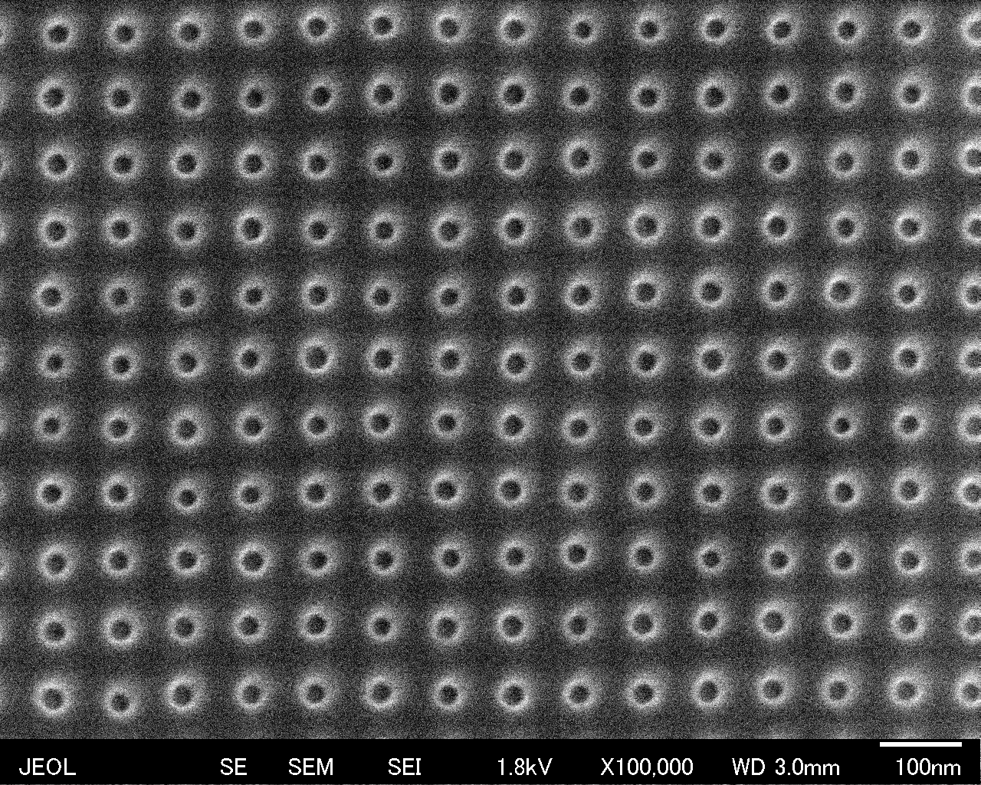
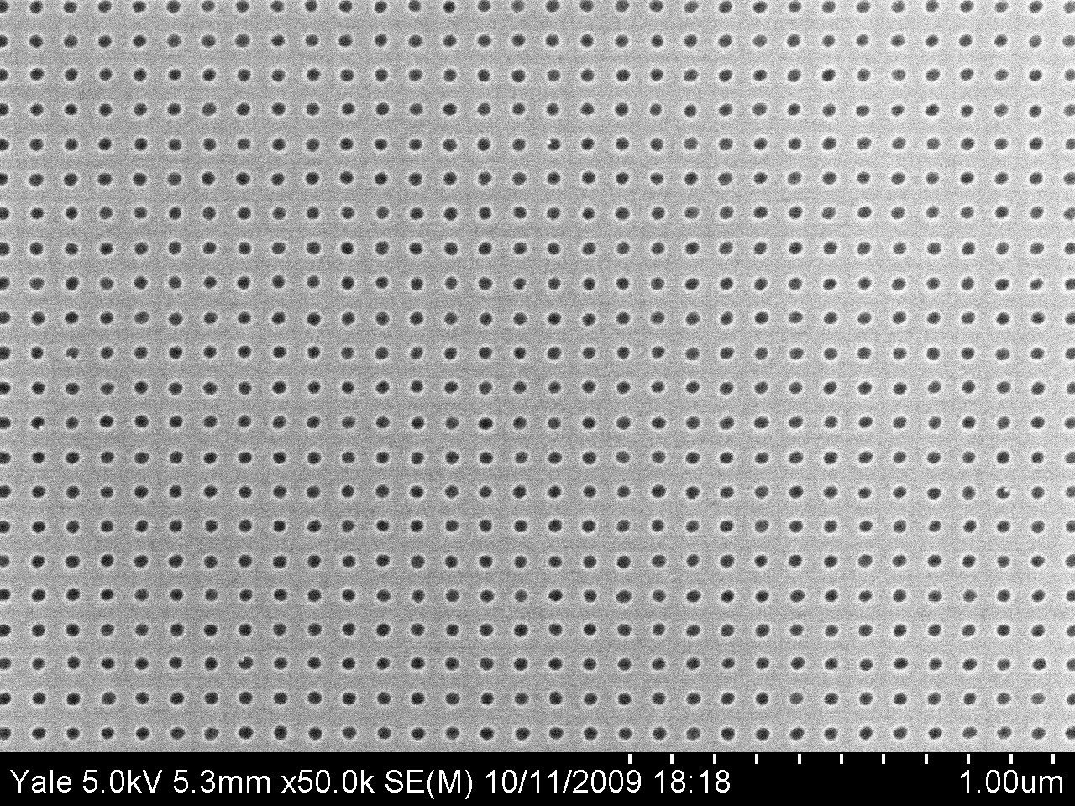
Which type of image is the best for noise analysis?
Resist Metal Etched holes
PMMA or ZEP Cr, 10 nm SiO₂ 15 nm
CHF₃ 40 sccm
O₂ 5 sccm
30 mTorr
100 W
3 min
Process as doughnuts or blobs Metal liftoff adds Etched holes
Too few pixels, too much noise noise are best

Slide 4
Image preparation
Manual image processing with an image editor such as Gimp or Photoshop:
Original image
Cropped &
rotated
Threshold
filter
Manually erase
dark regions
from background

Slide 5
The program searches
for dark regions. To
avoid false hits, one
may paint white
regions between the dark dots. The user
sets the minimum
number of pixels in
a dot, and this is
called the
noise threshold
Regions with fewer
contiguous dark pixels
will be discarded as
noise. Counting the
number of dots is
helpful when deter-
mining the optimal
noise threshold.
False hit

Slide 6
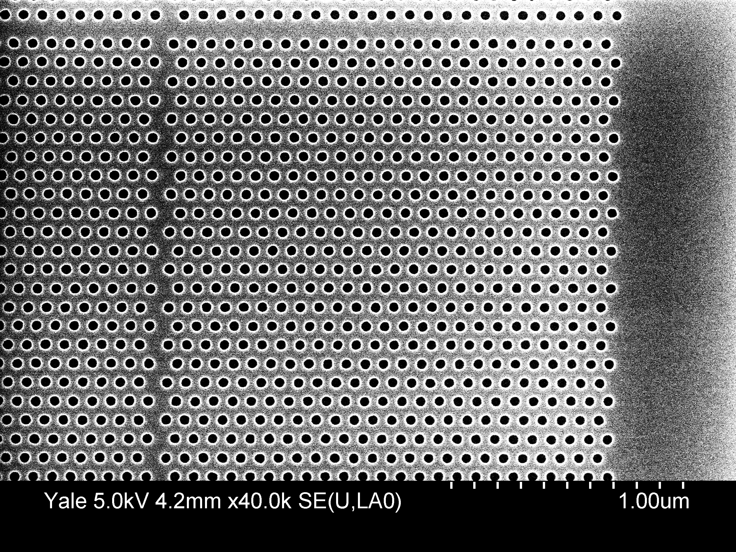
Hexagonal arrays of dots can be analyzed by using
the option “--hex” of the program “dotnoise”.

Slide 7
Program execution
Input image file
Find dark blobs and
calculate centers of mass
Fit horizontal
grating
Horizontal and vertical gratings are
fit independently, and my be
non-orthogonal. This avoids
problems with SEM drift during
imaging.
The known pitch of the dots is used
to calibrate the length scale.
Fit vertical grating

Slide 8
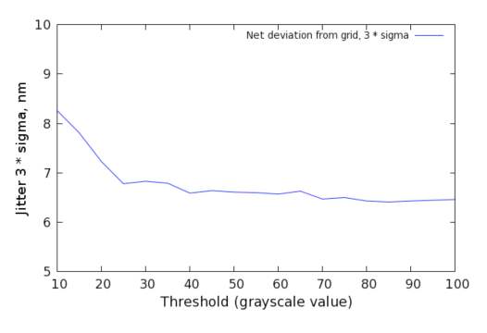
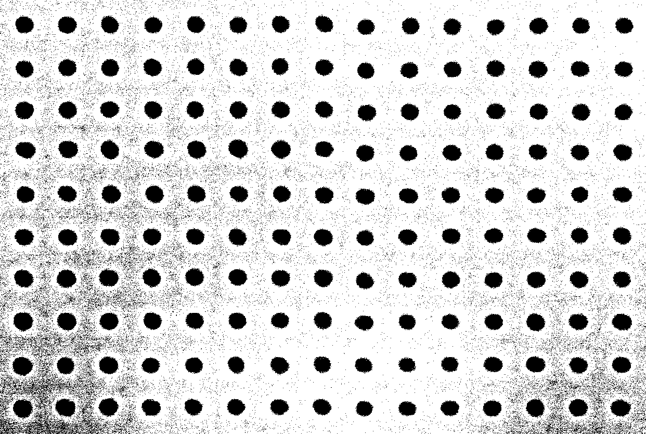
Sensitivity to data preparation
Effect of the choice of
threshold on the calcu-
lation of dot jitter.
Threshold values over
a broad range result in
< 10% change in jitter

Slide 9
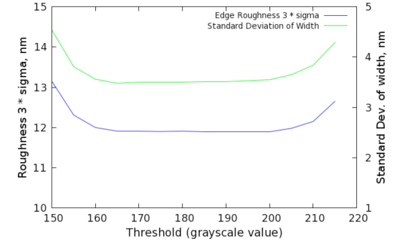
Sensitivity to data preparation
Effect of the choice of
threshold on the calcu-
lation of line edge roughness
and line width.
Threshold values over
a broad range result in
< 10% change in LER
and width.

Slide 10
Purposely add a 20 kHz perturbation
using a coil around the column:
Before After
3σ deviation from grid = 2.8 nm 3σ deviation from grid = 11.3 nm
This patch of dots was written inside a single subfield, so we know that they were
written consecutively. This is important if we want to calculate the noise spectrum.
Unfortunately, it is difficult to tell the order in which the dots were written.

Slide 11
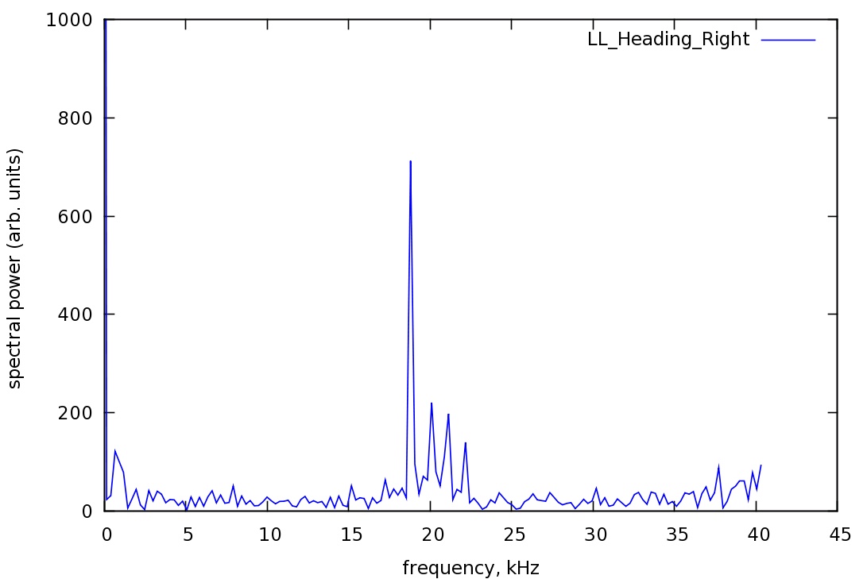
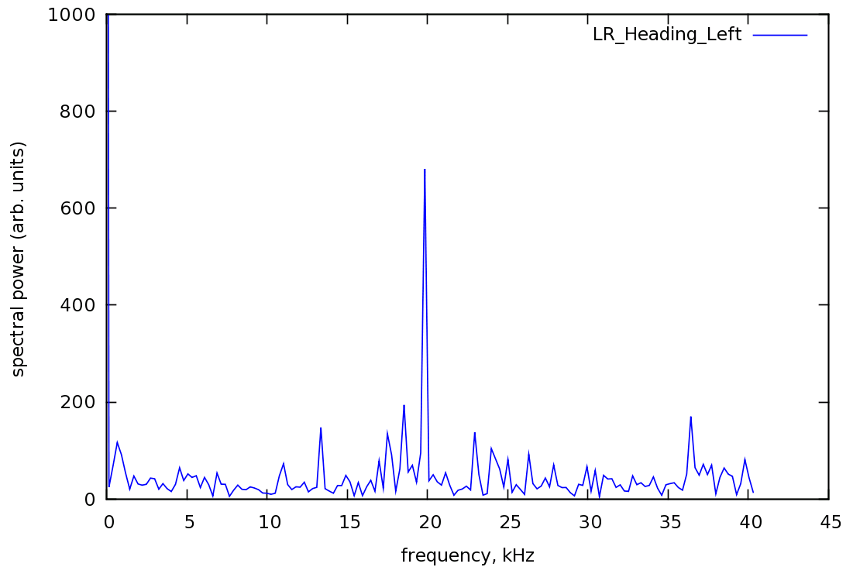
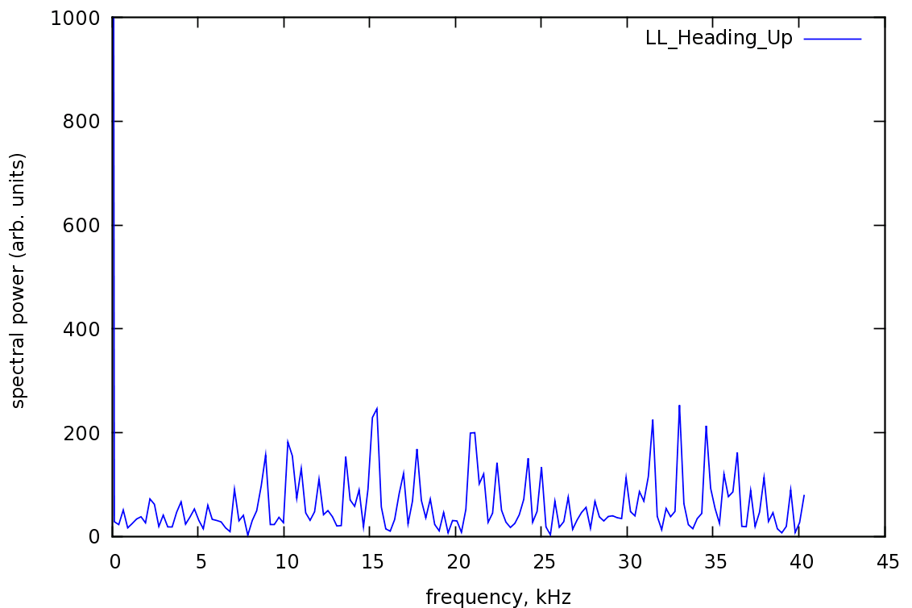
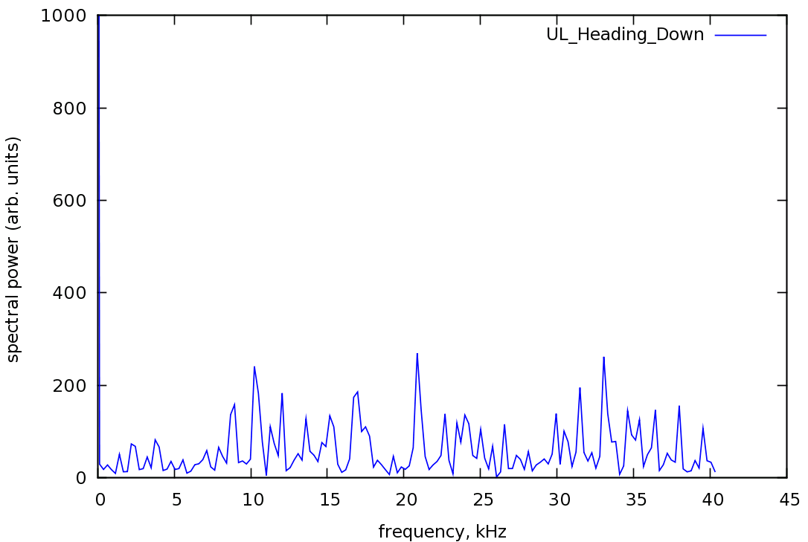
Why not calculate the noise spectrum?
We must first arrange the dots according to the order in which they were written.
There are four possible writing orders, since time-reversed paths are equivalent.

Slide 12
Why not calculate the noise spectrum?
The vertical paths are clearly incorrect, but either horizontal path could be right.
We would need an additional test frequency to sort it out. Spectra extracted from
images such as these are highly dubious, since pattern generators will typically
change the raster to match the longest side of the rectangle, and since the sample
can be rotated arbitrarily in the SEM. Because of these problems, spectral analysis
is not included in the current version.

Slide 13
Added bonus: line edge roughness program
3σ roughness = 12 nm
A very similar algorithm
can be used to find dark
lines on a bright background.
Straight lines are fit to
the edges, and the roughness
is calculated.
In addition to the usual
threshold function, the user
must be sure to cut the
line ends horizontally, so that
rounded ends do not contribute
to the roughness value.

Slide 14
What is this for? Who needs it?
When testing a new e-beam writer, this dot analysis technique provides a simple
and unambiguous way of specifying and measuring the deflection noise. When
diagnosing problems, it eliminates the convolutions of line-edge roughness. This
program can be used to quantify the accuracy of a patterning instrument or the
coherence of self-assembly.

