Slide 1
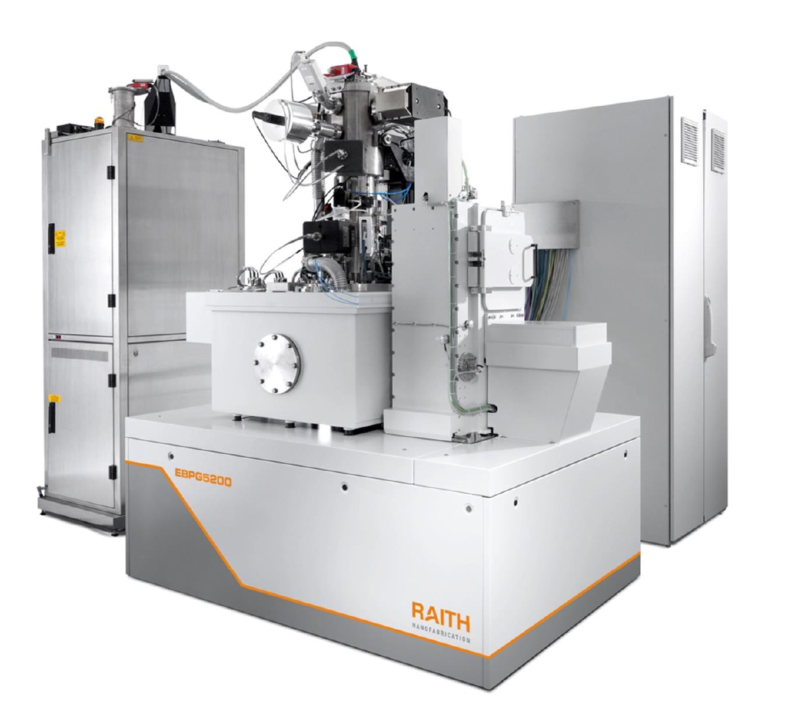
Electron-beam lithography with the Raith EBPG
Part 2: Choosing parameters
M. Rooks, Yale University

Slide 2
Choosing e-beam exposure parameters
Step 1: choose the resist and choose the resist thickness
Typical choices:
Metal liftoff | PMMA or PMMA on top of P(MMA-MAA)
Holes in SiO₂ | ZEP, CSAR, or PMMA
Plating Au | PMMA
Etching Nb | 20 nm HSQ on hard-baked photoresist
Etching Si with Cl | 500 nm HSQ

Slide 3
Choosing e-beam exposure parameters
Step 2: Choose a spot size < minimum feature size
EBPG theoretical on-axis spot size at 100 kV
For example, if you want 20nm wide lines you should use a spot size no larger than about 5nm. According to this plot, you could choose the 200um aperture at 3 nA, or you could choose the 300um aperture at 1nA. Of course you should pick the larger current, to run faster.
100
400 μm aperture
Spot Size, nm
10
300 μm
200 μm
1
0.1
1
10
100
Current, nA

Slide 4
Choosing e-beam exposure parameters
Step 3: Select a range of doses for testing*
Your first run should always be a dose test. Choose a range of doses that goes from too low to too high. Then expose your pattern (or part of it) a number of times using different doses. The best dose will depend on the pattern, the substrate, the developer and to some extent on the pattern transfer technique. It’s not like using a laser printer; some testing and tweaking is always required. Very small features with very few pixels will require even higher doses than these.
Resist | Developer | Typical dose range
PMMA | IPA/water, cold | 800 to 3000 μC/cm2
ZEP or CSAR | Xylene, cold | 500 to 1000
HSQ | MF312 (TMAH) | 800 to 3000
* We always start with a dose test, because you can’t trust your friends to tell you the right dose. In fact, you might need several different doses for different parts of the pattern.

Slide 5
Choosing e-beam exposure parameters
Step 4: Resist sensitivity and beam step size
Number of electrons in a pixel =
current * time = dose * area
In other words,
current / frequency = dose * (beam step)²
By “area” we mean the area of one pixel, which is the square of the beam step size. The dose delivered to one pixel is the same as the dose delivered to the entire shape.
The beam dwells on one pixel for a time equal to 1/frequency. The maximum frequency of our EBPG is 50 MHz. This constrains the exposure current, since there is a minimum dwell time.
To stay under the speed limit (125 MHz on the EBPG5200 or 50 MHz on the older EBPG5000) we can lower the current, or increase the beam step size.
Beam step size

Slide 6
Beam step size
The beam step size is the effective pixel size, even if the beam spot is larger or smaller than the step size. The average dose delivered to each pixel will still be current/area, where “area” is (beam step)². We don’t have to worry about the spot size when calculating the dwell time.
Of course, if the spot size is large (as shown on the right) then the shape will be too large. On the other hand, if the spot is very small and if the dose is too low, then the shape might end up an array of dots! But under normal circumstances, with the proper dose, the size of a shape is only a weak function of the spot size.

Slide 7
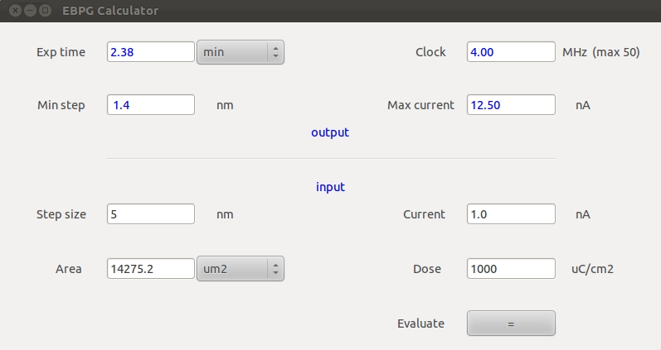
Choosing e-beam exposure parameters
Step 4: Resist sensitivity and beam step size the easy way
You can use the previous equation to calculate the minimum beam step size, or you can do it the easy way, using our handy EBPG parameter calculator.
Simply enter values for the exposure current and minimum dose, then this program will calculate the minimum beam step.
Do not work too closely to 125 MHz (or 50 MHz on the older machine). If the beam current is higher than expected, then the dwell time could be too small, causing the exposure to stop.
Find this program on the ebeam server desktop, or download the program from nano.yale.edu

Slide 8
Choosing e-beam exposure parameters
Step 5: Design
Now that you have chosen a beam step size, be sure to design the pattern so that all of the shapes snap to some multiple of the beam step size. Otherwise, strange things will happen when your pattern snaps to the exposure grid. This is especially important for periodic structures.
Did you already do the CAD ? Go back and fix it.
Starting over is often the best choice. That’s true in general.

Slide 9
End of part 2
Now you should proceed to the quiz.

