Slide 1
Controlling e-beam writing order to avoid stitching and drift problems
Michael Rooks, Yale University

Slide 2
Oh no! The e-beam system is broken!
No, it’s not broken. This is caused by drift – mostly due to the temperature difference between the wafer and the e-beam stage.

Slide 3
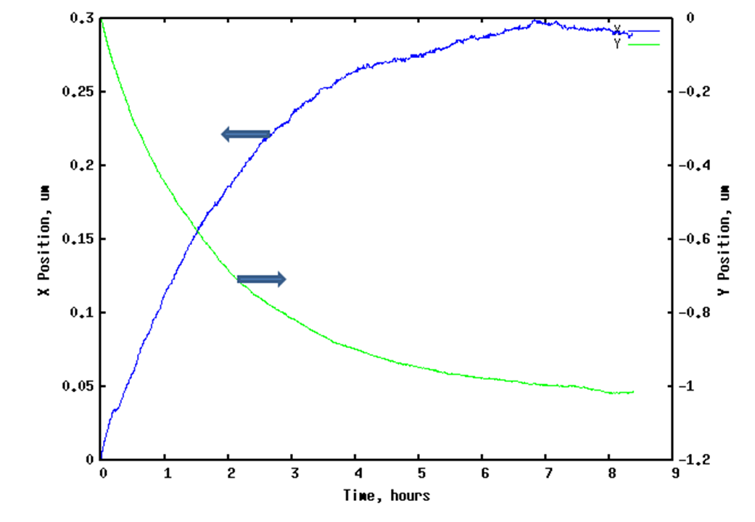
E-beam drift test
This is a plot of the location of one mark, over nine hours. It drifts quite a lot, because this particular machine has no temperature control.
It takes a long time to equilibrate because this machine has poor thermal conductivity between the wafer and the stage.
Your e-beam machine is better, right? Your time constant might be a lot smaller, but it’s not zero.

Slide 4
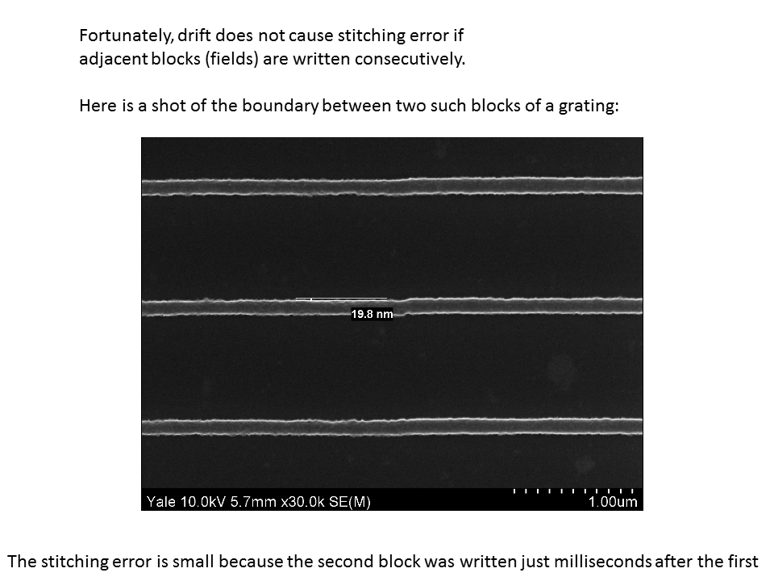

Slide 5
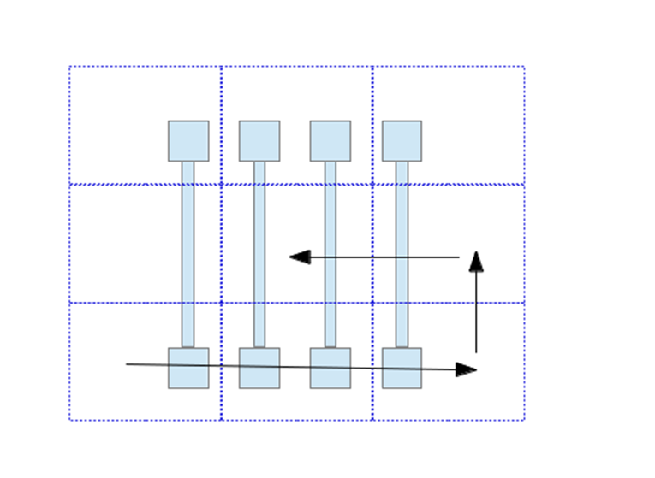
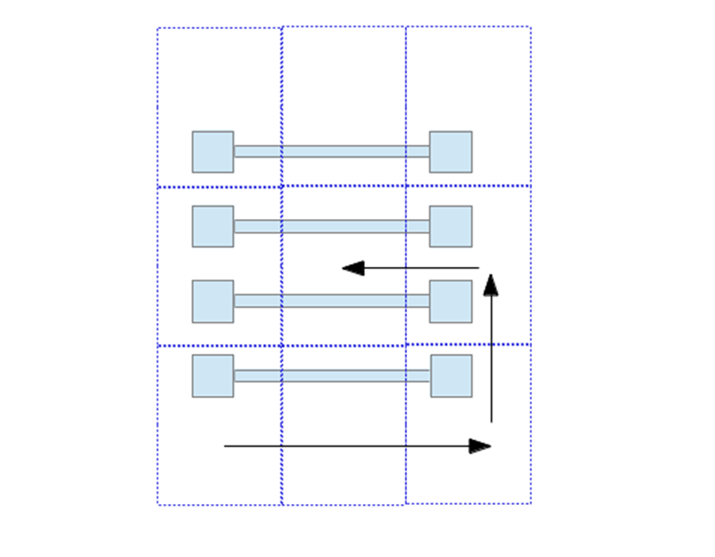
Design patterns to follow the default writing order
Bad idea
Good idea

Slide 6
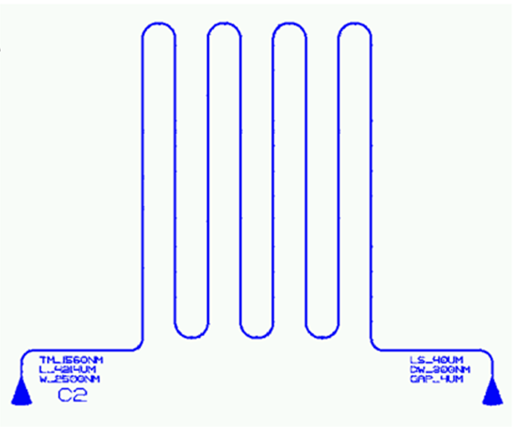
Typical problem: exposure of a long waveguide
The default writing order is poor.

Slide 7
We can fix this problem by making the fields smaller
Then use Beamer’s “follow geometry” option, or the utility gpfsort
But the fields are STILL not small enough. The software tries to connect populated fields, but does not understand the logical order.

Slide 8
We can fix this problem by making the fields EVEN SMALLER
We have to make the fields small enough so that unpopulated fields appear between the populated ones.
Now the populated fields can be exposed in sequence.
This kind of field sorting can be done with Beamer, or with ‘gpfsort’ (if you have an EBPG).
Sorting fields manually is a different story.

Slide 9
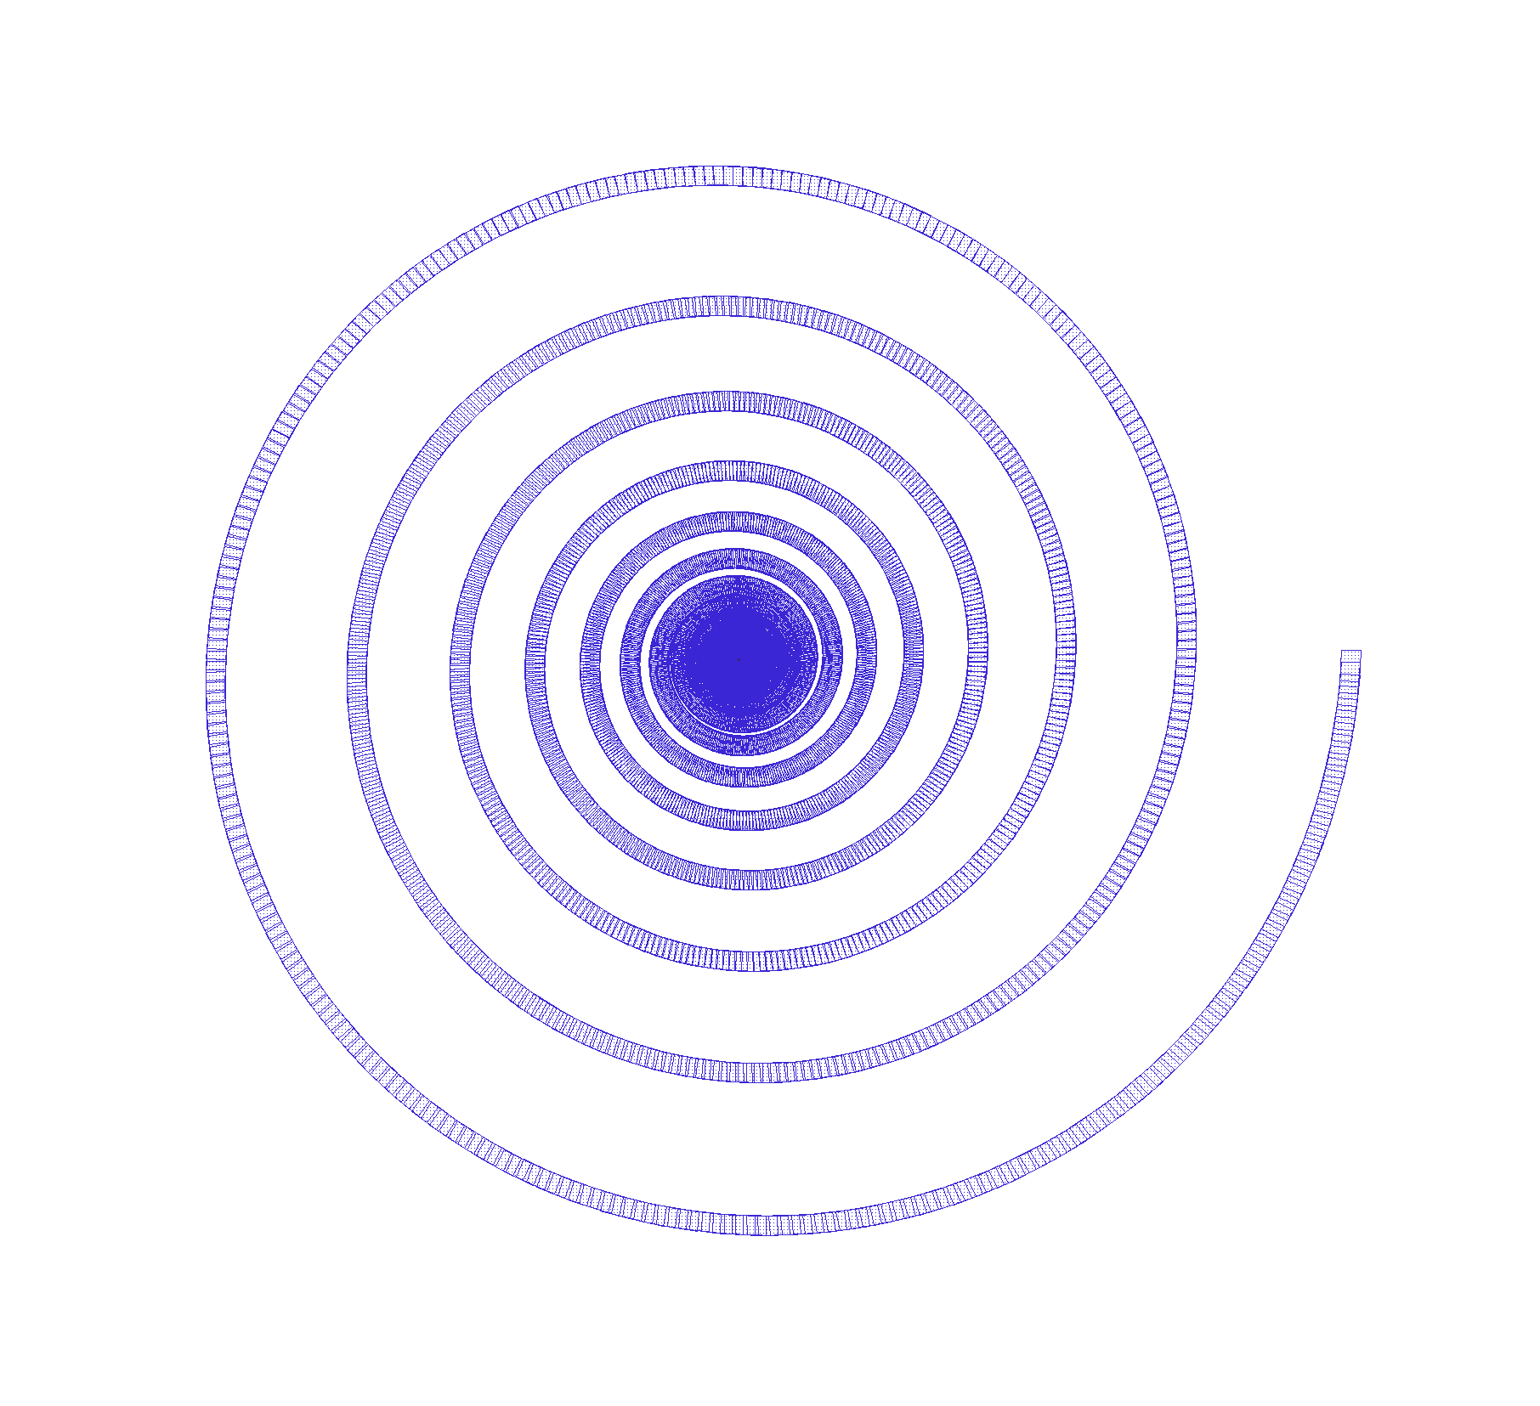
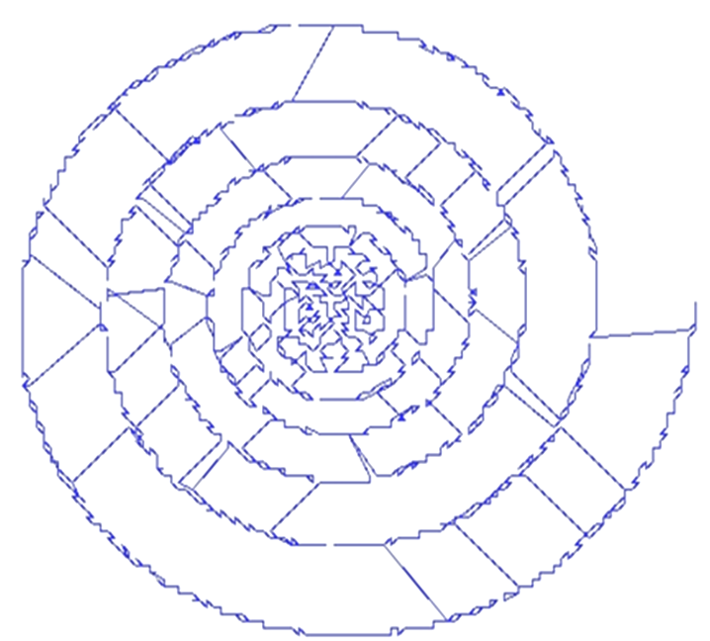
“Follow Geometry” a.k.a. “Yellow Brick Road” sorting is the most common choice for waveguides, but there are other choices – left-to-right, or top-to-bottom, or “travelling salesman”.
Travelling salesman
with Beamer’s floating fields or using “gpfsort –ts”
Pattern
Writing order
Travelling salesman sorting is almost never a good choice.

Slide 10
The travelling salesman sort is what you get if you choose “floating fields” in Beamer. If the pattern is sparse and not connected, then that might be good.
But if the pattern is connected across many fields, then the “floating field” option creates a confusing jumble of overlapping fields.

Slide 11
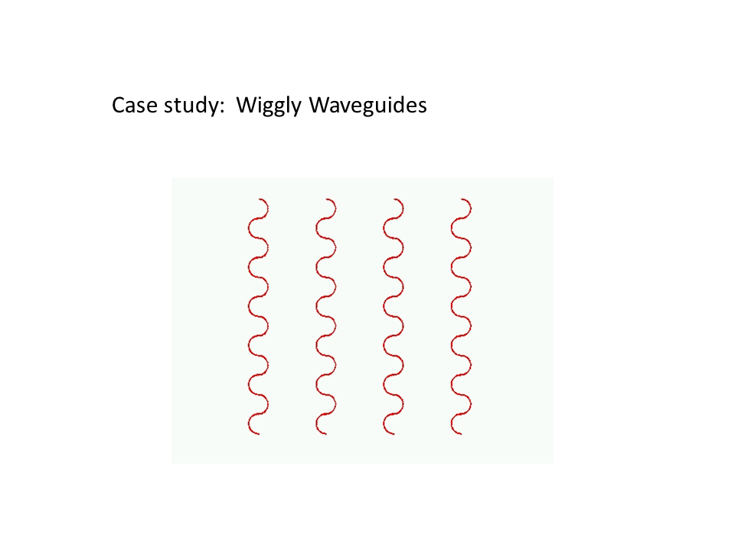
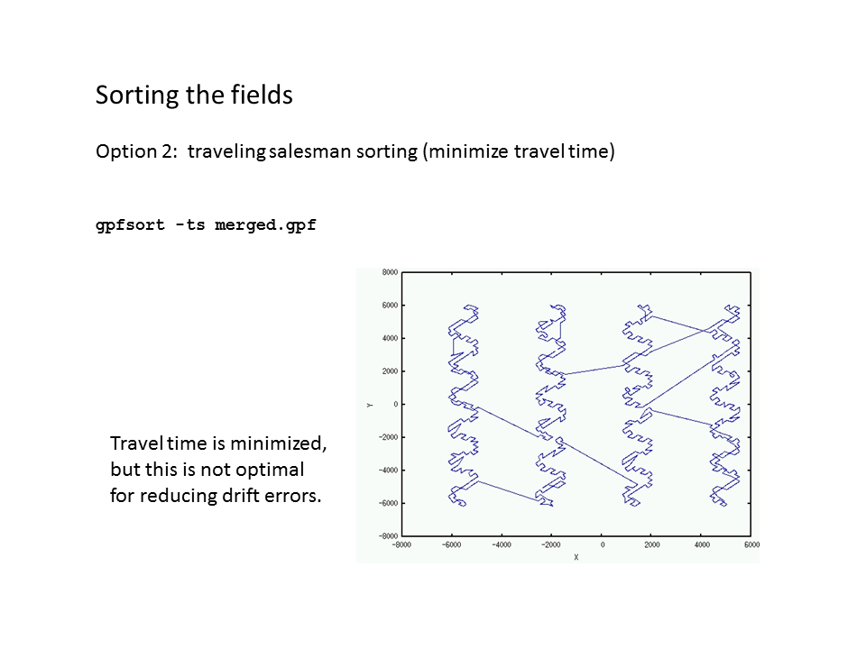
Another example of a travelling-salesman sort

Slide 12
In this case “yellow brick road” aka “follow geometry” sorting is much better

Slide 13
What if the optimal writing order is not obvious?
How can we coerce the e-beam to do the right thing?

Slide 14
How can we coerce the e-beam to do the right thing?
Option 1: Break the pattern into many separate files, then use the exposure layout software to print them in the best order.
File 1
File 2
File 3
File 4
File 9
File 10
File 11
File 12
File 8
File 5
File 15
File 13
File 7
File 6
File 16
File 17
File 18
File 14
File 19
File 20
File 21

Slide 15
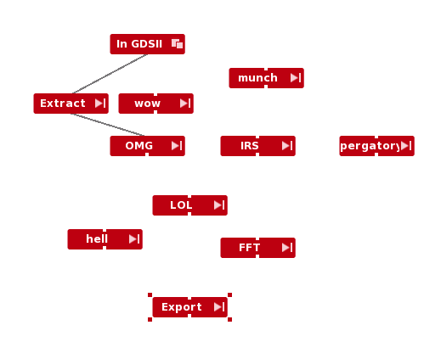
How can we coerce the e-beam to do the right thing?
Option 2: Use Beamer to define a very elaborate fracturing sequence that will really impress your friends. It’s definitely possible, and it is seriously complicated. Unfortunately we can’t afford to update Beamer, so option 2 is not an option.
Fortunately we can write our own software to create a simple solution, which is…

Slide 16
We want to define a path for the exposure.
In gpfsort, one can draw a path in CAD or create a list of coordinates.
The pattern will be sorted according to its proximity to this path
Option 3: Define a writing path, then use gpfsort

Slide 17
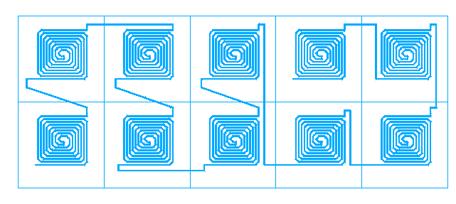
Here is another example.
If you want to manually specify the writing order like this…
Simply create a text file called path.txt, and type in the vertices of the desired exposure path.

Slide 18
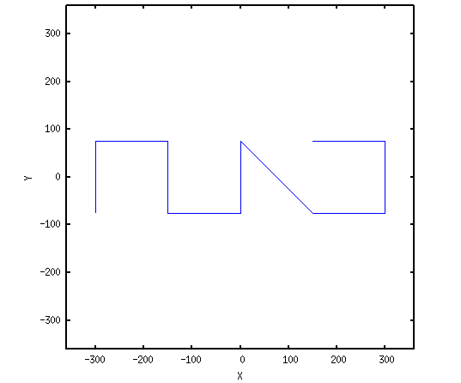
Writing paths for gpfsort
Use Beamer to create the fractured pattern, then use gpfsort to re-order the fields
path.txt
lower-left -500 -600
upper-right 400 400
#
-300 -70
-300 80
-150 80
-150 -70
0 -70
0 80
150 -70
300 -70
300 80
150 80
gpfsort –path path_example.gpf

Slide 19
Now that the fields are sorted in a sensible order, we still have field stitching errors. We can average out the stitching errors by setting up multiple passes, while shifting the field boundaries in each pass.

Slide 21
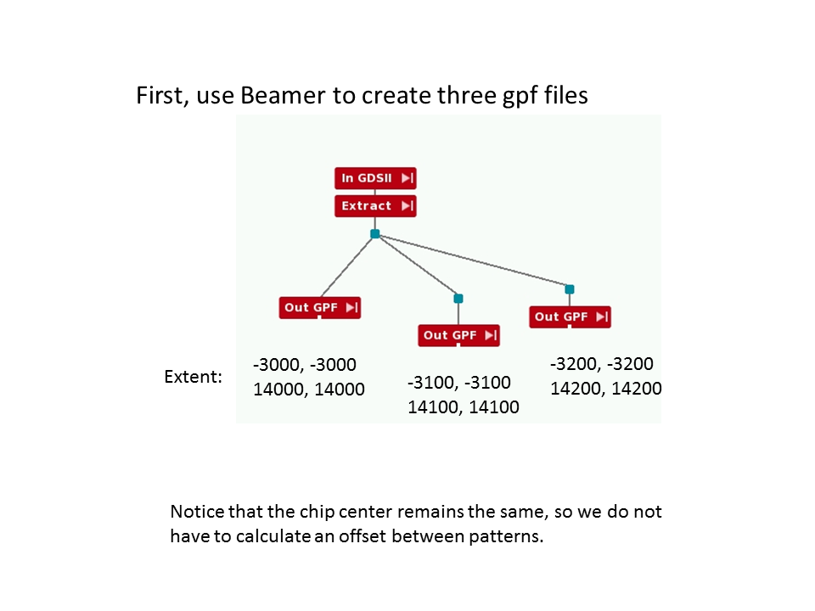

Slide 24
The fields can be sorted into a more sensible writing order by using gpfmerge and then gpfsort:
After using Beamer to create file1.gpf, file2.gpf, and file3.gpf, merge them with
gpfmerge file1.gpf file2.gpf file3.gpf
The merged pattern is now in merged.gpf. The fields are still in an unfortunate order, so we sort them in “yellow brick road” order with
gpfsort –ybr merged.gpf
Now be sure to set up the ebpg parameters to do periodic drift checks. If your exposure job file is named bla.job, then create a file named bla.ini which contains
pg set caldrift 00:01:00
pg set calrealign 1
pg set calinv 1
The system will realign once a minute, but only at the end of a field.

Slide 25
To be fair, we must point out that Beamer has some built-in multipass functions.
Unfortunately Beamer’s multipass function often results in a non-optimal writing order. So you still need to use gpfsort.
Also, Beamer will generate two passes or four passes, not three.
And it’s pretty confusing, imho. We made a video about it, so you should find the link in your email.
Now let’s get back to thinking about the writing order of our very long device.

Slide 26
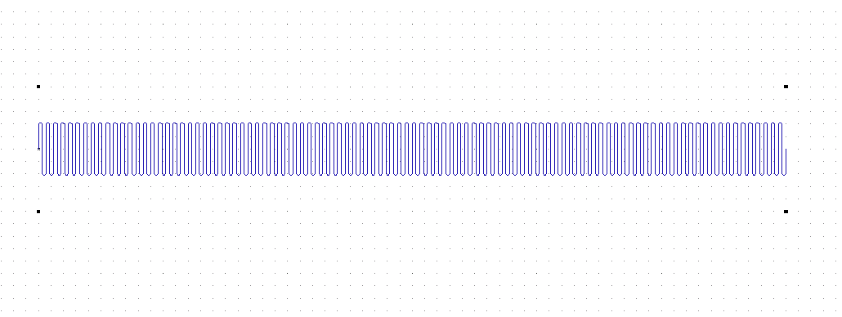
Here is the writing order we really want
Bad news: Overlapping patterns (written at 1/3 dose each) wash away stitching errors, but there will still be an overall curve in the pattern from one end to the other. This “runout” error is a serious problem for multi-level devices.
Fortunately in this example you have first fabricated alignment marks in the corners. By default, one pattern gets only one alignment.
600 µm

Slide 27
We should overlap fields, and also realign periodically
If the pattern takes (let’s say) one hour to write, then each 1/3 pattern takes 20 minutes. We really should realign more often than that. So let’s merge and sort the pattern as before, but then set calrealign=1 so that the system will realign every few minutes.
align
align
align
align

Slide 28
Now that the fields are all sorted, we should worry about the writing order INSIDE each field.

Slide 30
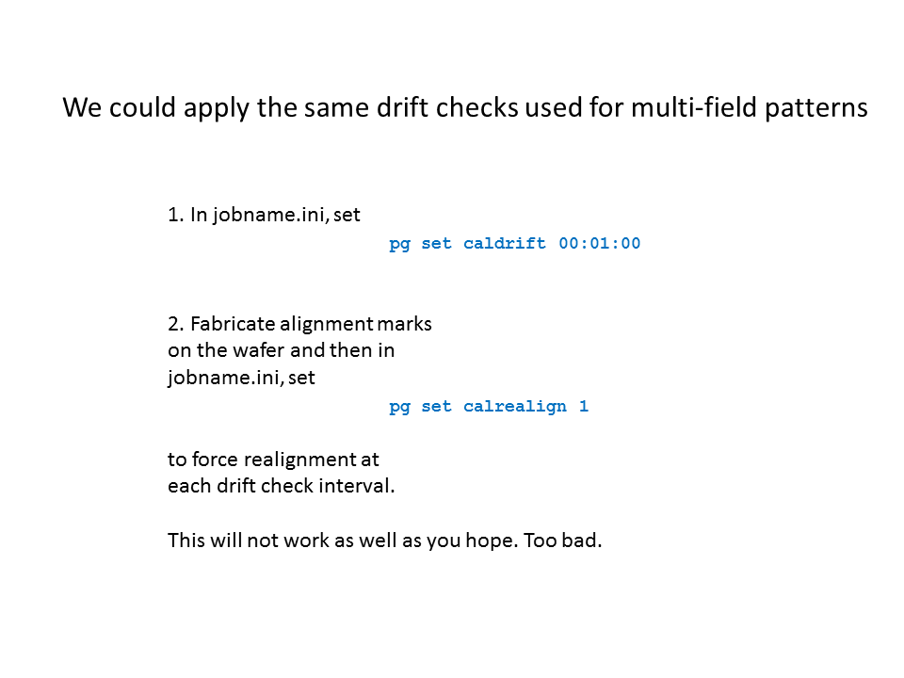

Slide 32
Circular grating on an EBPG – one field
Default sorting with Beamer After sorting with radial_sort.py

Slide 33
Radial sorting can be performed on gpf patterns with radial_sort.py
Or you can do this with the latest version of Beamer. But who can cough up the money for that? We do it the cheap way.

Slide 34
Proximity sorting inside the field is appropriate for singly-connected shapes
This can be done with ybrsort.py, or with the latest version of Beamer.
Newer versions of Beamer can sort horizontally, vertically, or by proximity… but only inside each field. It will not optimize the field order.

Slide 35
What about multiply-connected patterns?
Manual sorting inside one field with a user- specified path can be done with ybrsort, but not with Beamer (maybe someday, but not yet.)
The syntax is the same as with gpfsort.

Slide 36
Summary
Re-ordering fields and shapes can greatly reduce stitching errors due to drift. Of course, drift still causes runout errors, which can be minimized only with re-alignment.
Beamer provides multi-pass writing, or one can set it up manually with ebpg utilities. The manual approach is better.
Beamer has limited abilities for re-sorting fields, and shapes. It has no simple mechanism for following a path, but they will probably catch up if customers ask for this feature.
Look for free ebpg utilities at nano.yale.edu

