Slide 1
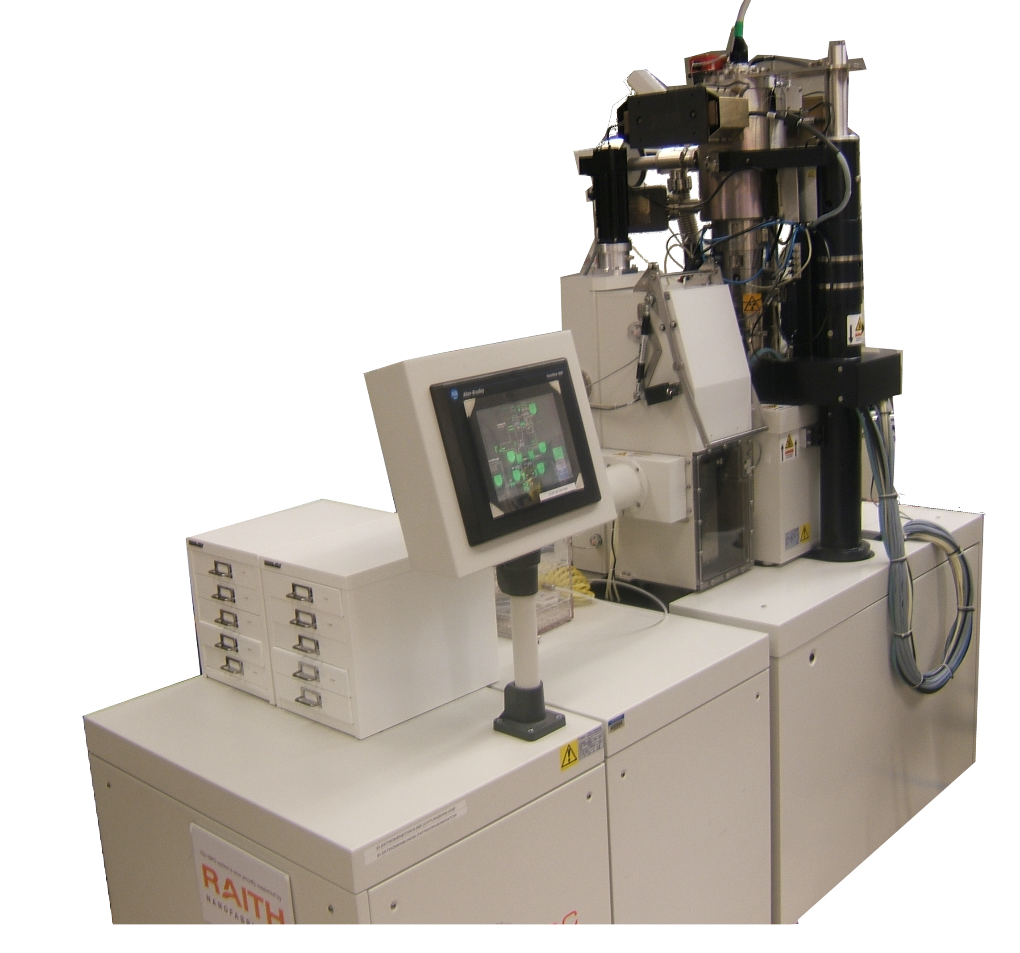
Electron-beam lithography with the Raith EBPG
Part 3: Hardware
M. Rooks, Yale University

Slide 2
EBPG 5000+ System Hardware
100 kV accelerating potential electrons of course
20 bit main field DAC Digital to Analog Converter*
14 bit trapezium DAC for filling shapes
50 MHz maximum clock minimum dwell time 1/50 μs
6 inch stage 15 cm for you communists
Two-stage magnetic deflection
* You should know the meaning of “DAC” and “LSB”. Look it up.

Slide 3
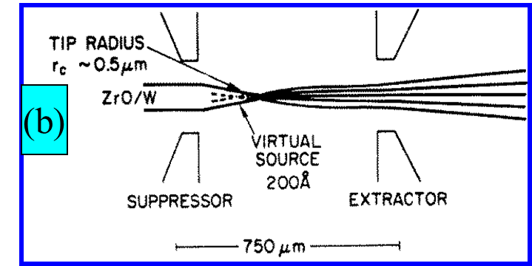
Electron Source
At the top of the column is the electron source, a thermal field emitter. Electrons are drawn out of the sharp tungsten tip by an extraction potential around 2 kV.
The emitter pin is kept hot so that ZrO will flow down the surface, thereby lowering the work function and producing a larger current. Keeping the tip hot also makes the source more stable.
This is exactly the same type of electron source commonly found in SEMs and TEMs.
(Older systems used hot LaB₆ emitters, but we do not speak of that.)

Slide 4
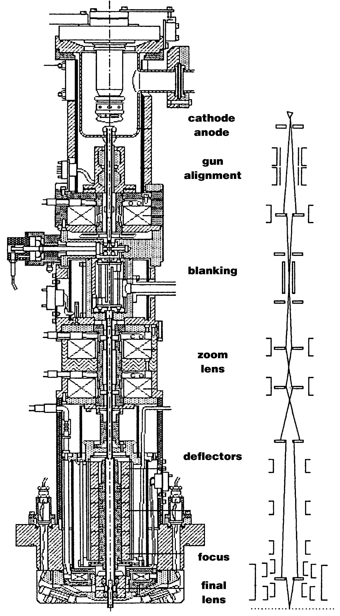
Electron Optics
Electrons are generated from a field emitter in the gun, then focused by an electrostatic lens (C1) before accelerating through the anode.
The magnetic lens (C2) focuses the beam to a crossover in the blanking cell, which is simply a plate which can be charged up to turn the beam off. Placing this blanking plate at the crossover allows the beam to turn off without shifting the image.
The third lens (C3) is the objective, focusing the electrons to a spot on the sample. Inside C3 is a smaller, faster coil for rapid tweaks to the focus. The beam is automatically refocused every time the sample moves.
Just like a SEM, the column contains coils to correct astigmatism, also adjusted automatically.
C1
C2
C3

Slide 5
Stage Control
The position of the stage is measured with a laser interferometer, with an accuracy below one nanometer. The interferometer uses a He-Ne laser and Zeeman splitting to create a GHz range beat frequency at the receivers. This frequency shifts as the stage moves, and so the Doppler effect can be used to measure the stage speed. Speed is integrated to find the stage position.
Motors on the stage move in a sloppy manner, while the laser signal is used to deflect the beam electronically, thereby compensating for any jerky mechanical motion or mechanical vibration.

Slide 6
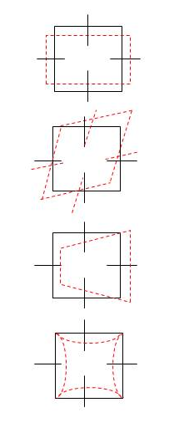
Main Field Deflecton Errors
The EBPG uses the laser stage to automatically calibrate and compensate for gain, rotation, keystone and pincushion errors.
Additionally, the focus and stigmation are dynamically corrected over the deflection field.
If you ever wonder why the big system is better than a converted SEM, this is the answer.
X, Y gain errors
X, Y axis rotation errors
Field keystone errors
Pincusion and third-order distortion

Slide 7
Stigmation coils & fast focus
More sigmation & fast focus coils
Secondary electron detectors – four unbiased scintillators on light pipes, with photomultipliers
Electron Optics – Bottom
Directly above the sample stage are the fast focus and stigmation coils.
Secondary electrons from the sample (usually a silicon wafer) are detected by four scintillators on the ends of light-pipes, coupled to photomultiplier tubes. These detectors are similar to those in SEMs, but without the usual 300V bias drawing in the electrons. A bias on the ends of the detectors would distort the writing field. Unfortunately, without the bias these detectors are not very efficient.
Other e-beam systems detect secondary electrons using a diode mounted under the objective lens, or with a scintillator built into the objective lens. It would be nice to have these more efficient detectors, but you can’t have everything.

Slide 8
Laser Height Sensor
Every time the stage moves, a height sensor corrects the focus and deflection gain.
System reads change in spot position on Dual Diode detector
Signals from Dual-diode detector
determines distance moved
by laser beam.
Laser projects spot onto surface of substrate.
Reflected laser beam
Substrate
Laser spot movement due to change in height of substrate surface.
Laser spot reflected onto detector.
If the laser beam hits the wafer’s edge or hits a metal fixture, then the height reading will fail. For this reason, patterns should be placed at least 1mm from any edge – especially if you are using a fixture for a small substrate.

Slide 9
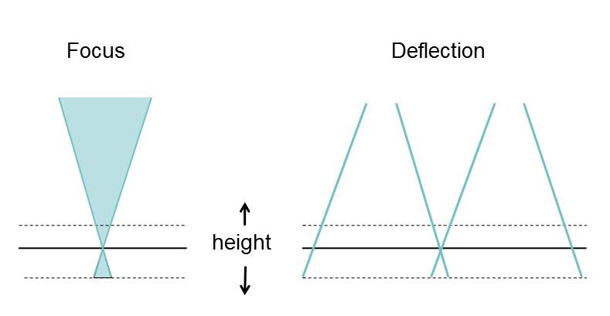
Substrate Height Correction
As the substrate height varies, the system must correct both focus and field size. Correcting the field size is critical, since this determines field stitching accuracy. You can see now why smaller field block sizes lead to smaller stitching errors.
On the EBPG you should keep the block size less than 700 μm so that field stitching errors will be less than 50 nm. The maximum block size is equal to the maximum field, 1 mm. But it would be a mistake to use such a large deflection.

Slide 10
Errors caused by beam deflection
Objective lens & aperture
Beam focused to form round spot at Field center.
Focal Plain
Spot defocused and astigmatic when deflected
Substrate Surface
When the beam is deflected, the EBPG system corrects the focus, astigmatism, and field size. Dynamic focus, astigmatism, field gain, and height adjustment are all calibrated automatically before each exposure.

Slide 11
Exposure Strategy
Software breaks a pattern into exposure fields (“blocks”) so that a large pattern can be stitched together by moving the stage.
Inside each field the shapes are broken into simple parallelograms.
Inside each parallelogram the beam paints the shape with a serpentine raster.
The slower 20-bit main deflector positions the beam in the field, then the fast 14-bit trapezium deflector fills in each shape.

Slide 12
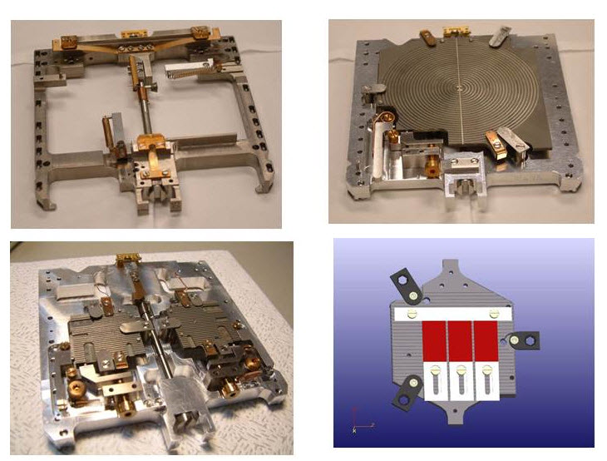
EBPG Sample Holders
Top left: holder for 5 inch mask plates. Top right: wafer holder. Bottom left: two two-inch wafers (we do not have this one). Bottom right: piece holder. This is a bottom-reference piece holder which we do not have at Yale. This holder requires manual trimming to level the substrate and to move it into the correct plane. The next slide shows a better design.
At Yale we have holders for 3, 4, and 6 inch wafers, as well as adapters for smaller substrates.

Slide 13
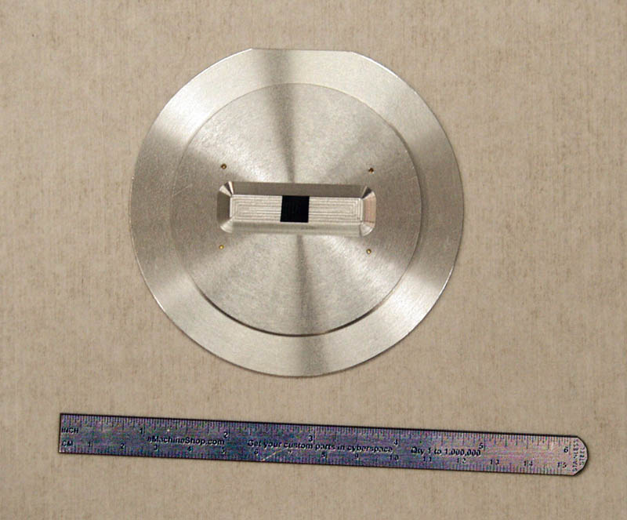
Adapters For Small Pieces
These fixtures fit in place of a 4 inch wafer. The small substrate will be at the proper focus height, determined by its top surface. This is a better design than the one on the previous slide, because any junk on the back of the substrate will not tilt the sample, nor move it out of the focus plane.
These fixtures are built at Yale, and so it is easy to make holders customized for your weird samples. Currently, we have fixtures with window sizes of 8mm, 10mm, 20mm, 38mm, and 2 inch (50mm). Your substrate must have one dimension at least 2mm larger than the window size.
sample

Slide 14
Substrate fixturing ideas that do not work
File under “It seemed like a good idea at the time” these bad ideas:
Gluing the piece to a big wafer with PMMA, photoresist, or glue. Terrible idea – the solvent will not completely dry under the piece. In the vacuum system the solvent will boil, and the piece will pop off.
Using vacuum grease to hold the piece. This is less stupid, but you will have a hard time getting the grease off the substrate, and you cannot put vacuum grease in the developer.
Building an adapter with a “V” shaped window. Sorry – the angle will always be wrong, and the adapter will cover alignment marks, etc.
Building an adapter with adjustable top rails. This idea is too complicated and too easily broken. We’ve been there, done that, and it doesn’t work.

Slide 15
Substrate fixturing ideas that sometimes work
Clipping the wafer to a metal puck. This does work sometimes, but it requires a lot of fussing. The puck has to be shimmed to the correct plane, and the back of the wafer must be cleaned to avoid tilting. If the clip pushes down on a delicate spot, the substrate can easily break.
Taping the substrate to a large wafer, with carbon tape. This does work, but the previous comments about shimming and cleaning also apply. In addition to fussing with shims, you will get carbon tape goo on the substrate. Also there is a risk of breaking the piece when removing the carbon tape.
Using crystalbond wax to attach the little piece to a wafer. Yes, we have done this with diamonds, but it’s tricky. The substrate is not grounded, and so it must be coated with gold (on top of the resist). The wax can go into IPA/water or TMAH developer, and it can later be removed in acetone. The wafer/wax/diamond can go from the e-beam to developer, and then to the evaporator or etcher. The tricky bit is that liftoff in acetone will also lift off the little piece.
Raith’s own butt-end clips (seen a few slides back) also work, after a fashion. Unfortunately, brittle materials like GaAs and InP tend to break when pushed from the side. You’ll also have the fun of trimming the height.

Slide 16
Small Substrates Are Bad
Using substrates smaller than 1 cm is stupid for a number of reasons:
Resist edge beak ruins the exposure within 1mm of the edge.
Piece-part fixtures will cover another 2mm of the stubstrate.
The laser height sensor will not operate closer than 1mm to the window, which means that you will lose 4 mm in one dimension and 2 mm in the other. That’s quite a lot of lost real estate on a 10mm piece.
Alignment of a multi-layer device will be very difficult, because the piece must be pre-aligned to within 0.2 degrees. That means your alignment marks must be on-axis within 35 μm over 10mm. That’s not fun at all.
If you are trying to save money by chopping up an expensive substrate, then think about how much e-beam time you are wasting by misaligning the substrate. One hour of ebeam time is $100. How much did you save?
It takes 6 minutes to vent and 6 minutes to pump the load lock, as well as ~ 10 minutes to find your alignment marks. Therefore each piece has an overhead cost around $37. How much did you really save by chopping up a $50 wafer? Do the math.

Slide 17
CAD
e.g. with “layout”
Output GDS format
Running the EBPG – preparing a pattern
Start by designing a pattern, then convert it to EBPG format with the program Beamer.
Use cjob to set up the exposure, specifying the exposure dose and pattern placement on the substrate.
Finally, coat the substrate with resist, put it in the EBPG, and start the exposure.
pattern conversion with “beamer”
Output GPF format
pattern check
with “cview”
exposure setup
with “cjob”
Output job script
exposure on EBPG
with “beams”

Slide 18
Running the EBPG – a simple exposure
Cjob produces a script that runs your exposure, but this is not required. You could expose a pattern with a simple set of commands, as shown here. Just type them into a terminal window.
Complex jobs use the same commands, with more elaborate scripts created by cjob.
pg info arc beam list beam files (that contain lens settings)
pg arc restore beam 10na_300um_2 set the lenses for 10nA beam current
mcur measure the beam current
pg select pattern abc.gpf choose a pattern
pg set resist 800.0 set the dose
pg adjust ebpg calibration
pg move position 75mm,75mm move somewhere
pg expose pattern expose!

Slide 19
End of part 3
Now you should proceed to the quiz.

