Slide 1
Getting the least from your e-beam
or…
How not to design stupid patterns
M. Rooks, Yale University

Slide 2
Settle Down
Now that you have completed the CAD tutorial, you probably think you can slap together your design and the e-beam system will poop out a shiny nugget. Nope.
First, let’s think about settling time. Every shape requires the beam to be deflected to a particular place, using a 20-bit main-field DAC and a fast 14-bit subfield DAC. (You should know what a DAC is by now, so go look it up.)
After one main-field deflection, the beam remains blanked for ~150µs while the beam position settles. (Or longer, if the deflection is large.)
After one subfield deflection, the beam remains blanked for ~1 µs (or longer) while the beam position settles.
For patterns with a lot of small shapes, this can really add up.
main deflector
~150 µs
subfield deflector
~1 µs

Slide 3
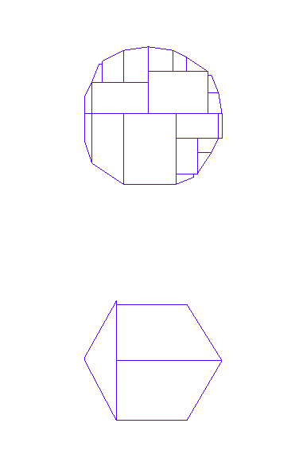
This is not a circle
This is a polygon with n sides. There is no such thing as a circle in e-beam land. The number of sides matters a lot, because the use of more sides requires the use of more small shapes to generate the pattern.
This means the deflection settling time will increase dramatically simply by using more vertices to define the polygon. After conversion to gpf format, a “circle” could look like this…
…if we use 360 sides
…or like this if we use only 6 sides

Slide 4
What you design is not what you get
Actual size after exposure and development
The diameter of this “circle” is 200nm. We have converted it to gpf format using a 5nm beam step size. When exposed at a high enough dose, these two “circles” will look exactly the same on the wafer.
BUT
The first one will have a settling time overhead of 19 µs and the second will have a settling time of 3 µs.
3 mm
A 3 x 3 mm patch of these dots with a pitch of 300nm (center-to-center spacing) will contain 100 million polygons.
The total overhead for deflection settling is 32 minutes for the 360 sided shape, or 5 minutes for the hexagon.
So being stupid will cost you some serious money. In this case, it will cost ~ $50 more for each pattern.
200 nm

Slide 5
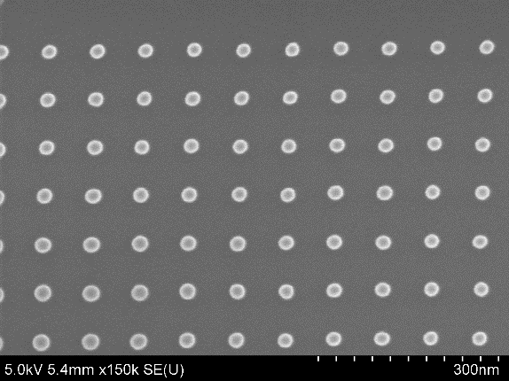
Why not reduce that dot down to one pixel?
That’s not a bad idea. You can bias a dot down to one pixel. If you want to use a beam step size of 5 nm, then in the CAD program you should draw a 5x5 nm box. The actual size of the dot will be determined by the exposure dose and development chemistry.
In this case the concept of “dose ” (in coulombs / cm²) is unclear. Scattered electrons spread the energy over an area much larger than the single pixel, but when you specify a “dose ” the EBPG will calculate the dwell time based on just 5x5 nm². Empirically we find that the dose should be set roughly 25 times higher than the dose for a large shape.
Similarly, the dose for a single-pixel line will have to be roughly 5 times higher than the dose used for a large shape.
Here’s a neat trick: If you use a beam step size of 100nm then a rectangle exposed at a low enough dose will end up as a set of dots! The beam will try to fill in the rectangle by making 100nm hops – without blanking or settling. The dots will be a bit elongated, but this might not matter for your application. In fact, making a field of “dots on the fly” is a common diagnostic test. Misplacement of the dots can be used to measure abnormal beam deflection noise.
What you see
What you get
Dots in HSQ resist, using a single large rectangle printed with a 80nm beam step.

Slide 6
Shrinking and growing: Bias
The single-pixel dot is an example of ‘bias’. The exposure and development process will broaden the shape. We could call this a ‘positive’ process bias, or we could describe the pattern has having a ‘negative’ size bias.
When using positive resist (eg PMMA) all shapes will be larger than the design in the CAD files. Typically, a line in the resist will widen by at least 10% of the resist thickness. For example, if you use 3% PMMA for a thickness of 200nm, then you can expect a process bias of about 20nm in the resist. If you use this resist as an etch mask, then the width will increase further.
It makes sense to design your pattern with smaller sizes; that is, to bias the pattern.
What you see
What you get
design
process bias
e-
PMMA
silicon

Slide 7
Be prejudiced against bias
It’s tempting to design a device at the correct, unbiased size, then shrink it by some amount right before you print it. You could use Beamer, CATS, or Layout to apply an automatic bias.
The problem is that automatic biasing will often separate shapes. You must be very careful to match adjoining vertices (without overlaps) and you must put all the vertices on the exposure grid. Otherwise, shapes will break apart.
You can avoid this problem by applying an overlap removal step (aka “healing” in Beamer) but that step might take a long time, and the process will wipe out all layer and datatype settings.
Baising geometry automatically is a very difficult problem, and so it’s not surprising that even the best software goofs it up sometimes.
It’s a lot more reliable to put in a size bias yourself, by hand.
Unbiased design with an overlap
What you want
What you get

Slide 8
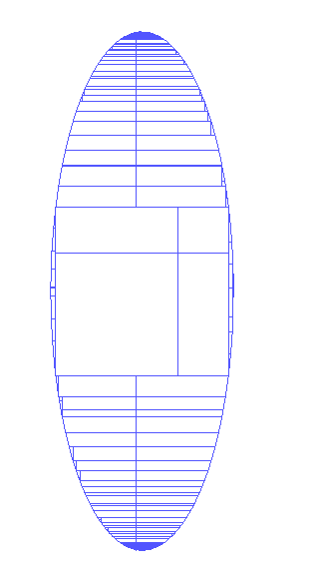
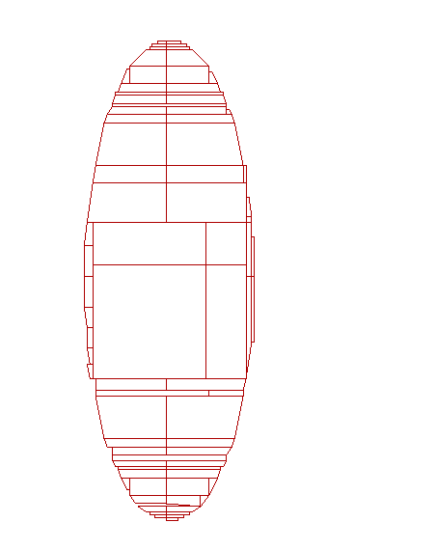
More sides or fewer sides?
Will a smaller beam step make smoother waveguides?
Shape settling overhead is a lot smaller when the polygons have fewer vertices, but polygons that are supposed to be smooth – such as waveguides – might not be smooth enough.
When choosing a beam step size, consider the fact that the intrinsic lumpiness of PMMA is around 5nm, and that of HSQ is around 3nm. Metal grain size or lack of etch selectivity will also cause 1-10nm more roughness. Beam deflection noise adds several more nanometers.
Therefore there is no point in using a beam step size smaller than about 5nm. If you need smoother features then you should be thinking about desperate measures such as…
Improving the etch process
Annealing and reflow
Hydrogen plasma smoothing
Waveguide cladding material
If your device requires atomic smoothness, then it’s time to change the entire concept of your device.
beam step = 5nm beam step = 50nm

Slide 9
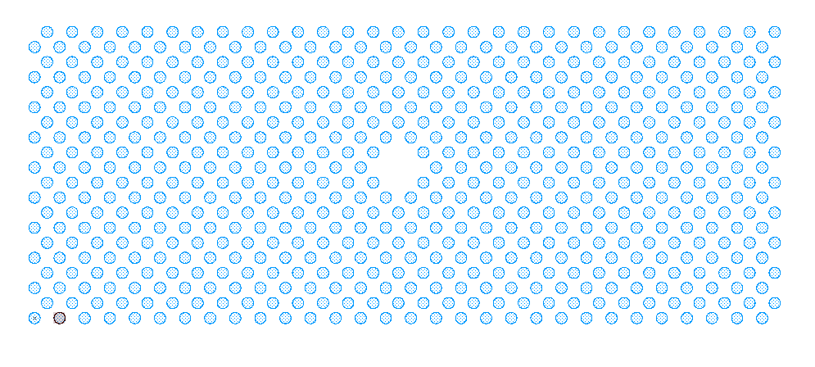
Placement accuracy
The beam step size is always a multiple of the least significant bit, LSB. On our EBPG the LSB is usually set to 1nm. Pattern features will snap to multiples of the beam step size.
For example, to fabricate a Bragg grating on a GaAs laser we might want a grating with a pitch (center-to-center) distance of precisely 241.3nm. Unfortunately, our e-beam LSB is normally set to 1nm, which is not accurate enough.
In this example we could recalibrate the LSB to 0.7541nm, and we could choose a beam step size which is 5 times the LSB, 3.7703nm. This makes the grating pitch equal to 64 beam steps.
The EBPG system can be recalibrated with an arbitrary LSB. Other e-beam systems achieve the same “field stretch” by lying about the distance between alignment marks. A variety of different pitch values requires recalibration with a variety of different LSBs (or different lies about the mark positions.)
In practice, we almost never need to use a LSB other than 1nm because we can allow periodic structures to snap to a coarse grid. It’s the average pitch that matters.
241.3 nm = 64 beam steps
DFB grating
Photonic bandgap cavity

Slide 10
Aperiodic Structures
Matching the deflection LSB to the grating periodicity will not work if we need a continuum of grating pitches. For example, we might need a chirped grating where the pitch varies from 1070.66nm to 1070.11nm over one millimeter. In this example we cannot pick a convenient LSB.
Instead, we set the LSB to 1nm, then let the grating lines snap back and forth onto the exposure grid. This coarse technique works because light scatters weakly from each grating line, and effectively averages over the placement errors.
Random snapping to a coarse grid is far easier and more versatile than finding the perfect LSB. This is the preferred technique for creating ‘weak’ gratings.
Chirpped dispersion filter

Slide 11
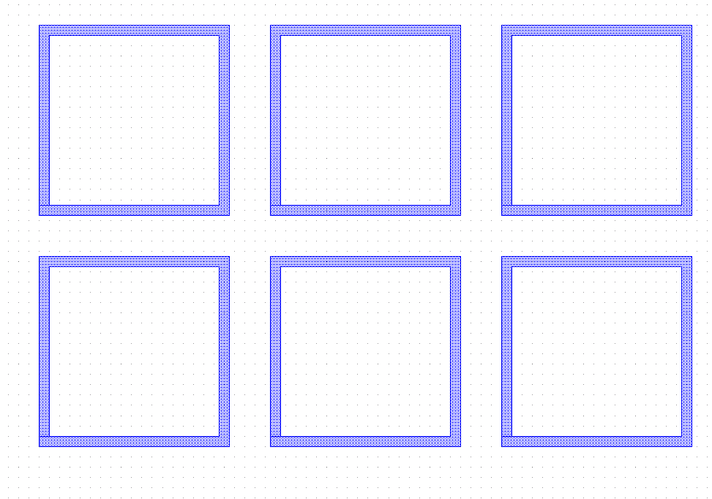
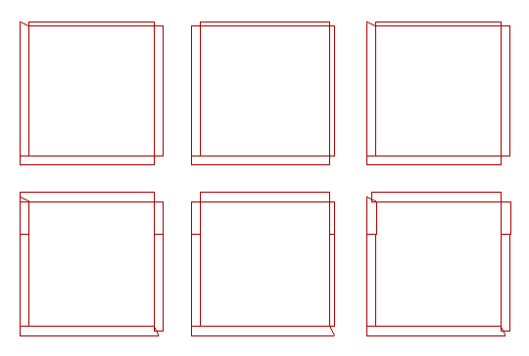
Oh Snap!
The previous slide made random grid snapping sound great. It is great for weak gratings, but for everything else, it’s terrible. Here is an example of an array of square rings, designed on a 10 nm grid, but converted to e-beam format with a 12 nm beam step size.
The rings have a 450 nm pitch, but because the 20 nm wide lines were designed as “paths,” the edges of the lines fall on a 10 nm grid.
The linewidth is nominally 20 nm, but you can see that grid snapping to a 12 nm beam step causes the linewidth to vary between 0 and 2 pixels. The exposure would be very non-uniform.
The designer should have placed the array on a 12nm grid, and should have made the linewidth a multiple of 12 nm. (Of course, she could have used a 10nm beam step size instead.)
This example also illustrates the folly of using paths instead of polygons. If the path corners are interpreted as being round, then those little corner fill shapes can be lost by snapping to a coarse grid. It is smarter to convert paths to polygons before saving the CAD file.
In this example, 20 nm wide lines exposed with a 12 nm beam step will be only one pixel wide. In other words, they are “single pass” lines.
The moral of the story is: Design your pattern so the vertices are on the beam step grid.
CAD file contains 20nm wide ‘paths’ at 450nm pitch. Line edges fall on a 10nm grid. The square-ness of the corners depends on how the file is saved.
After conversion to e-beam format using a 12nm beam step. Corner pieces were lost because paths were interpreted as having rounded corners. Line widths vary between 0 and 2 pixels.

Slide 12
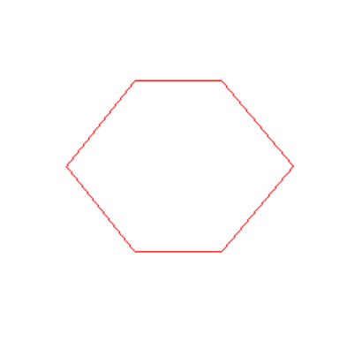
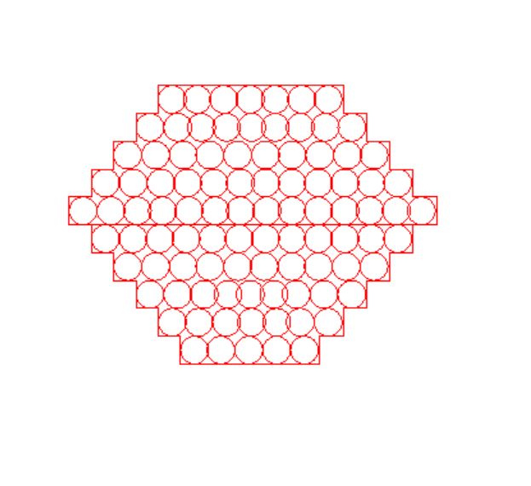
But wait – what if the shapes are bigger?
Normally we try to make polygon vertices fall on the beam stepping grid. BUT if the shapes are more than a few beam steps wide, then we can relax this restriction.
It is possible to specify a placement accuracy which is smaller than the beam stepping distance. Then the vertices of polygons will fall on the finer placement grid, while the shape is filled in with a larger beam step. What? How can the electron beam hit both sides of such a shape?
The system will fill the shape cleverly, possibly with multiple trapezoids, allowing some overlap in the center. This strategy is called “split and bury.”
If the shape is only one to three pixels wide, then this trick will not work.
As designed, the vertices of this hexagon fall on a 1 nm grid. However, we want to expose the shape with a 10 nm beam step.
If the conversion software (Beamer) is given the freedom to use a placement accuracy of 1 nm, then it will try to put the beam shots on the edges of the polygon; that is, on a 1 nm grid.
Some overlaps are allowed inside the shape.

Slide 13
A few more common mistakes:
Tone reversal & overlaps

Slide 14
Reversing tone
Sometimes you need the “reverse” of a pattern. For example, when creating waveguides, you may wish to leave resist on the pattern, so that most of the material will be etched.
Reversing the pattern with software is probably the wrong approach. Instead, you should be using a negative resist such as HSQ or MA-n. Probably. We will talk about software pattern reversal on the next slide.
The lesson of this slide is: USE THE RIGHT RESIST. Use positive resist when you need slots or holes. Use negative resist when you need to etch away everything except your pattern.
Some people fall in love with the wrong resist, and are afraid to switch. Or maybe they are just too lazy. It’s sad to watch people waste so much time. This advice probably applies to more than just e-beam resist. Who knows.
Good: this is the right way to use positive resist
Good: this is the right way to use negative resist
e-
e-
PMMA
HSQ
Bad: The wall of positive resist will fall down or wash away.
Bad: The slot between exposed sections will fill in.
e-
e-
HSQ

Slide 15
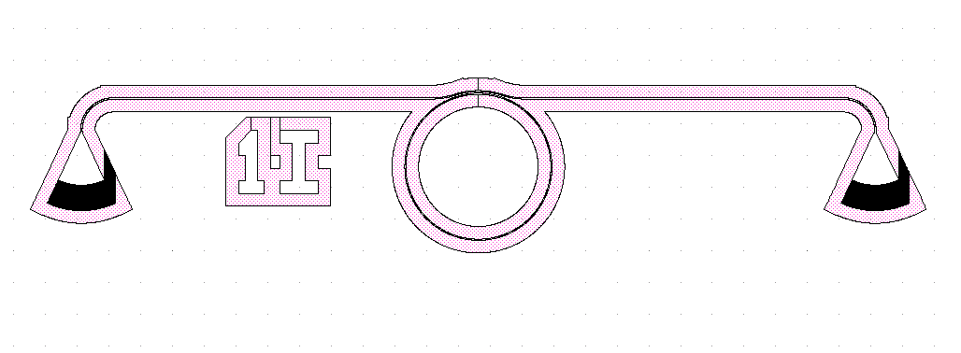
Reversing tone in software
There are some odd cases where it is actually faster to expose positive resist around the device. Let’s assume that you have thought about negative resist and you are not just being stupid.
You can reverse a pattern using Beamer, or with a CAD program such as Layout or Design Workshop. The process is usually found under “Boolean” operations, where you must designate two shapes and then do a “minus” or “not” operation.
The right way to define the second shape is to copy your pattern and then apply a large positive bias. When the original pattern is subtracted from the fat version, the margin will remain.
The wrong way to define the second shape is to use a large rectangle, which results in a very large exposure area. This seems like common sense, right? But people can be amazingly stupid. Not you though.
Watch out: Sometimes even Beamer (!) will make mistakes. Be sure to inspect the pattern carefully.
Wrong: subtracting the pattern from a large rectangle
Right: subtracting the pattern from an expanded version of the same pattern

Slide 16
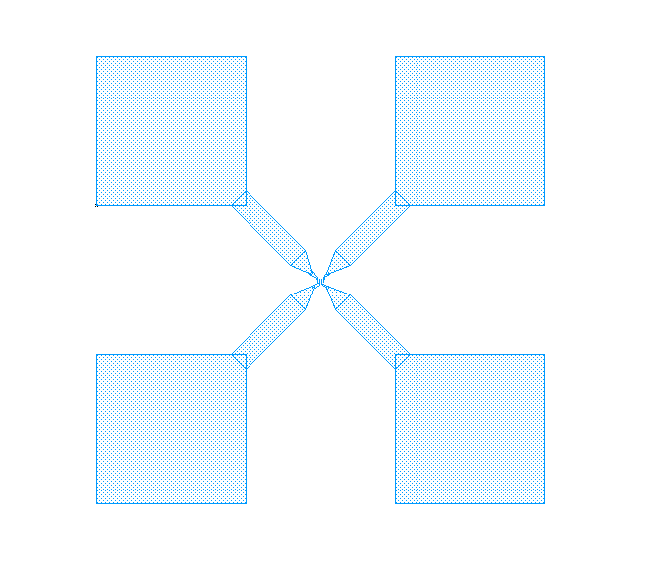
Overlaps
When you are designing things in a hurry, as usual, it is tempting to let shapes overlap, as in this example. But watch out! Wherever there is an overlap, the resist will be exposed twice, doubling the exposure dose.
On the large pads, separated by 100 µm, this does not matter. In the center, where narrow wires are separated by 100nm, this matters a lot. Sloppy CAD work in the center will cause the wires to short together. Remember that the 1/e distance for electron scattering in silicon is ~ 26 µm.
You could use a CAD program to remove these overlaps. In Layout, use Utilities → Global Tools → Remove Overlap.
Or you could remove the overlaps with Beamer, in the “Heal” module.
BUT if you are using layers or datatypes to designate different doses, then the doses will be lost when the overlaps are removed. It is a lot smarter to avoid overlaps by snapping to a convenient grid in the CAD program.
Overlaps on the big pads cause double exposures, but this does not matter at all.
100 µm
zoom
Overlaps on the narrow wires will cause problems, shorting the wires.
0.5 µm

Slide 17
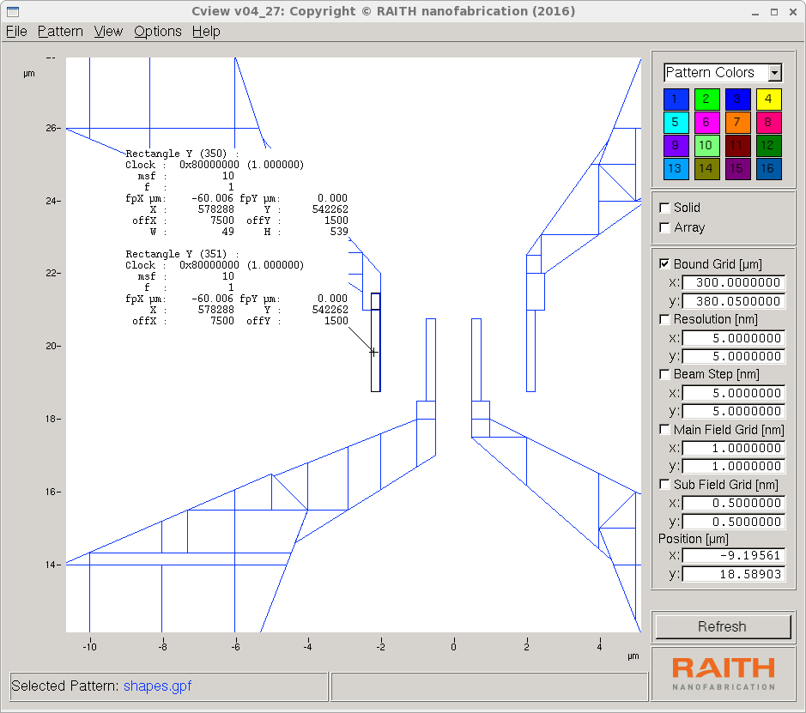
Finding overlaps with cview
It can be very difficult to see pattern overlaps, especially if you have accidentally placed two copies of a cell in one place, or if you have created an array with a pitch of zero.
Often such problems are not found until you look at the pattern in resist, and say “what happened?!”
That’s when you can look at the gpf pattern with “cview,” which is one of the only ways to find overlaps. By hovering the cursor over the pattern and pressing the “Ctrl” key, you will get a report on all the shapes under the cursor.
Two shapes are under the cursor

Slide 18
Summary: Watch out for these stupid mistakes
Using too many vertices to define the unit cell of an array
Using a design grid which is not a multiple of the beam step (unless you have a good reason)
Setting the beam step below 5nm to decrease roughness
Choosing the wrong type of resist. Use positive to make holes, negative to make posts.
Including sloppy or accidental overlaps

Slide 19
The End
Now you should proceed to the quiz.

