Slide 1
A tutorial for the CAD program LayoutEditor
LayoutEditor is available from
www.layouteditor.net
by Jürgen Thies, Juspertor UG, Munich
M. Rooks, Yale University

Slide 2
Common terminology
Layers designate processing steps
Cells are parts, or parts of parts
Top-level cell contains the whole enchilada

Slide 3
Typical example
Side view Top view
CELL “TRANSISTOR”
Si
SiO₂
Fill/isolation oxide LAYER 2
Gate oxide LAYER 3
Gate polysilicon LAYER 4
Implant dopants LAYER 5
Metal wiring LAYER 6

Slide 4
Your design should be a hierarchy of cells
adder
half-adder
and or not
transistor-n transistor-p
Each cell may contain shapes on many layers, describing how to build separate devices.
To produce one mask plate for one processing step,
we pull out one LAYER.
Get it? Cells = devices or parts
Layers = processing steps

Slide 5
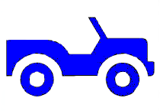
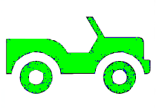
A lot of people don’t understand this, so pay attention:
cell “car”
CAD cells are parts of the final device
cell “b”
The cells are contained inside higher level cells.
cell “w”
cell “w”
Inside each cell are found layers which represent steps in the manufacturing process.

Slide 6
To build the device, the cells are “flattened” to remove hierarchy, then the layers are extracted into separate files.
But not until later, and not with the CAD program.
There is a separate program for flattening and extracting layers, and then fracturing the shapes into simple forms that can be printed with the e-beam system.

Slide 7
Remember this:
The top-level cell should look just like the final device.
e.g., alignment marks do not go into a separate FILE they go on a separate LAYER. Do not make this typical, stupid mistake.

Slide 8
Now let’s get started with the CAD program Layout.

Slide 9
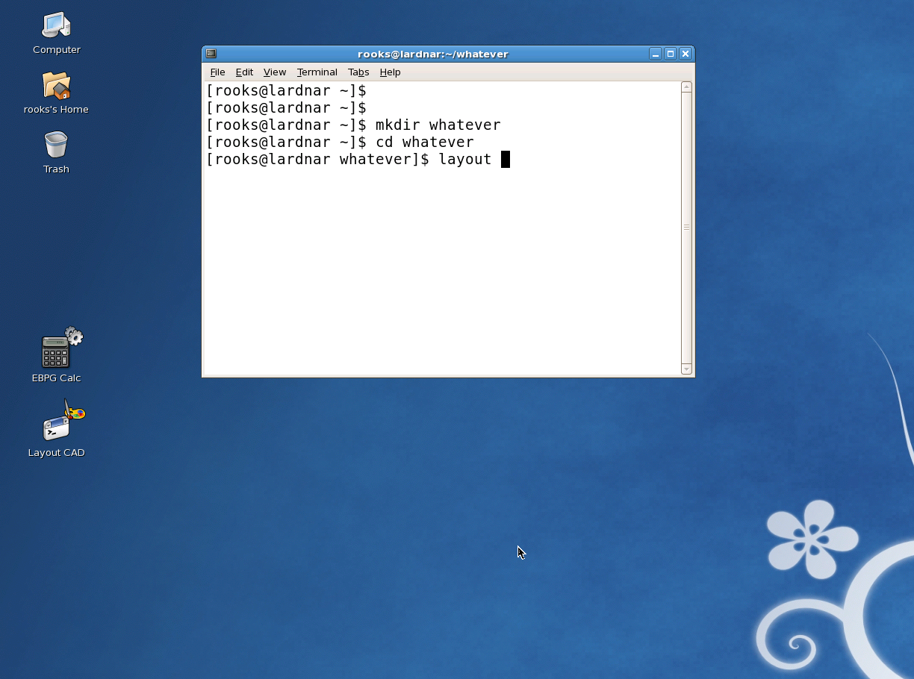
Log into the Linux server and open a terminal window (try the right-click menu).
Use “mkdir” to create a directory for your project,
then use “cd” to make this the default directory.
Type “layout” to fire up the CAD program.

Slide 10
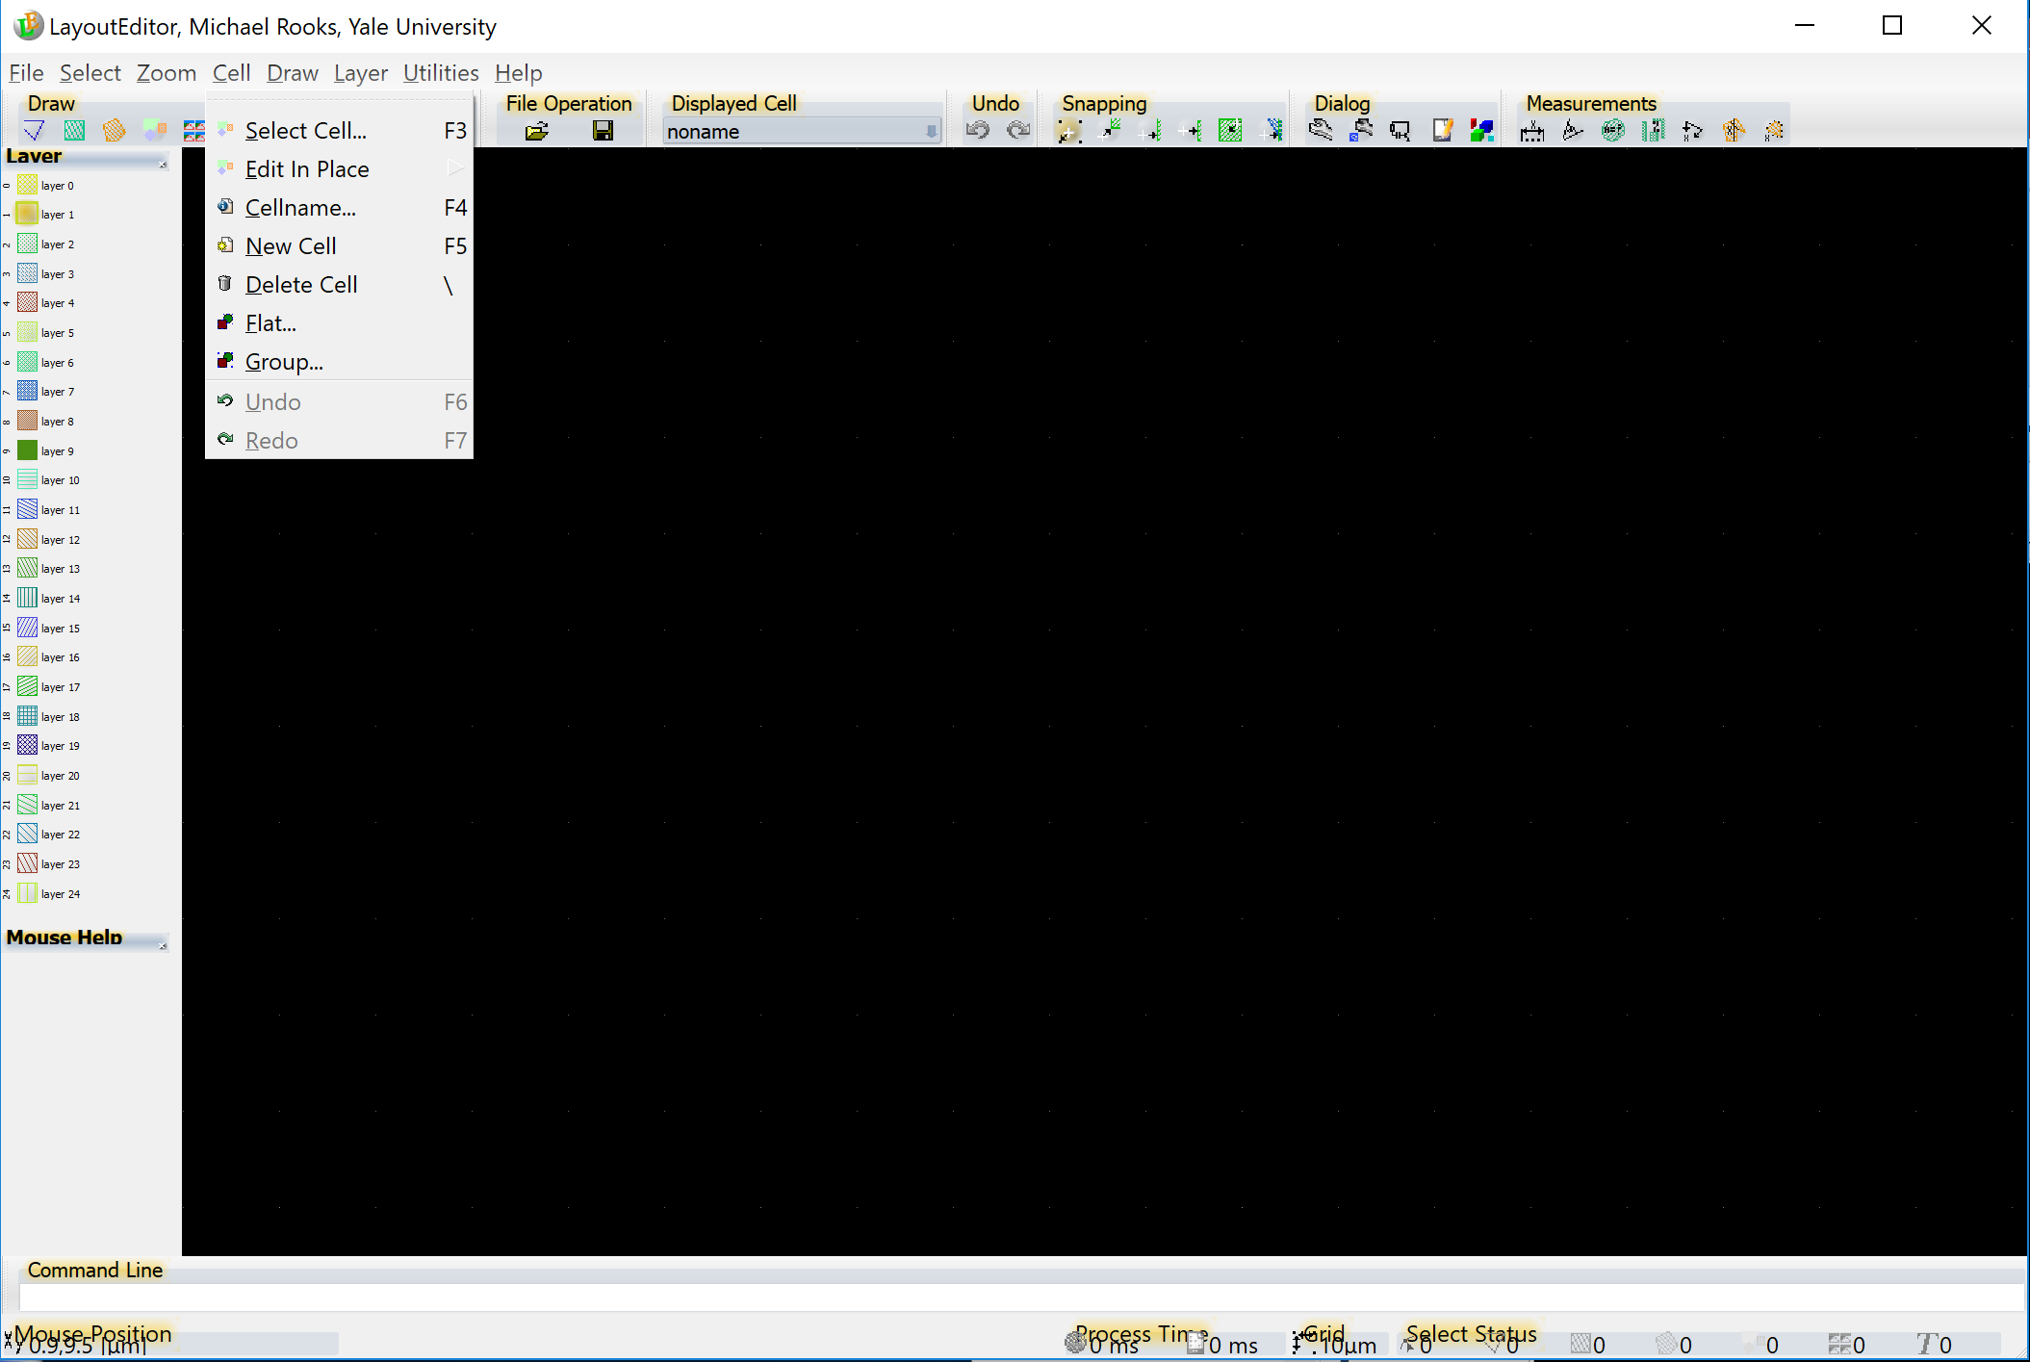
New Cell
Right click here and turn on the ‘measurement’ menu
Create a new cell with the menu Cell → New Cell (or F5)
then give this cell a name with Cell → Cellname (or F4) Let’s call it “foo”.
Well yes, it still says “noname” under “Displayed Cell” because I forgot to actually change the name.

Slide 11
Click on a layer to make it the default

Slide 12
Zoom → Set Grid
or just type ‘g’

Slide 13
Click on the
measurement icon
to display coordinates
in lower-left of screen

Slide 14
Polygon mode

Slide 15
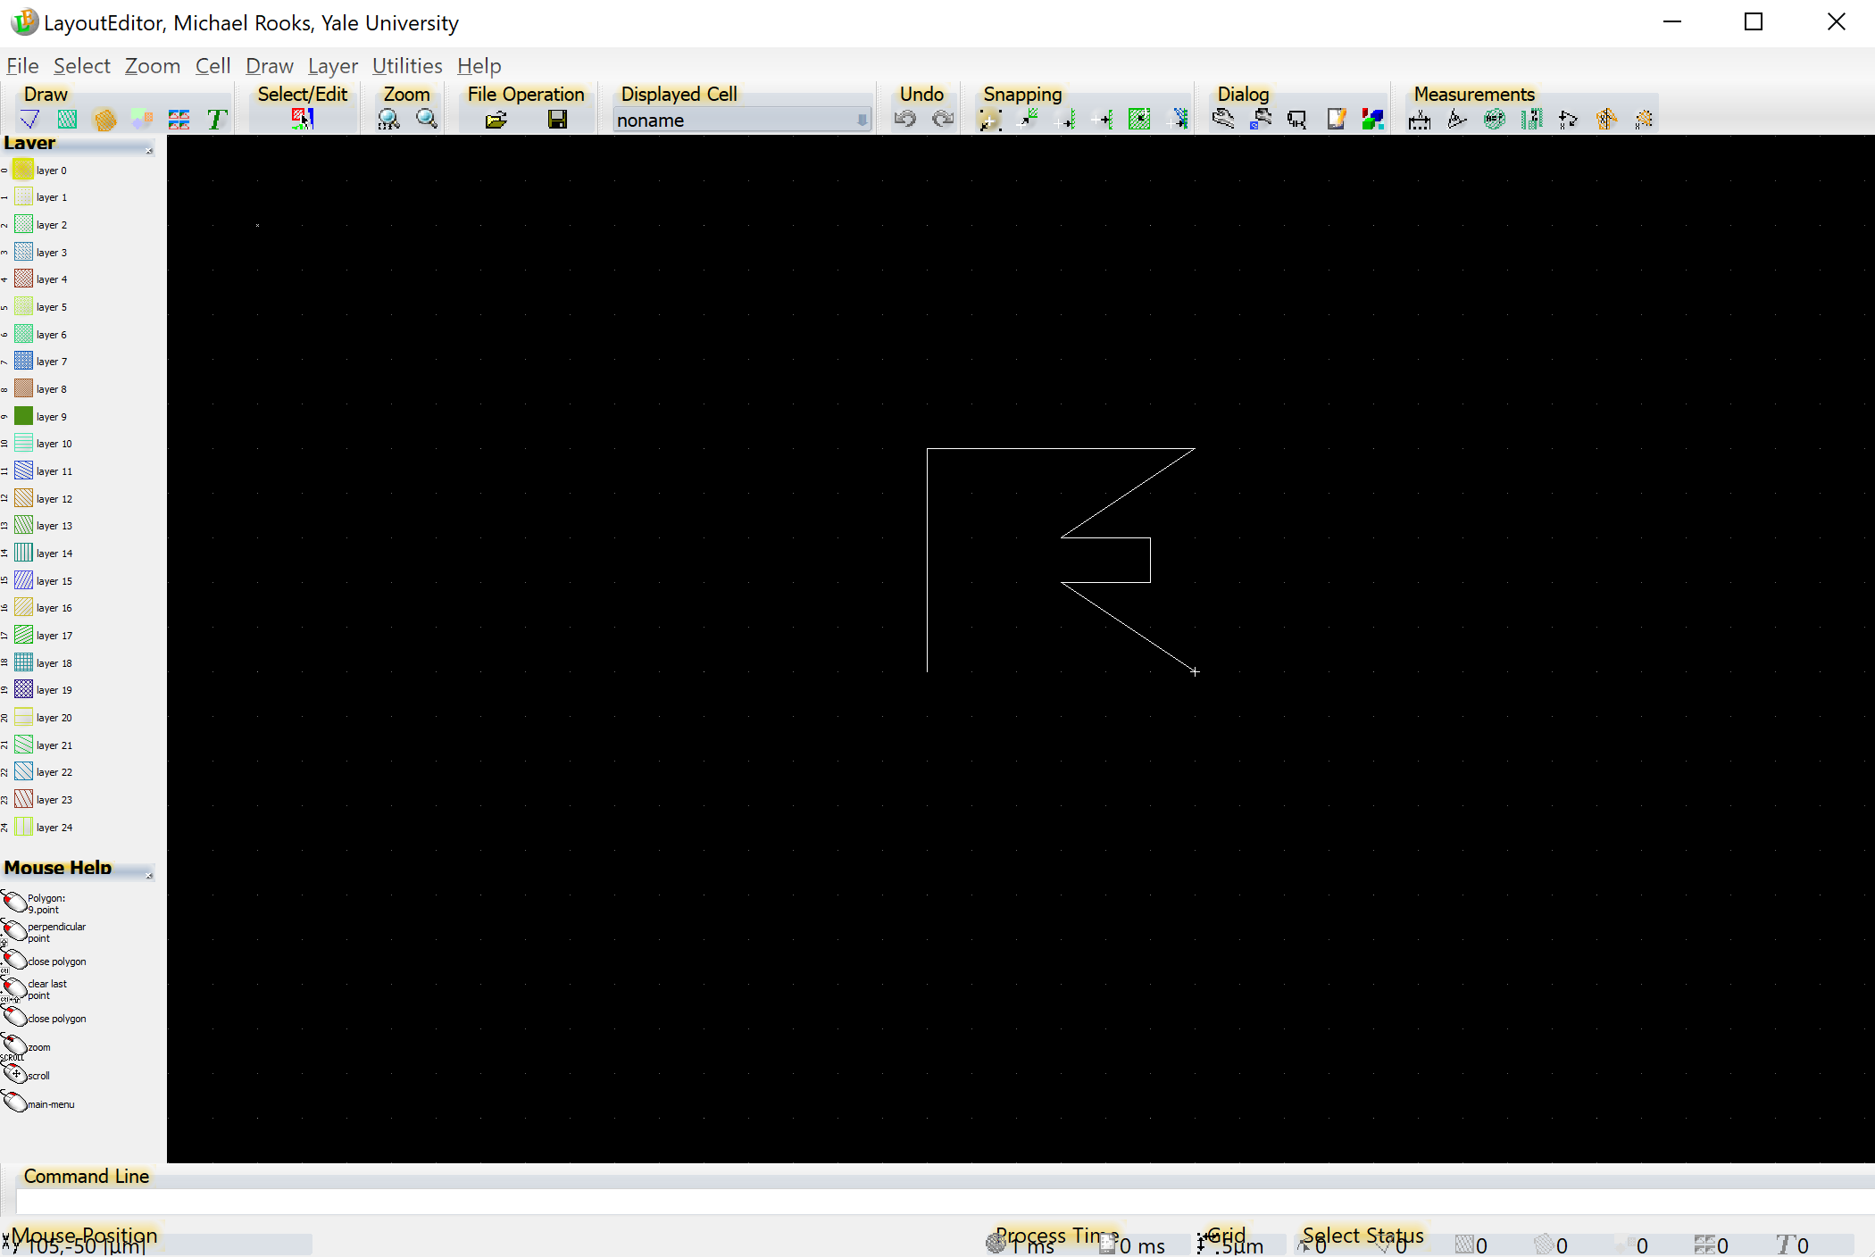
Start clicking to draw a polygon
Use the mouse wheel to zoom in & out.
Use the right mouse button (and drag) to pan.

Slide 16
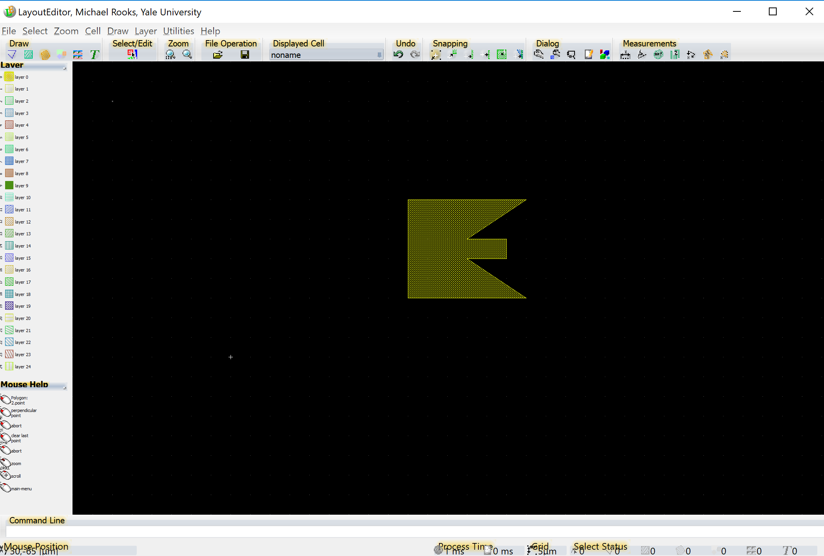
Close the polygon with middle-click.
That is, push down on the wheel.

Slide 17
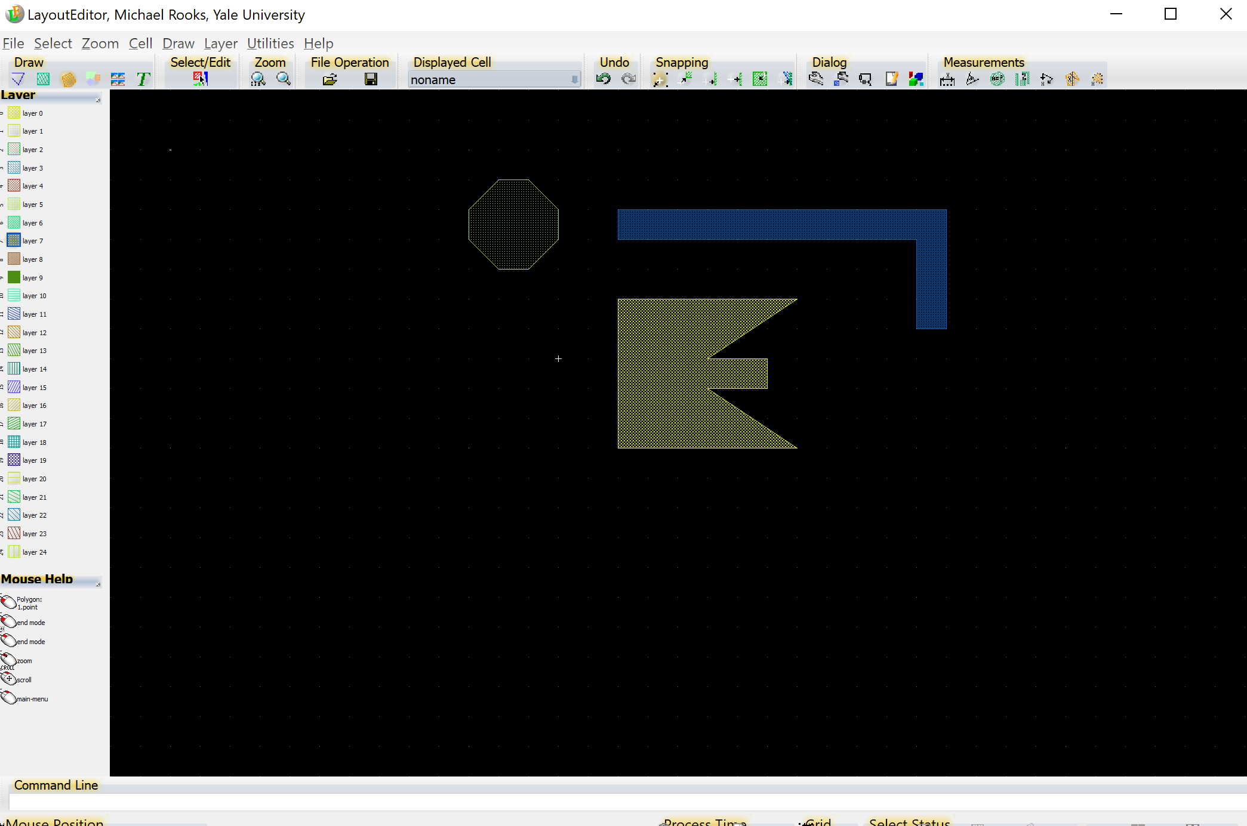
Add a few more shapes
on a few more layers, just for fun.
Suppose we need to assign a different dose
to one of these shapes. The traditional way
is to assign a different “datatype” to the shape.
Later, we can map that datatype onto a dose.

Slide 18
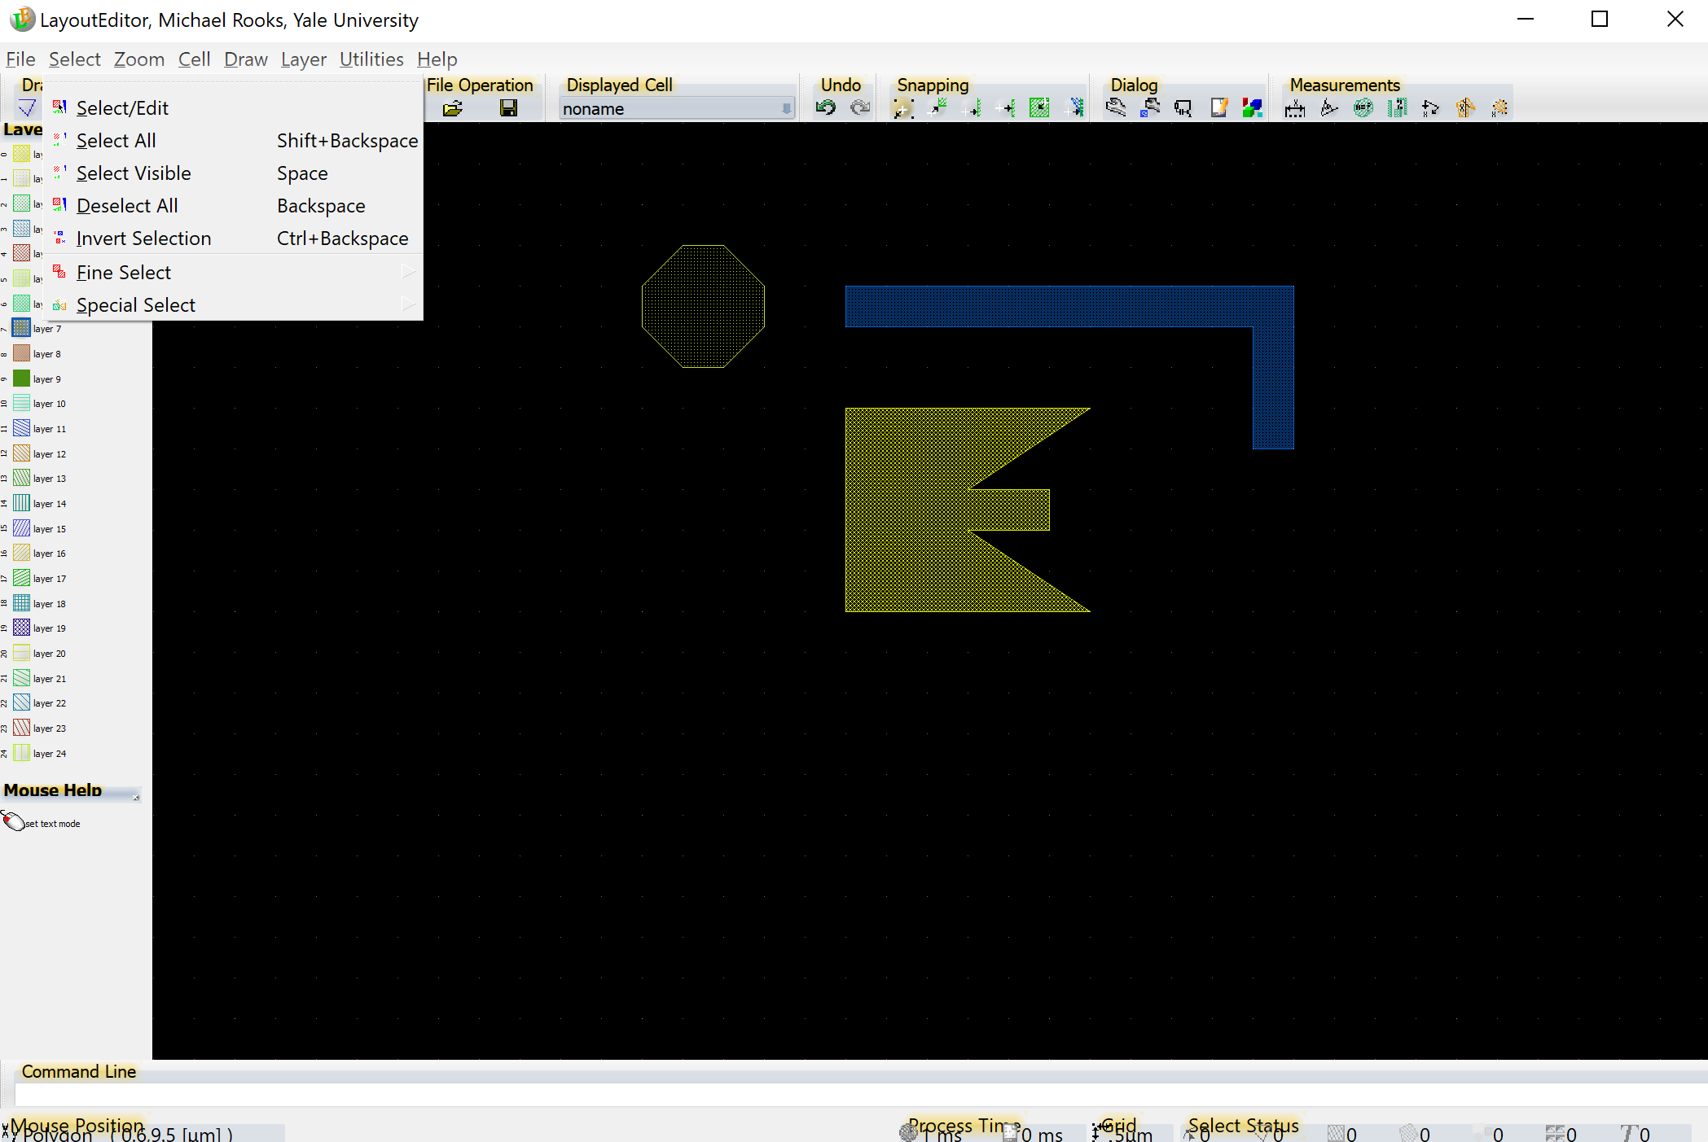
Select/Edit (or Home key)

Slide 19
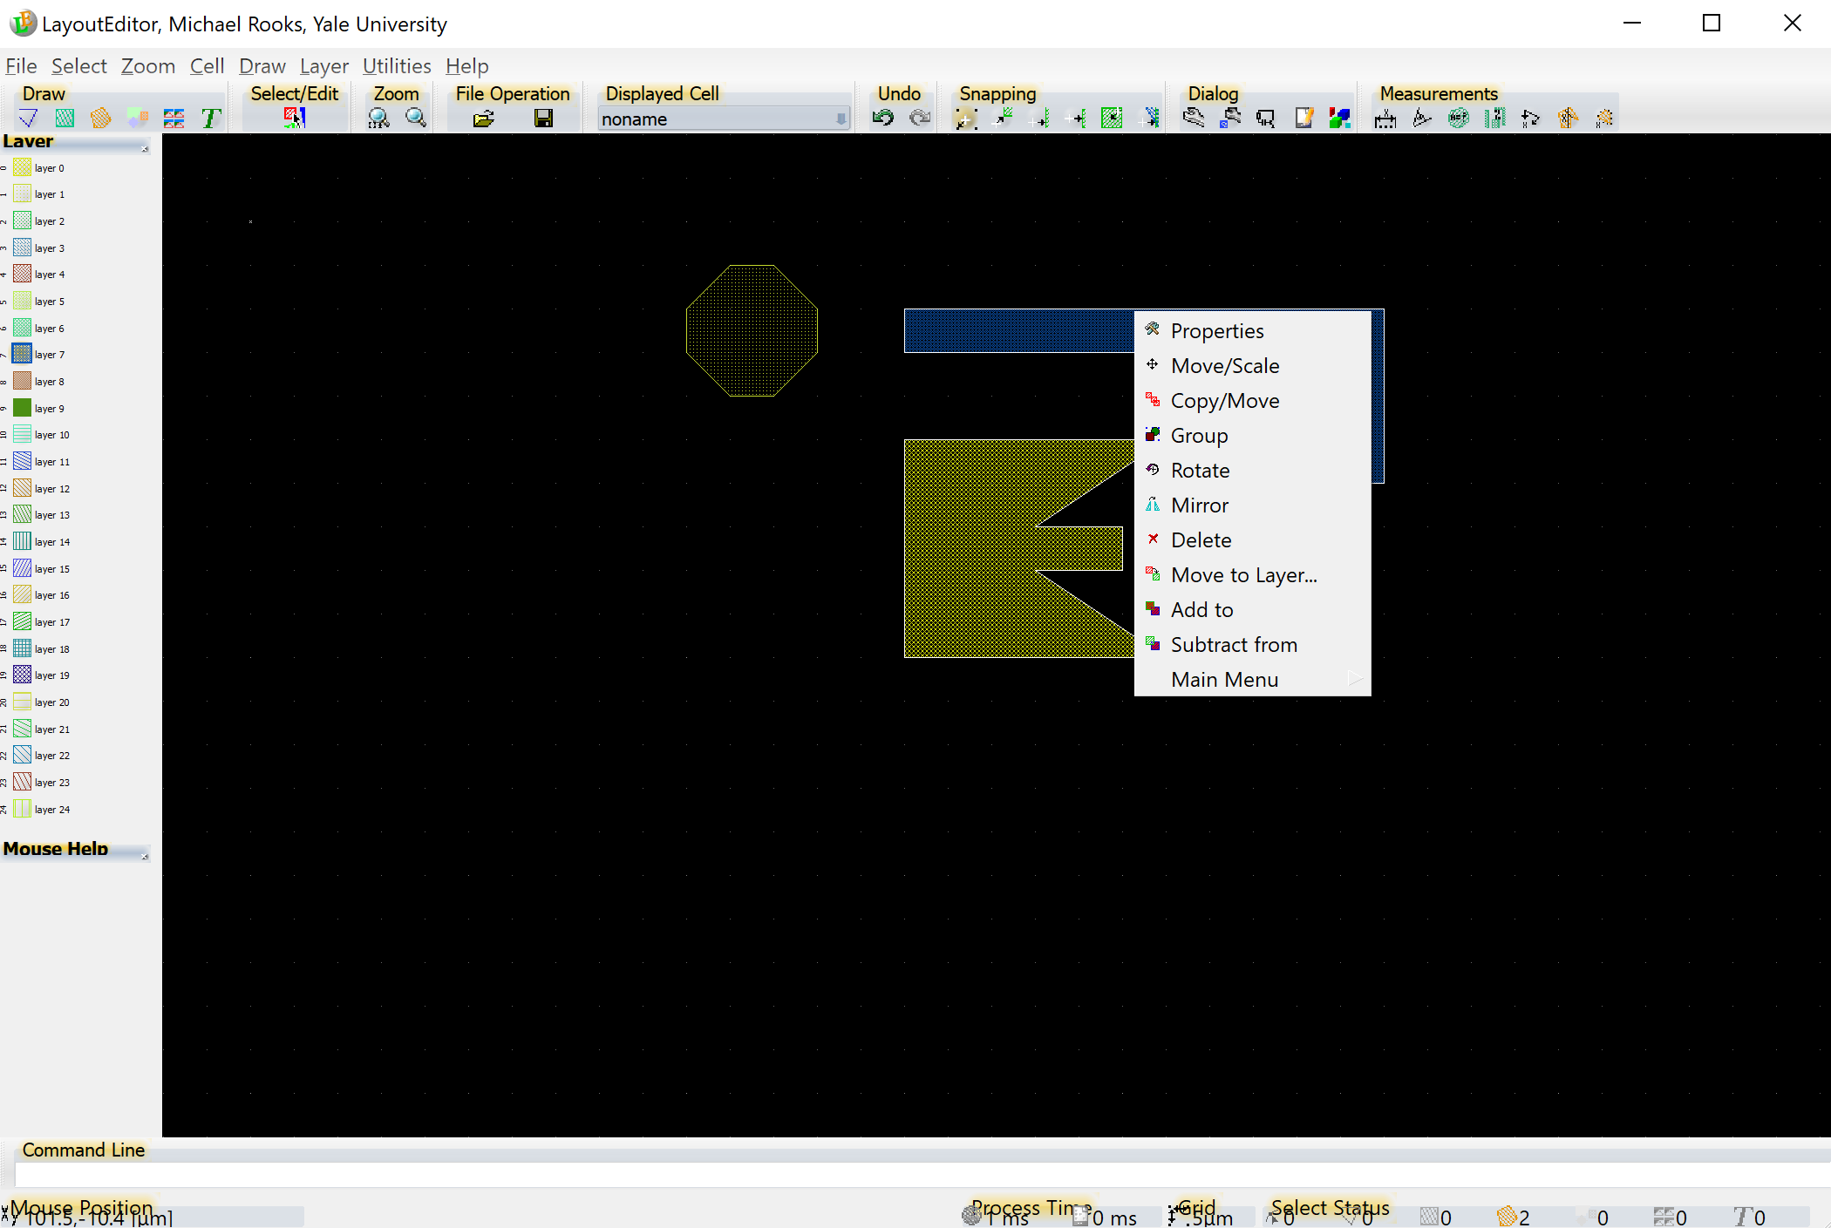
Click on a shape to select it, then right-click to choose Properties

Slide 20
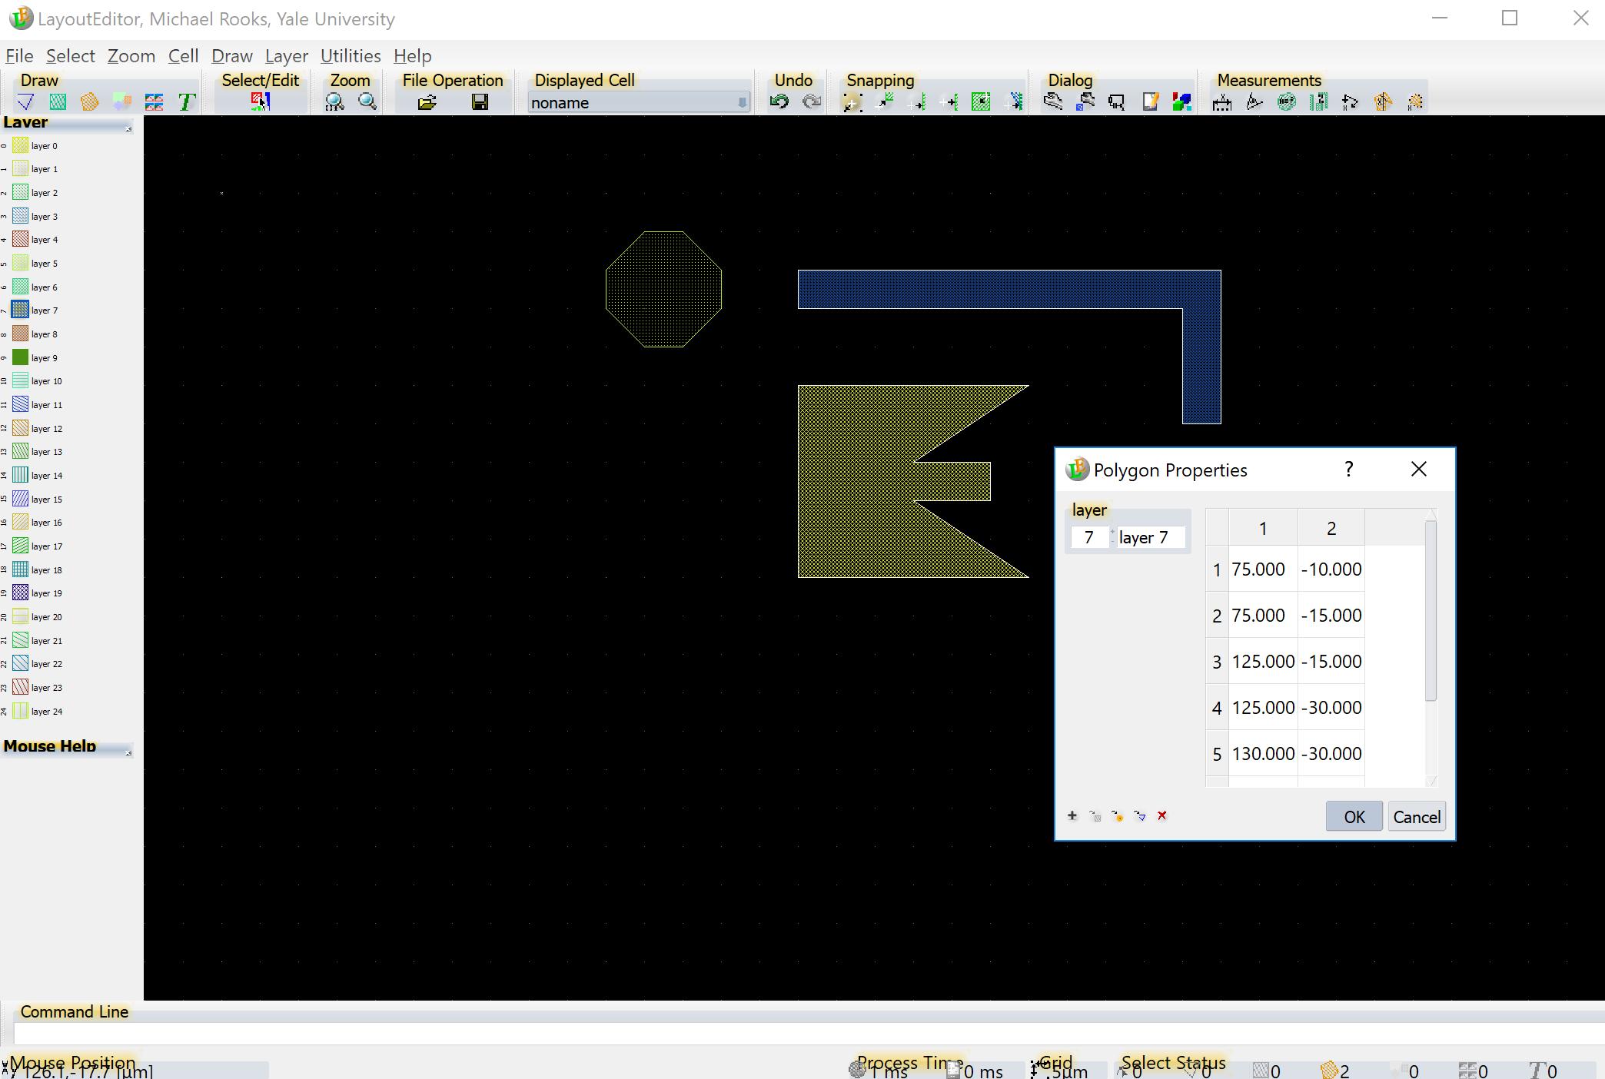
Datatype is hidden until you click on +

Slide 21
Now change the datatype from
the default value of 0 to some other value, such as 1.
Datatypes can be displayed in color using Cview or Beamer (the pattern conversion program)
Beamer can assign different relative doses to different datatypes.

Slide 22
Setting datatype numbers is the traditional way of assigning different doses inside a pattern, but you can also use Beamer to assign doses to layers.
Using layers for doses works fine, if you do not need to use layers to represent processing steps or mask plates.

Slide 23
Now use the Backspace key to clear all selections.

Slide 24
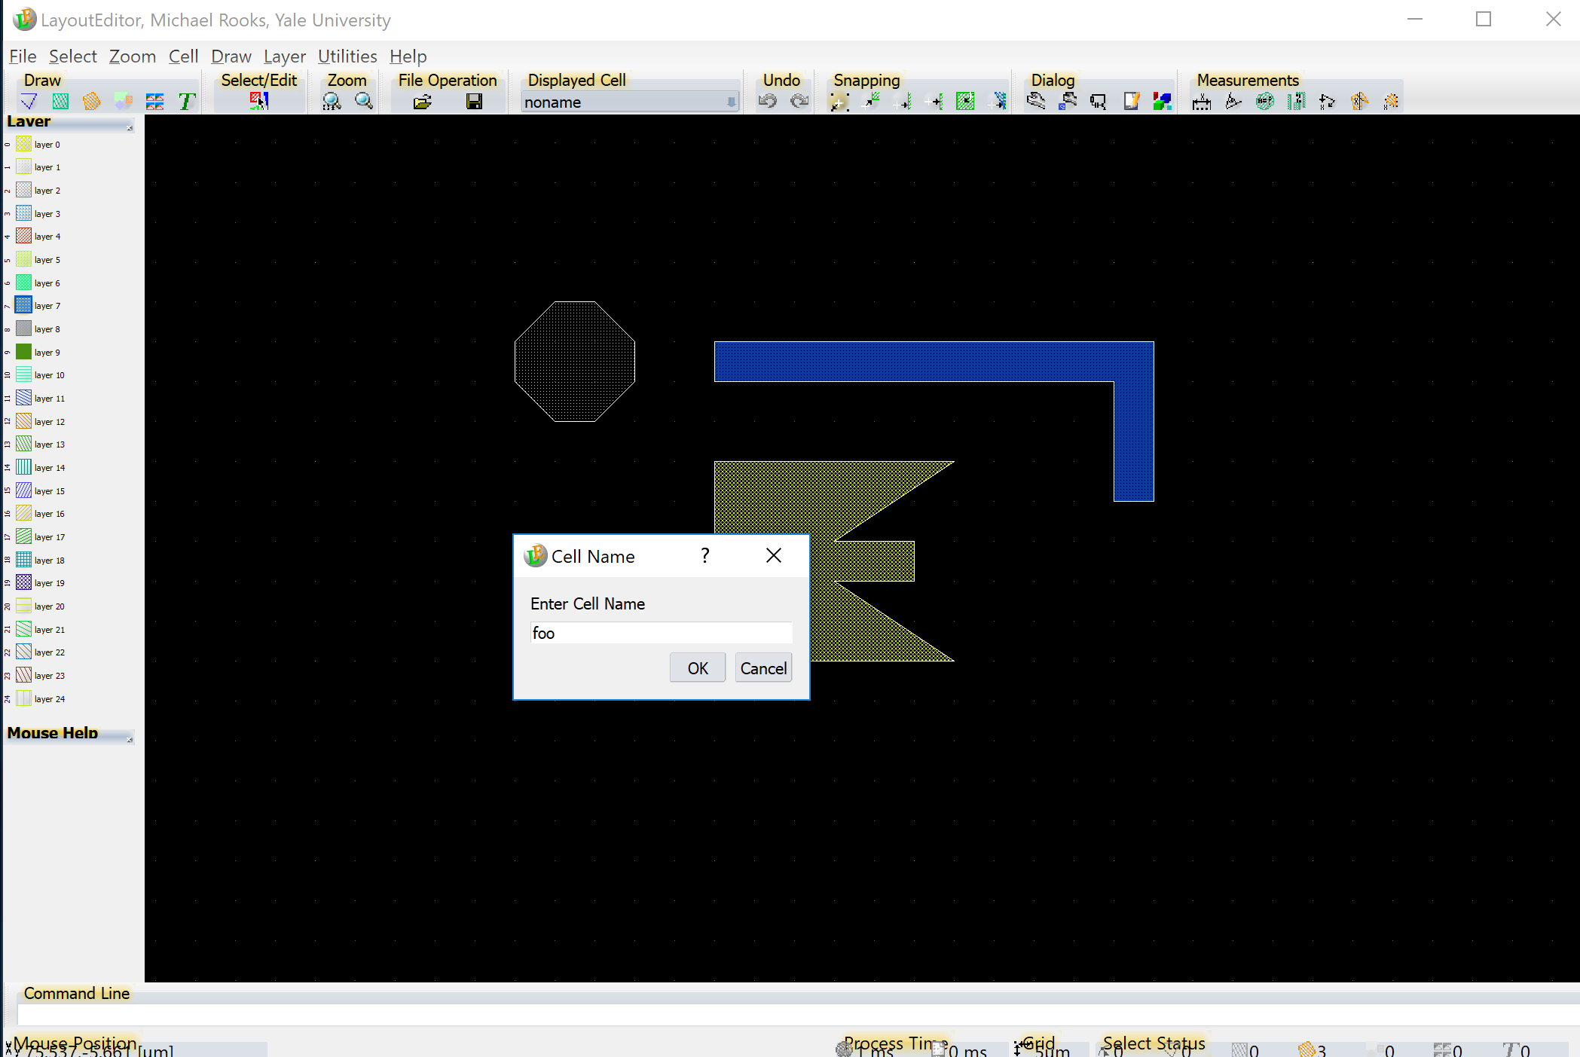
Let’s save the cell. Oh oops! We forgot to change the name. Just press F4 to name this cell “foo”.

Slide 25
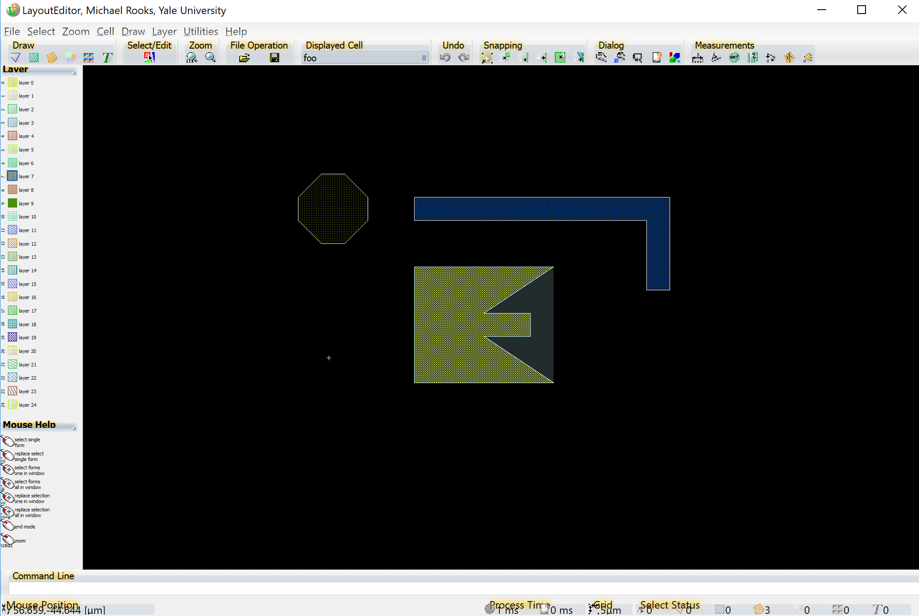
File → Save the file in GDS format.
DXF format is bad.
Do not use it.
CIF is not so hot either,
but is sometimes useful
for algorithmically-generated
shapes.

Slide 26
Let’s create a new cell called “bar”,
and then place the cell “foo” inside it,
at a few different locations.
Use F5 to create a new cell, then F4 to name it ‘bar’.

Slide 27
Use the ‘cell’ button to insert a cell into ‘bar’.
So far there is only one other cell (foo) and so we will not be presented with a choice.

Slide 28
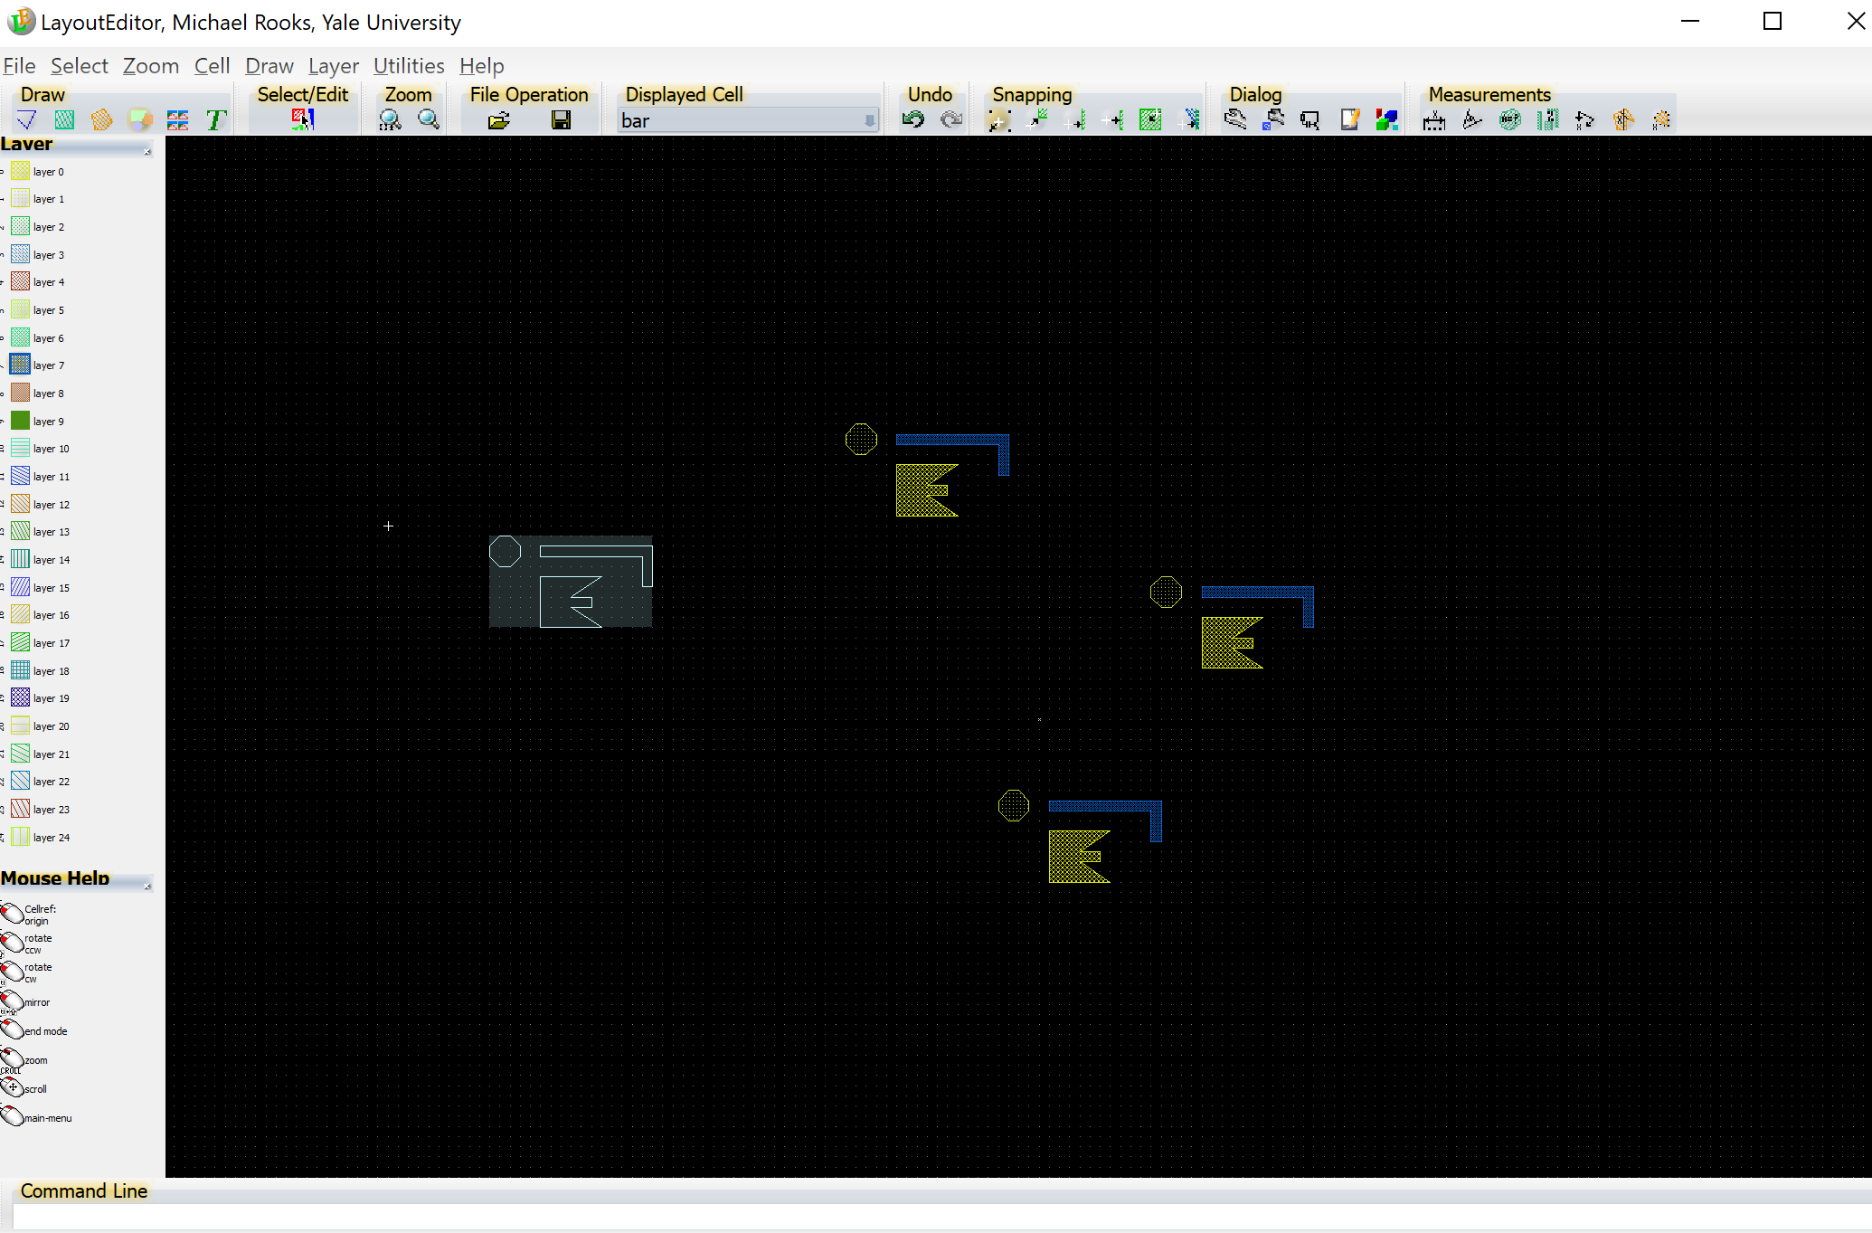
Click
The cursor
now looks
like the cell
“foo”.
Click
Click

Slide 29
Now let’s create an ARRAY of the cell “foo”.
First use F5 to create a new cell, then use F4 to name it ‘foobar’

Slide 30
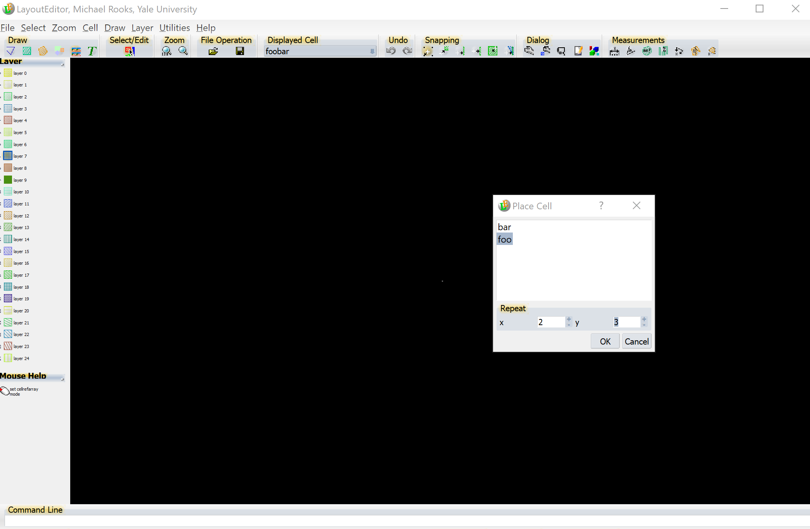
Cell Array
Click on “cell array” at the upper-left. A dialog box pops up, asking you
to choose a cell and to choose the number of rows and columns.

Slide 31
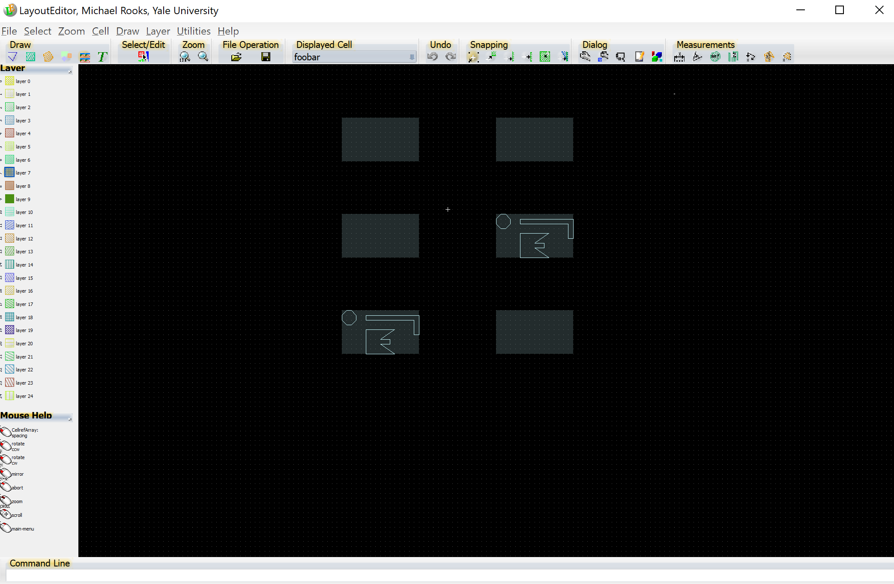
Click to place the lower-left corner, then move the cursor by ΔX,ΔY.
The shape of the array is displayed as you move the cursor.
Click again to create the array.

Slide 32
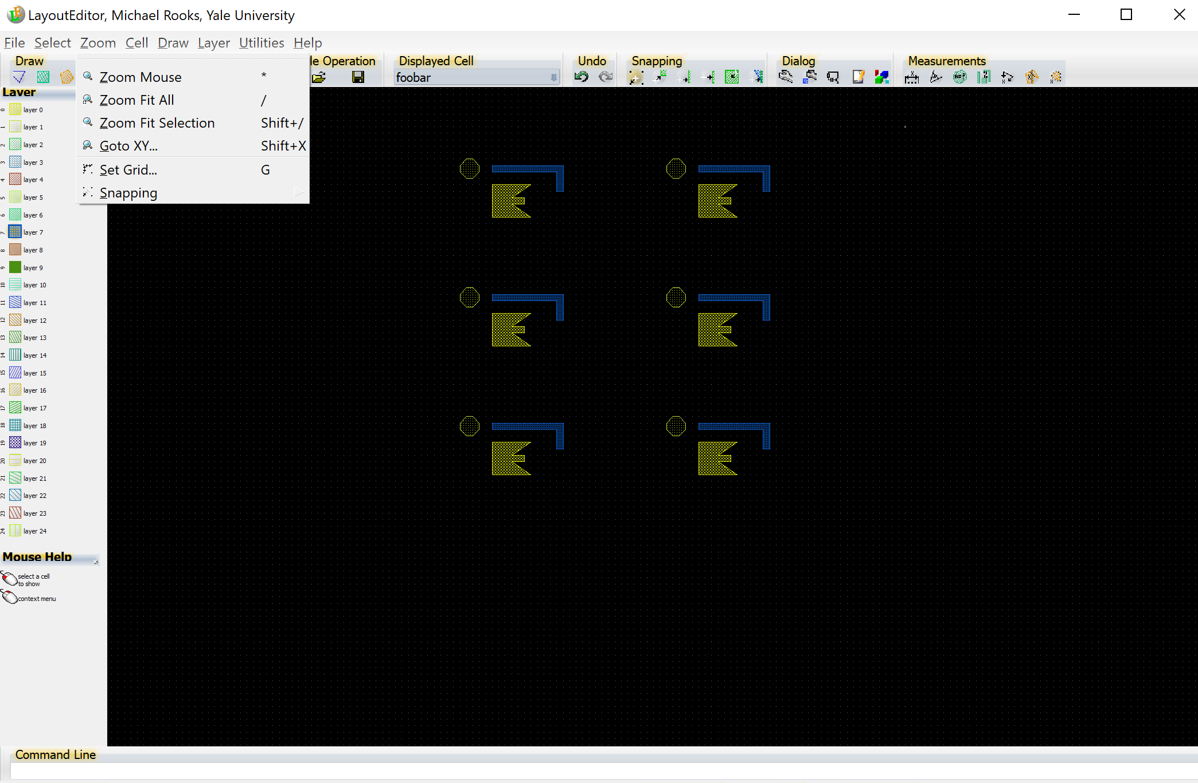
You’ll probably want to display everything
using Zoom Fit All… or just type ‘/’.

Slide 33
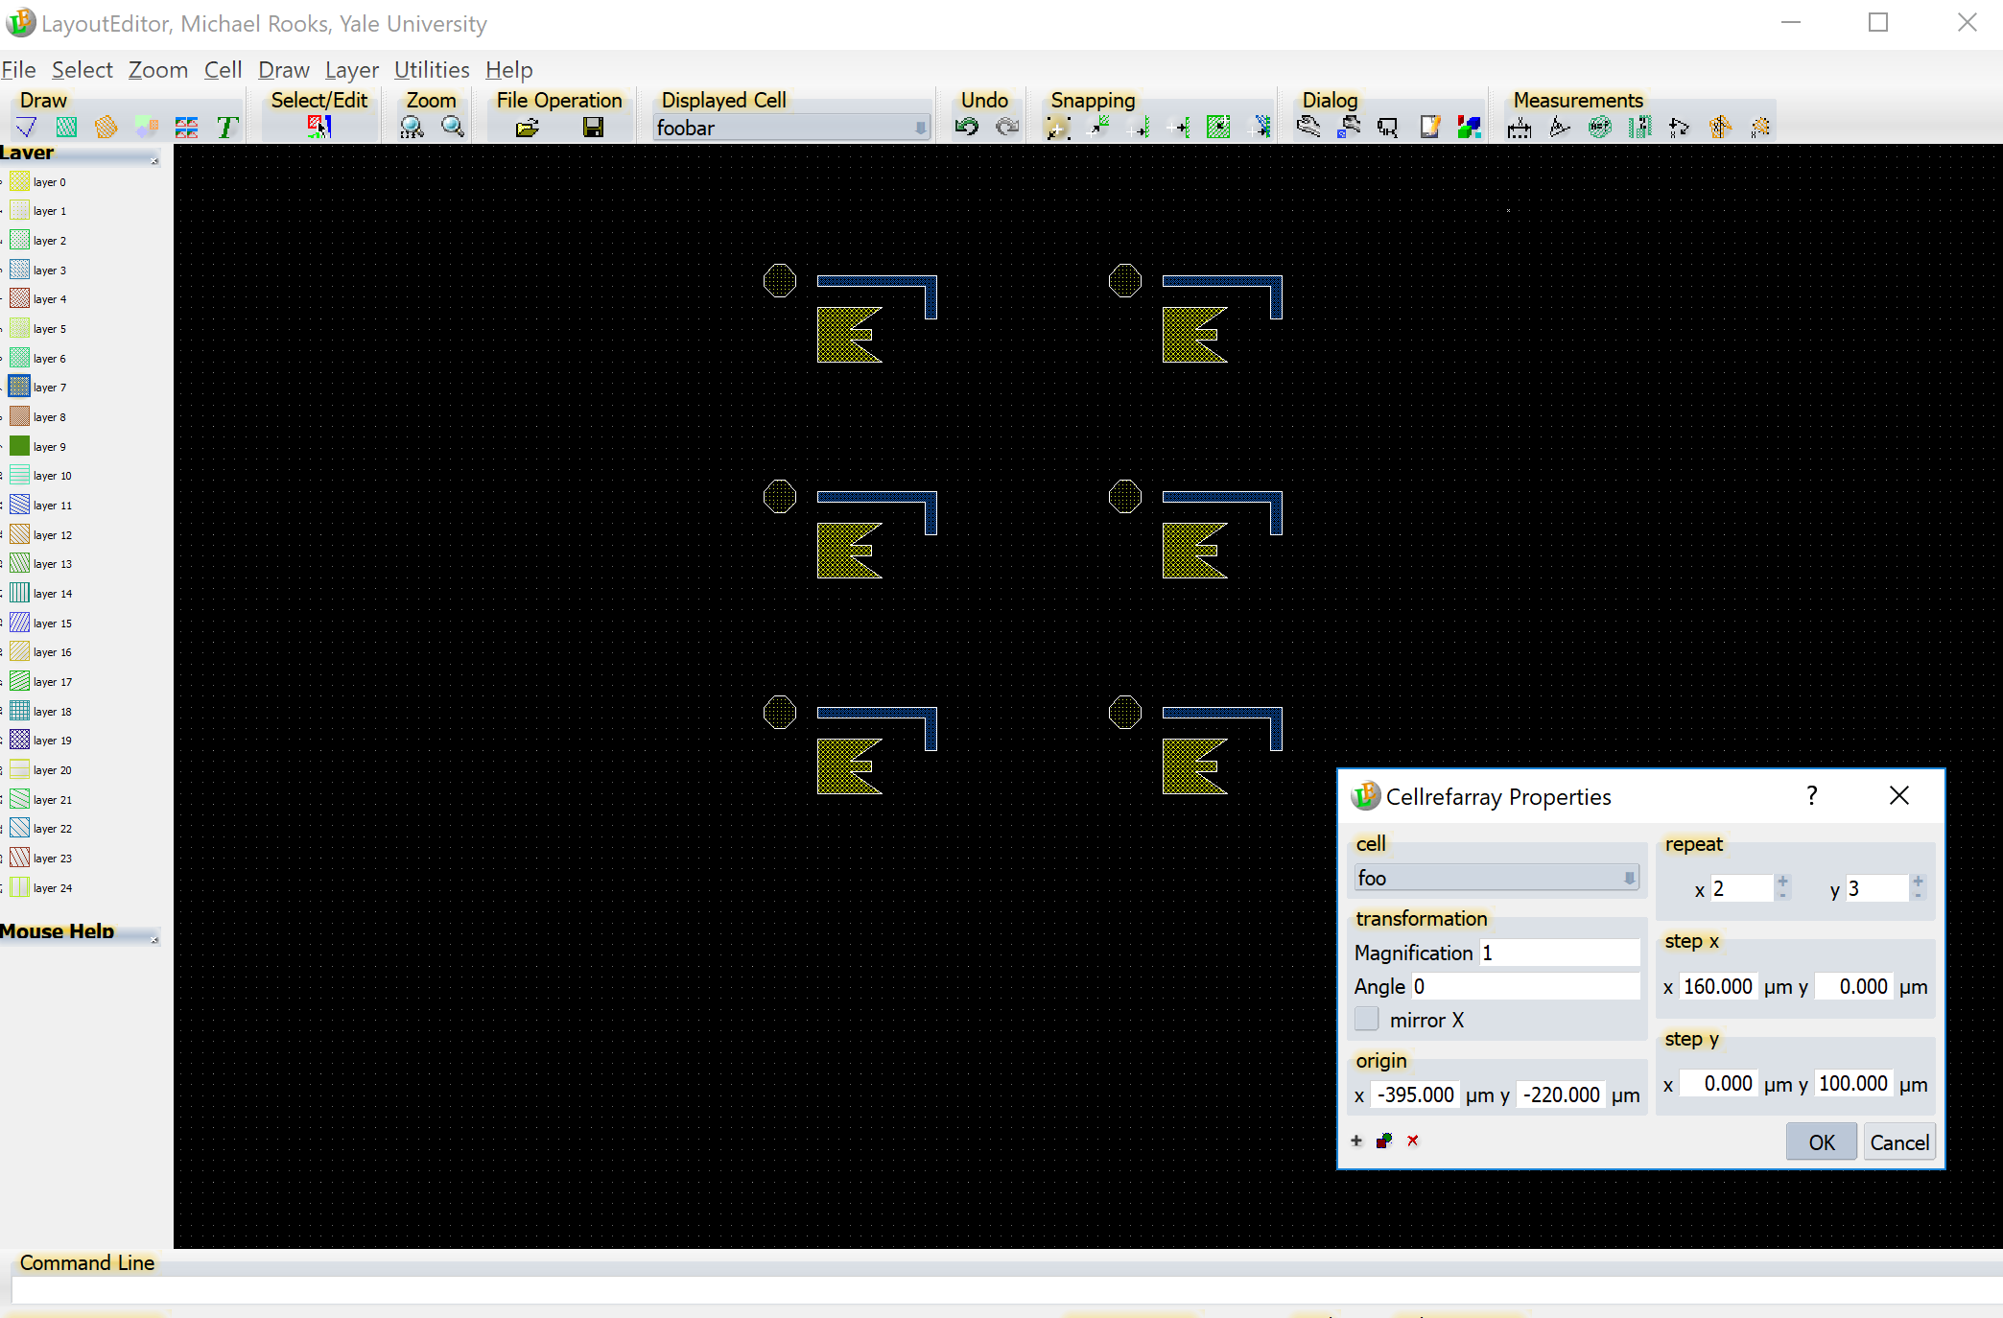
If the array does not come out right, do not despair.
Use Select → Select/Edit (or Page Up) to select the array, and then right click to select Properties. You can change the spacing to whatever you really wanted.

Slide 34
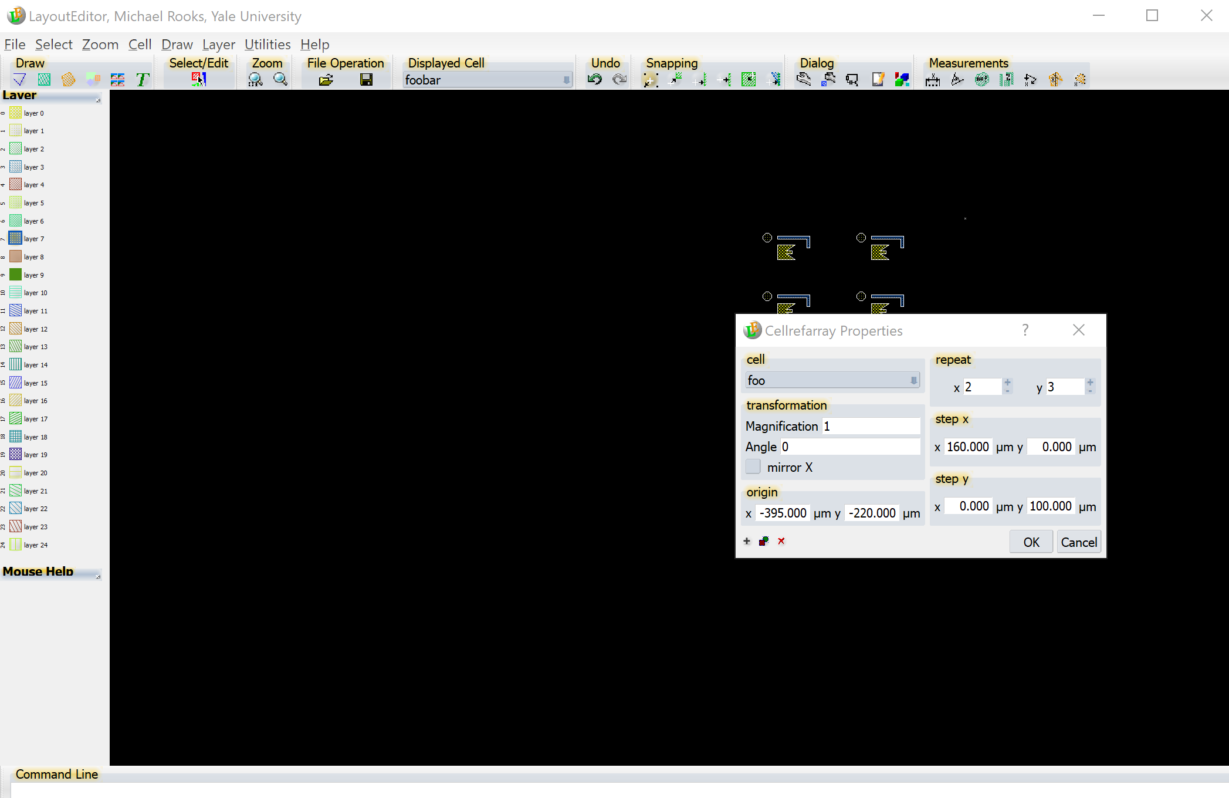
BUT FIRST, A WARNING ABOUT A BUG IN LAYOUT
Note that you can also change the magnification and angle of the array. Unfortunately, Layout has a bug which creates invalid GDS format if you do that.
DO NOT CHANGE MAGNIFICATION OR ANGLE HERE.
Instead, you can change the magnification and angle of a cell reference, then use that cell as the element of an array. No problem!
This bug will show up as a fault in BEAMER, causing distorted or missing patterns. If you run into this bug (because of some else’s dopey design) then you can fix it with the utility “flatten”.

Slide 35
A REPETITIVE WARNING ABOUT A LAYOUT BUG
The CAD program "Layout" allows you to create rotated and scaled arrays, but the output GDS file is wrong. Beamer does not warn you about this problem, but instead will crash or spit out strange patterns. One easy solution is to use rotated (or scaled) cells as elements of arrays, instead of using the array's attributes. Another solution is to use the utility "flatten" to avoid these bugs. Simply run your_file.gds through flatten with flatten your_file.gds cell_name which creates the output file "flat.gds". If you use Layout to create arrays that are both scaled and rotated, then that is too crazy for flatten to fix just yet.
AND NOW WE RETURN TO THE TUTORIAL…

Slide 36
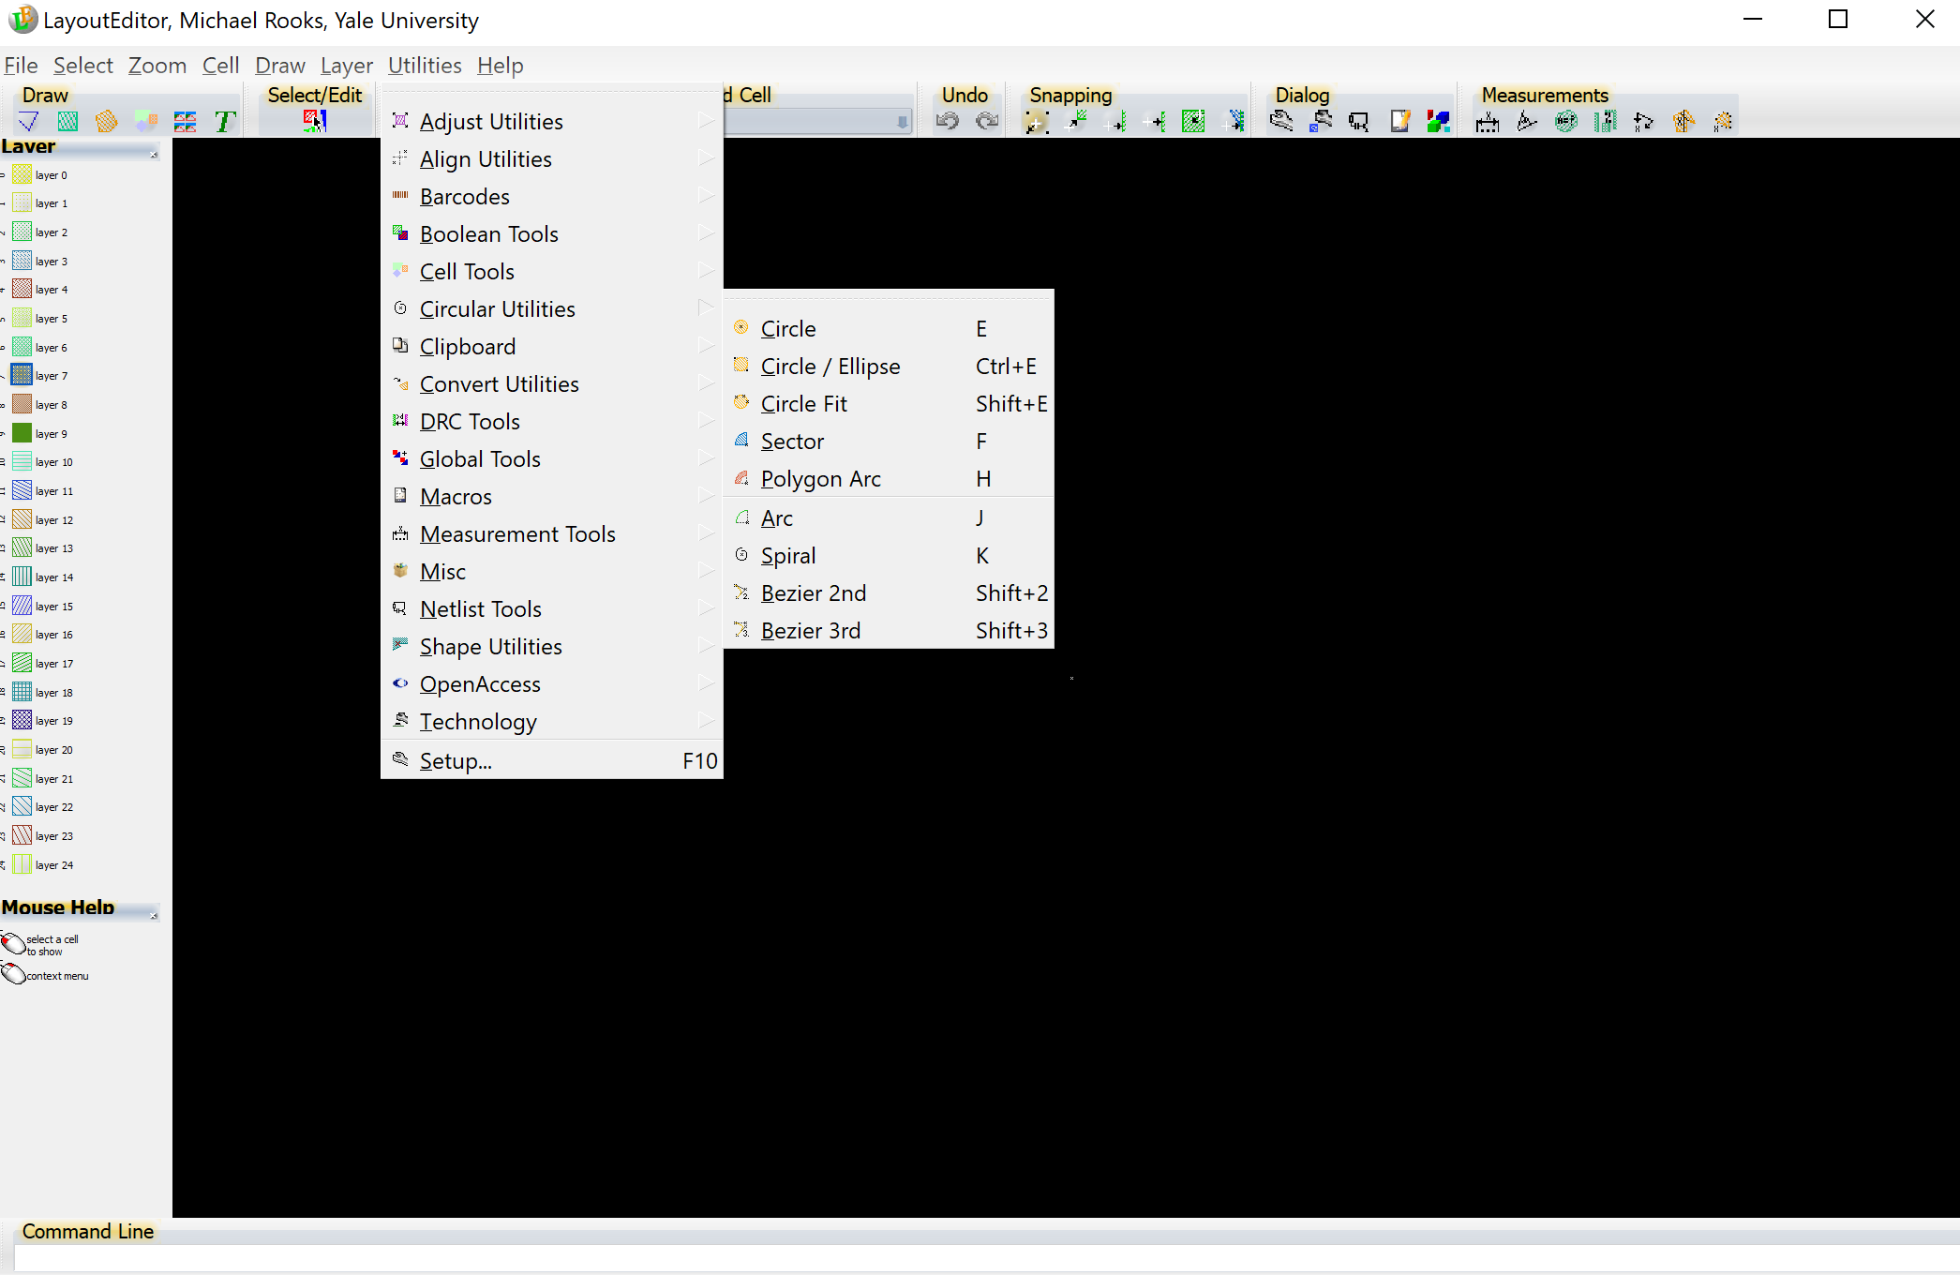
Let’s make a circle. Start with the usual F5, F4, “New Cell”, “Cell Name” sequence,
then select Utilities → Circular Utilities → Circle

Slide 37
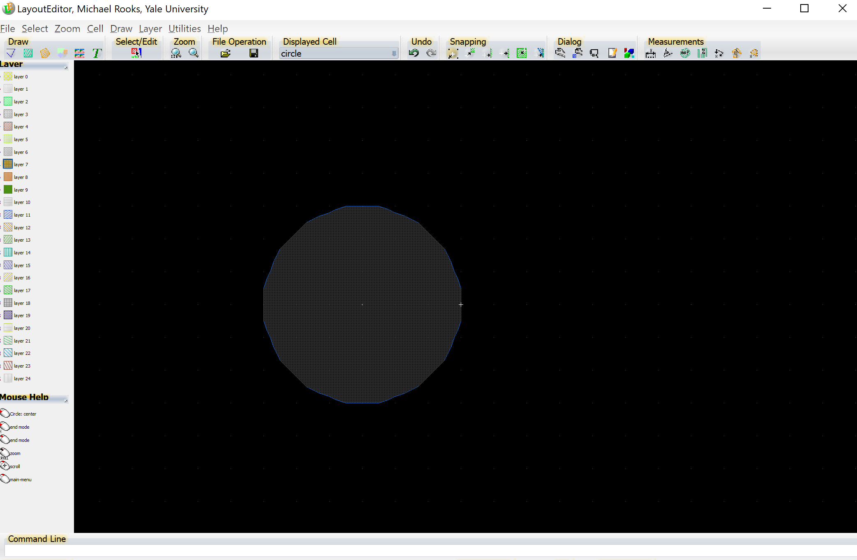
The grid (press ‘g’) is set to 10 nm. Zoom in with the wheel until you see the grid,
then click to set the circle’s center. Move the mouse and click to set
a radius of 30 nm.
The number of vertices is too large for such a small circle. More vertices
means more shapes, which leads to a lot of wasted settling time during exposure.

Slide 38
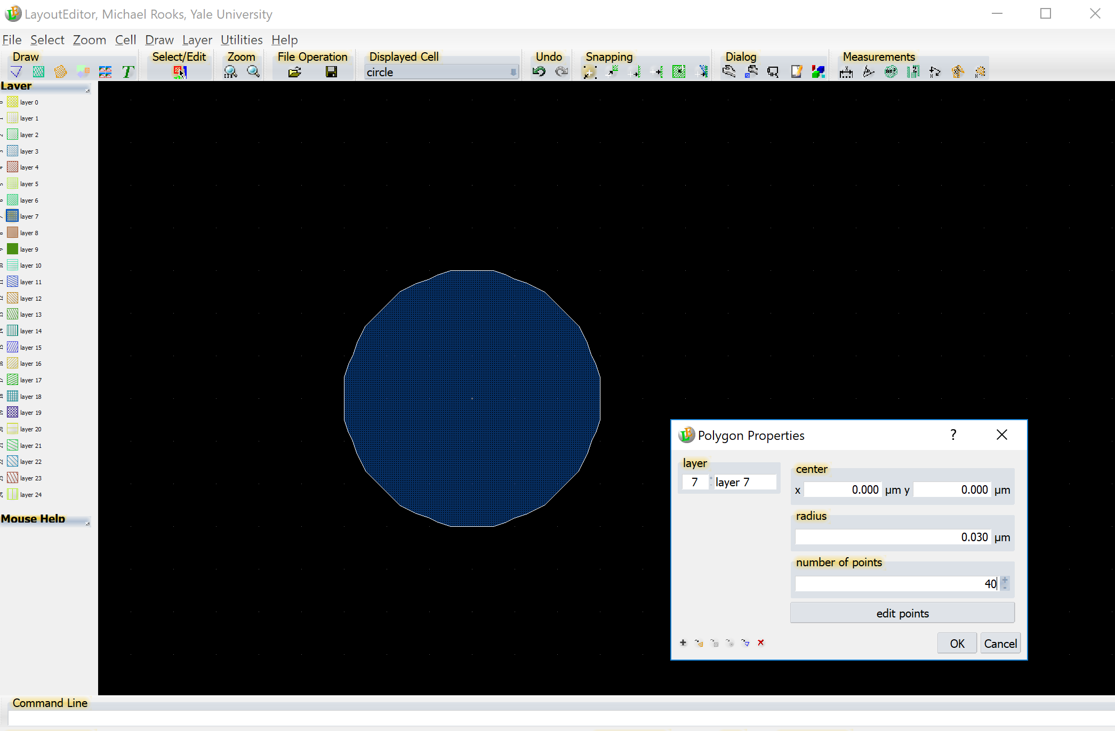
Press HOME for “form select”, click on the circle, then right-click
to select Properties. Here we can change the number of vertices to 8.

Slide 39
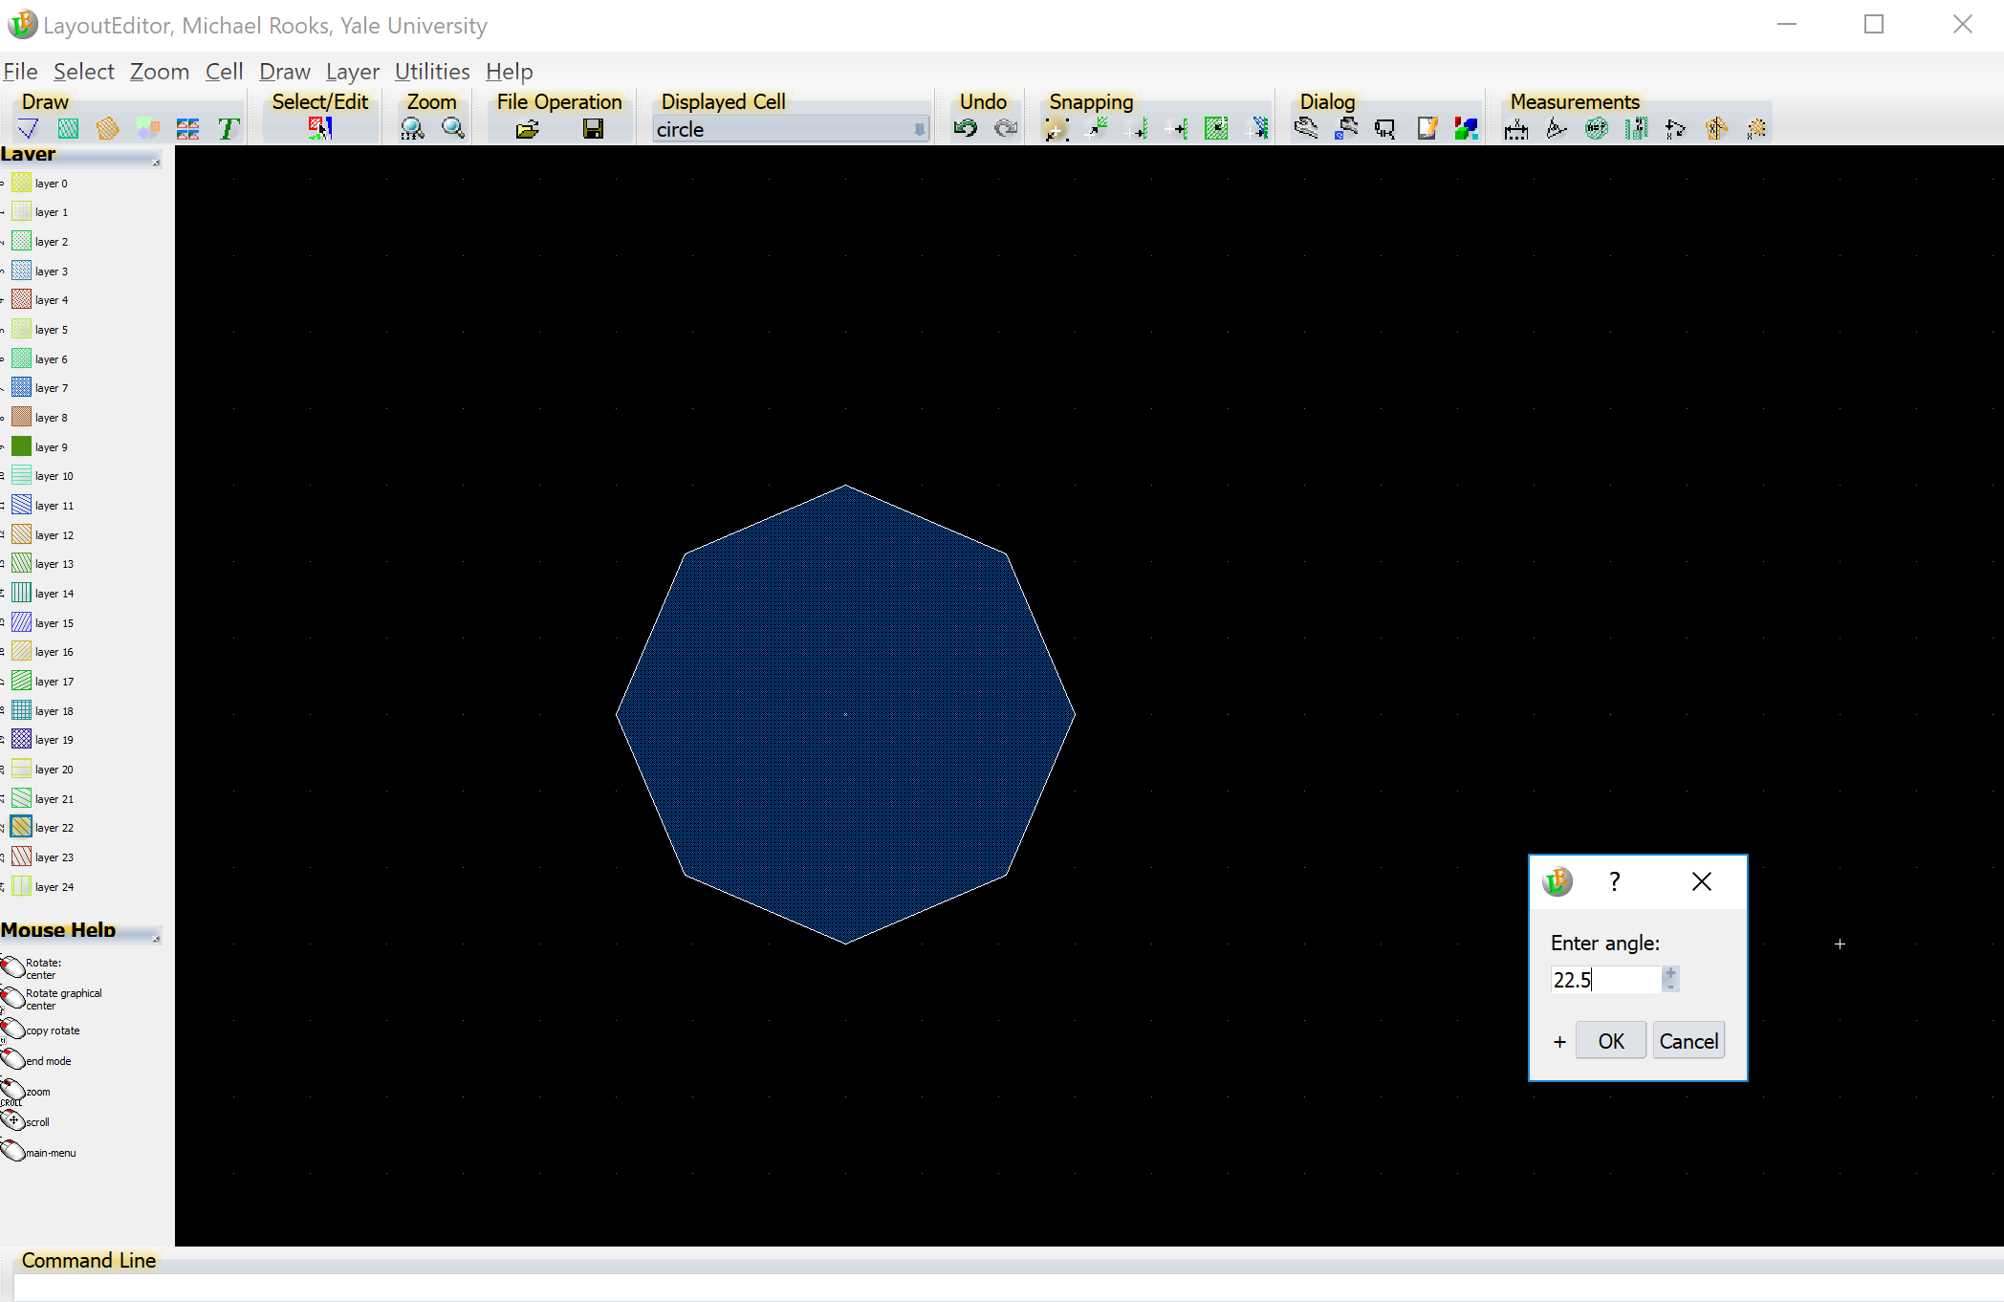
But this is not exactly what we want. Let’s rotate the octogon by 22.5°so that it looks like a “stop” sign. Use Draw → Rotate
Click on the shape’s center, then enter a rotation angle of 22.5

Slide 40
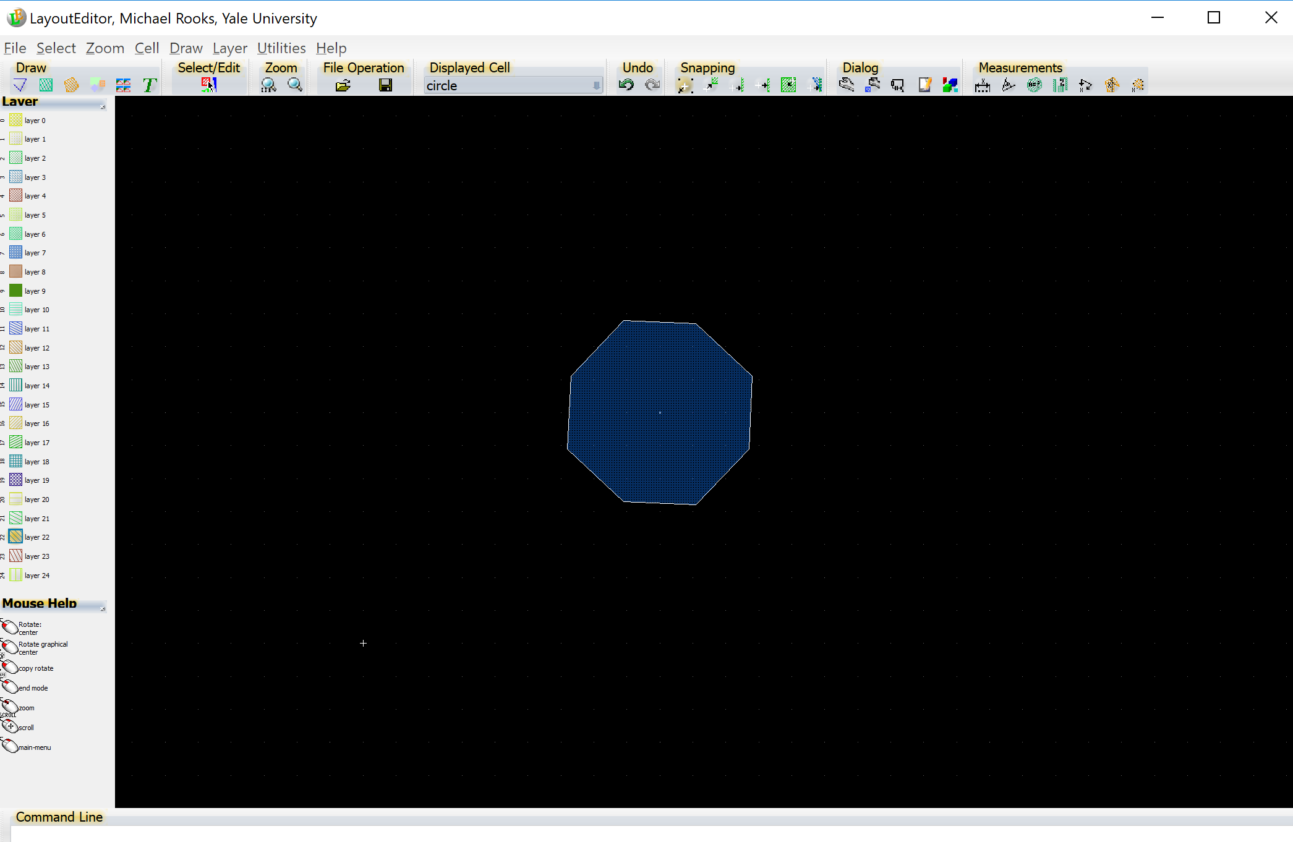
That doesn’t look right either. The vertices have snapped off the grid.
We can move the vertices manually to put them back on the desired
grid. Press ‘g’ for the grid menu, then switch to a 5 nm grid.

Slide 41
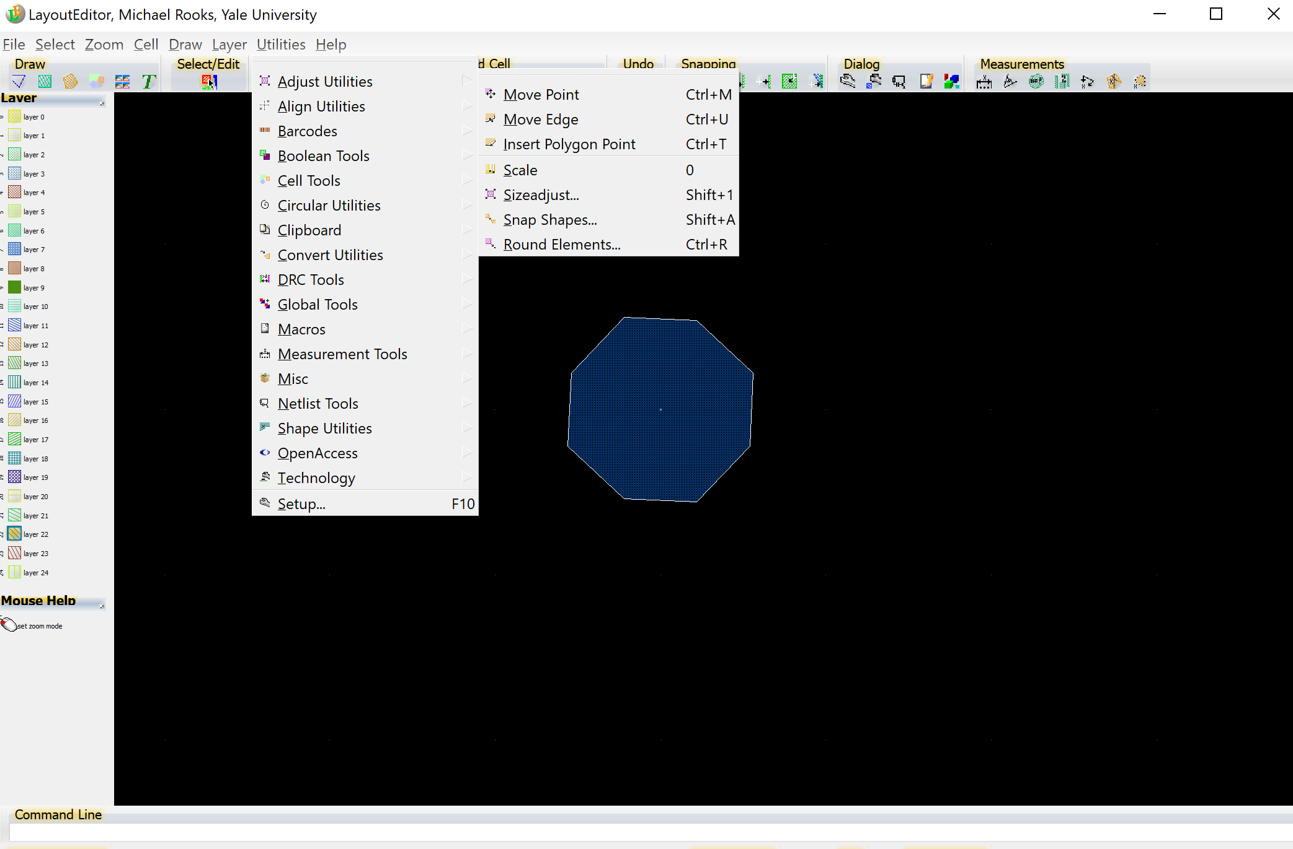
The shape is still selected, so we can use Utilities → Adjust → Move Point
You might expect to find this under “Draw”, but no. It’s easier to use ^M

Slide 42
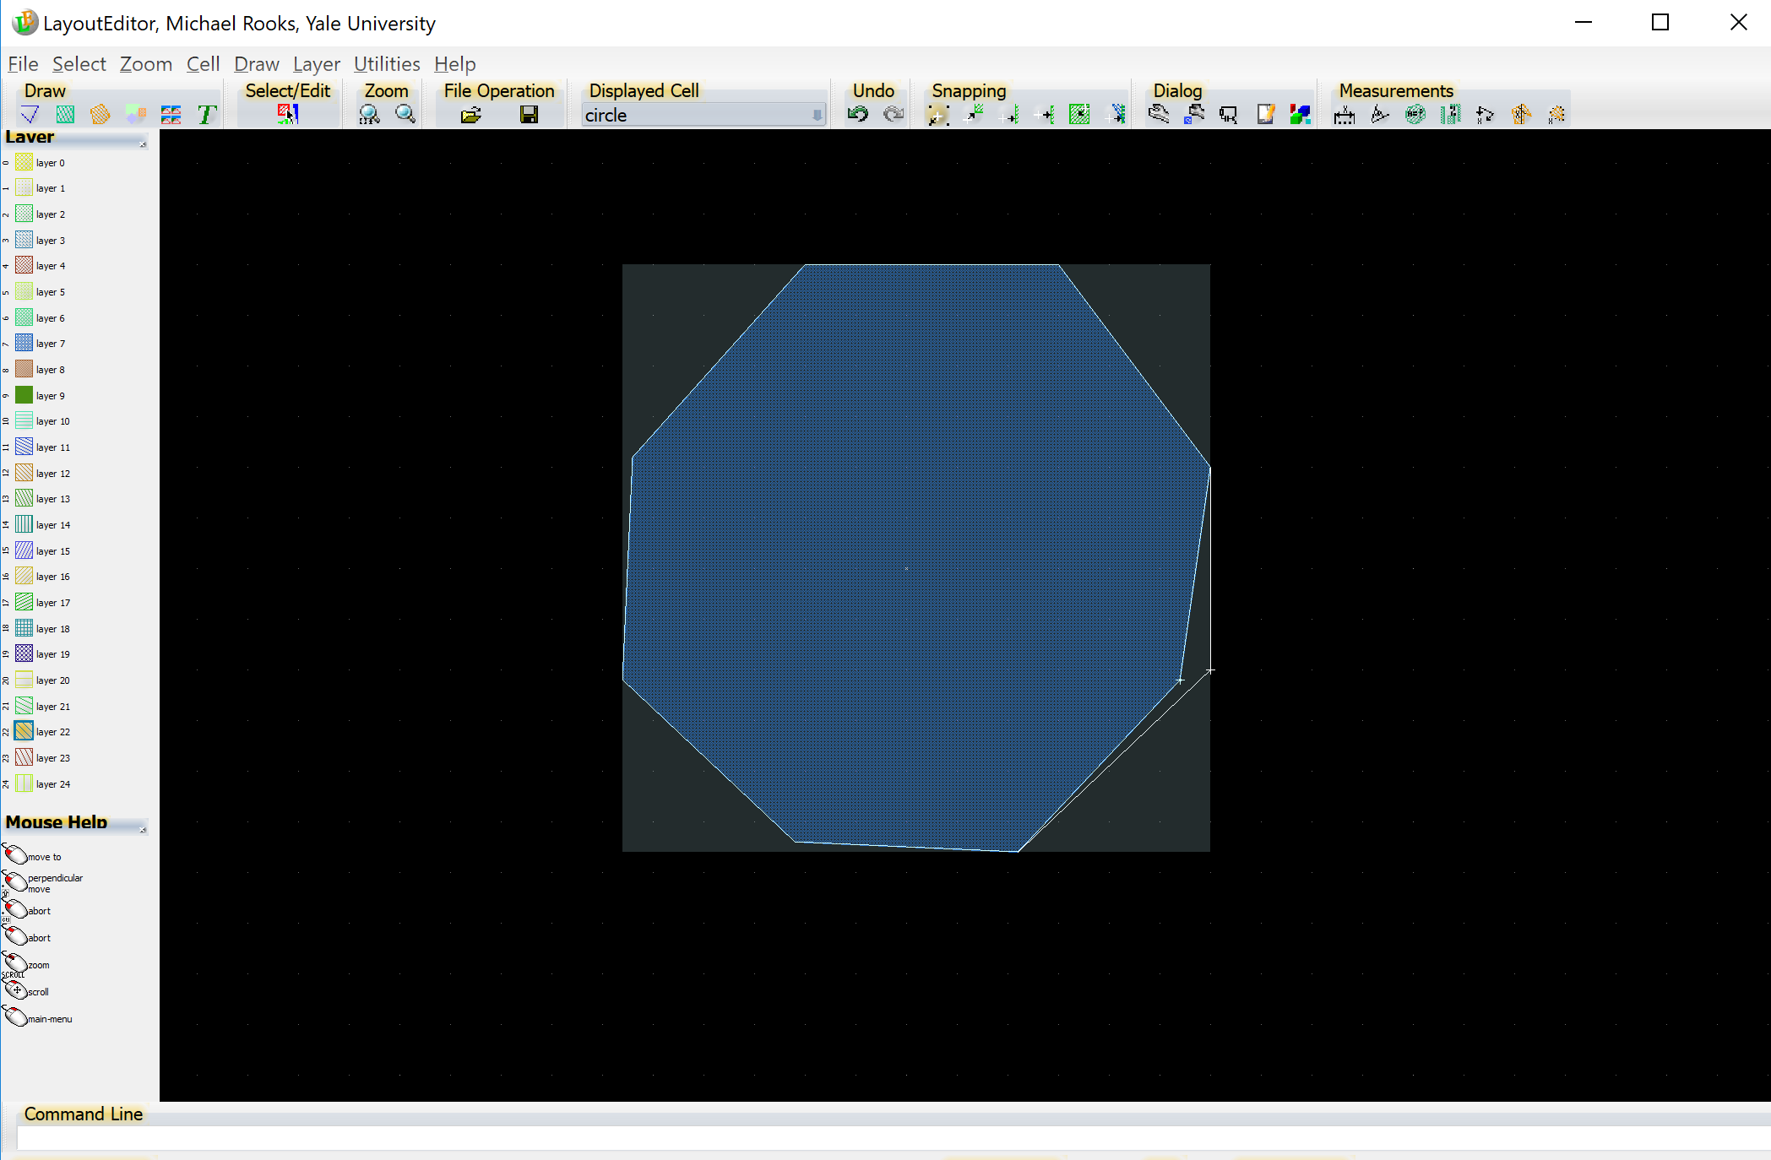
Click on a vertex to pick it up, then move the mouse and click again
to put it down. Once the octogon is on the grid, the later shape
fracturing for e-beam exposure will result in only three trapezoids.

Slide 43
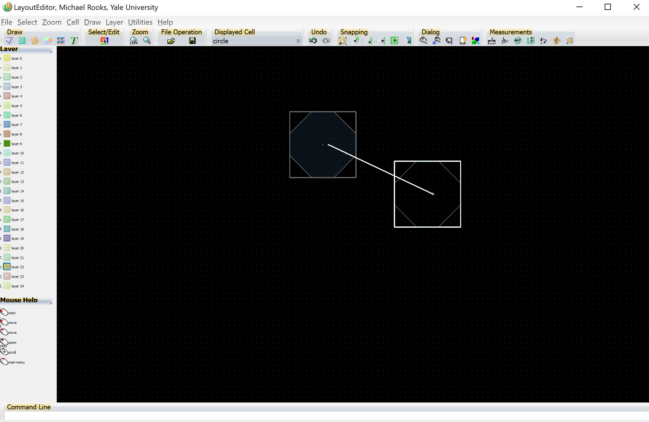
It’s most likely that you will want to create an array of this cell. That way,
when you change the “circle” cell, the entire array changes. But just for
the sake of illustration, suppose we want a copy of the polygon. Maybe you’d
like to copy it and then change the shape. Start by selecting the polygon
and then right-click to choose “copy”. Click, click and you’re done.
Note that this is new polygon is separate from the original.

Slide 44
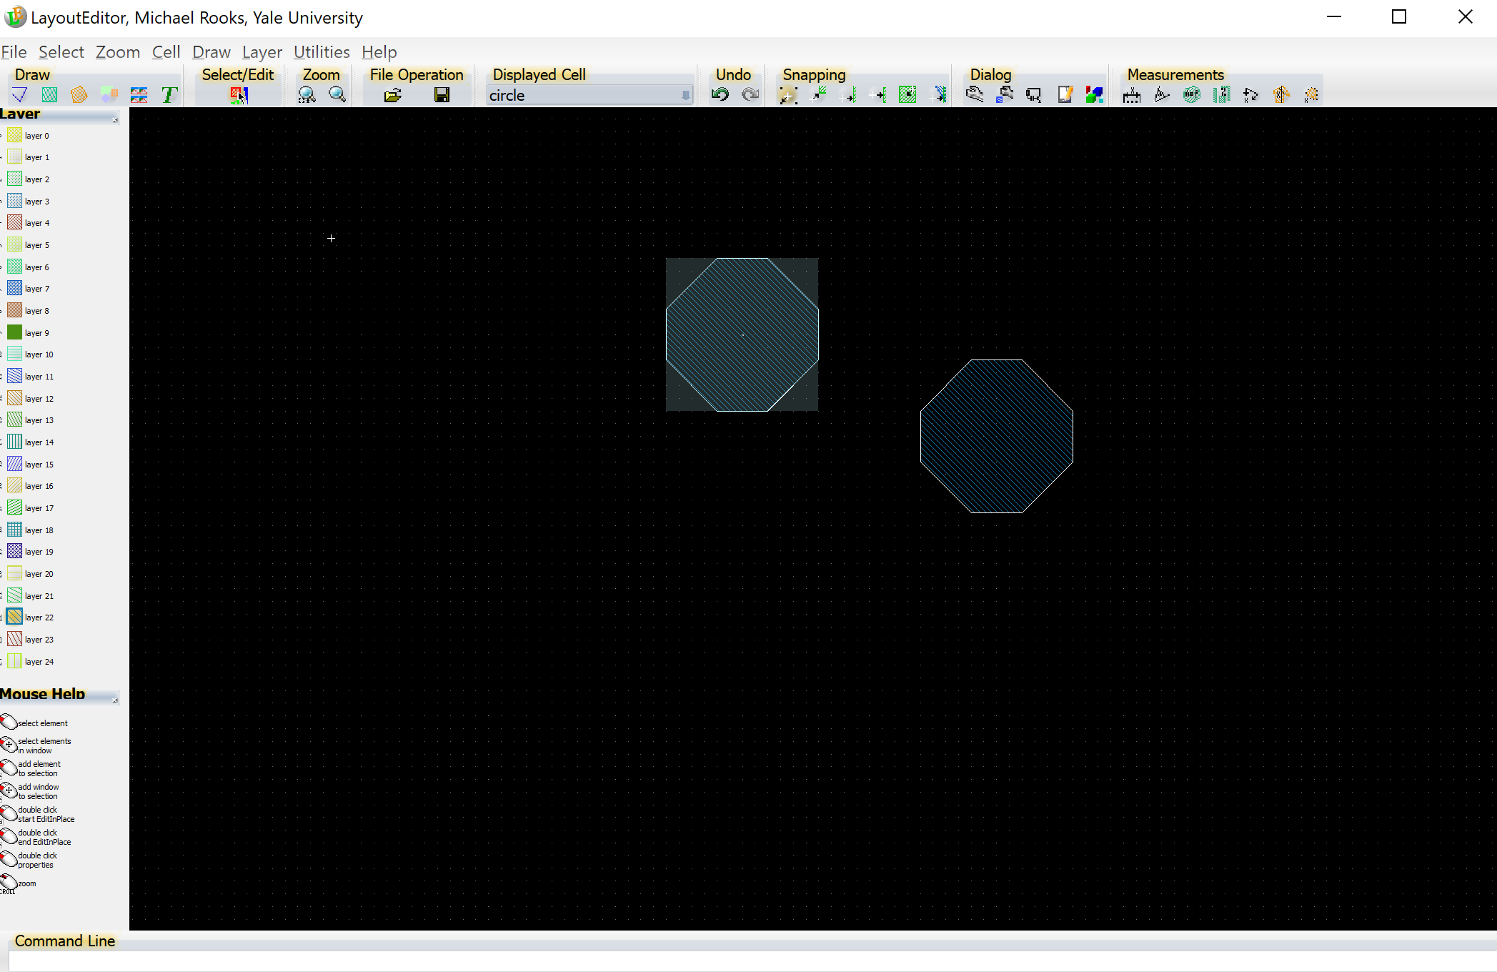
Now measure the area of the shapes. This will be useful for
estimating exposure time. Start by selecting all the shapes, using
Select → Select All.

Slide 45
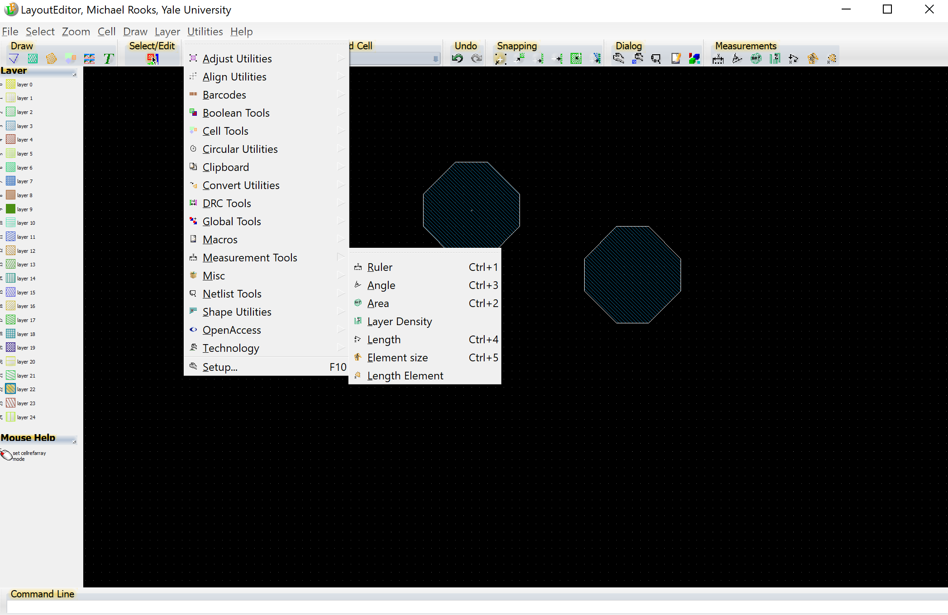
Utilities → Measurement Tools → Area

Slide 46
Overlap removal
Use the “merge” function to eliminate overlaps, thereby avoiding double exposures.
(Alternatively, you could use Beamer to remove all overlaps; but then you would lose all dose assignments.)

Slide 47
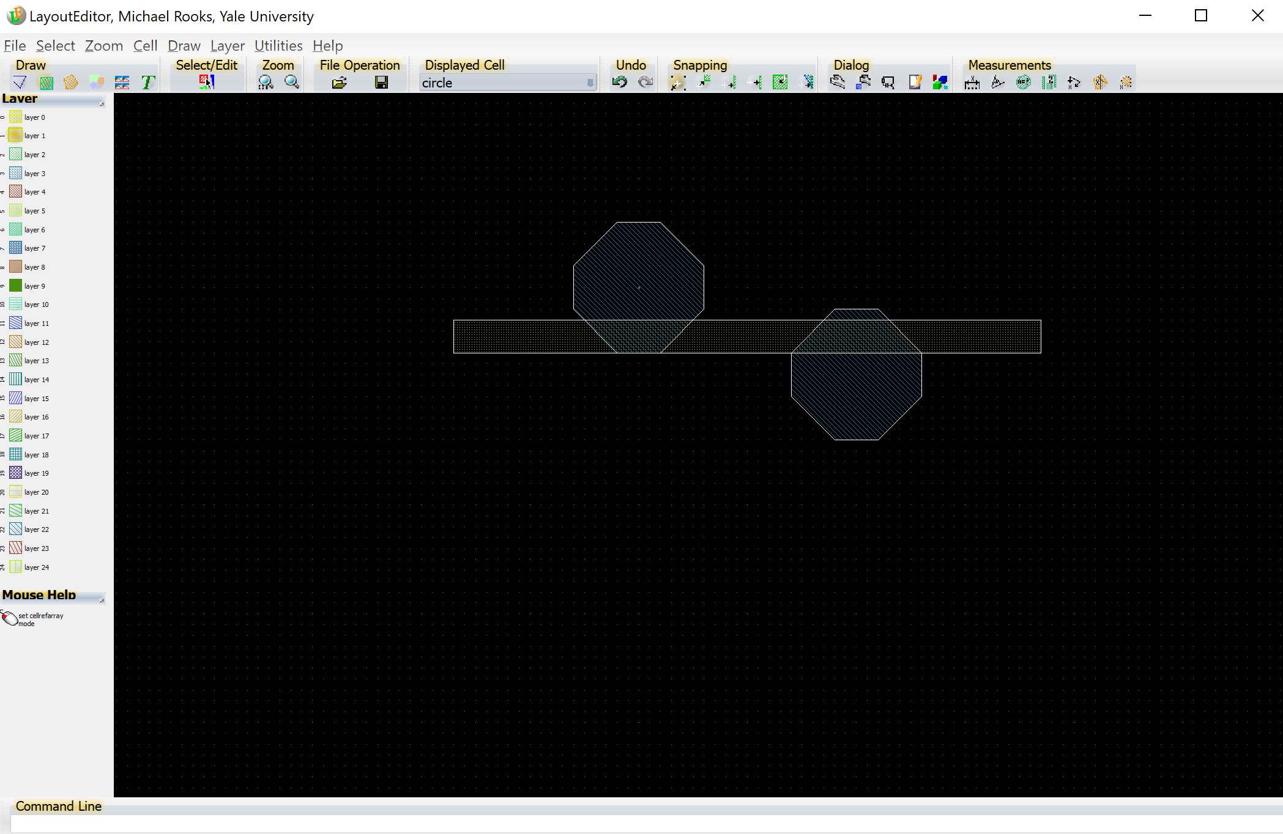
Select the shapes to be merged, or “select all”.
Use Draw → Merge or type ‘V’ to remove the overlap.
You will be prompted for a destination layer.
Let’s choose layer 1, since the original shapes are on other layers.

Slide 48
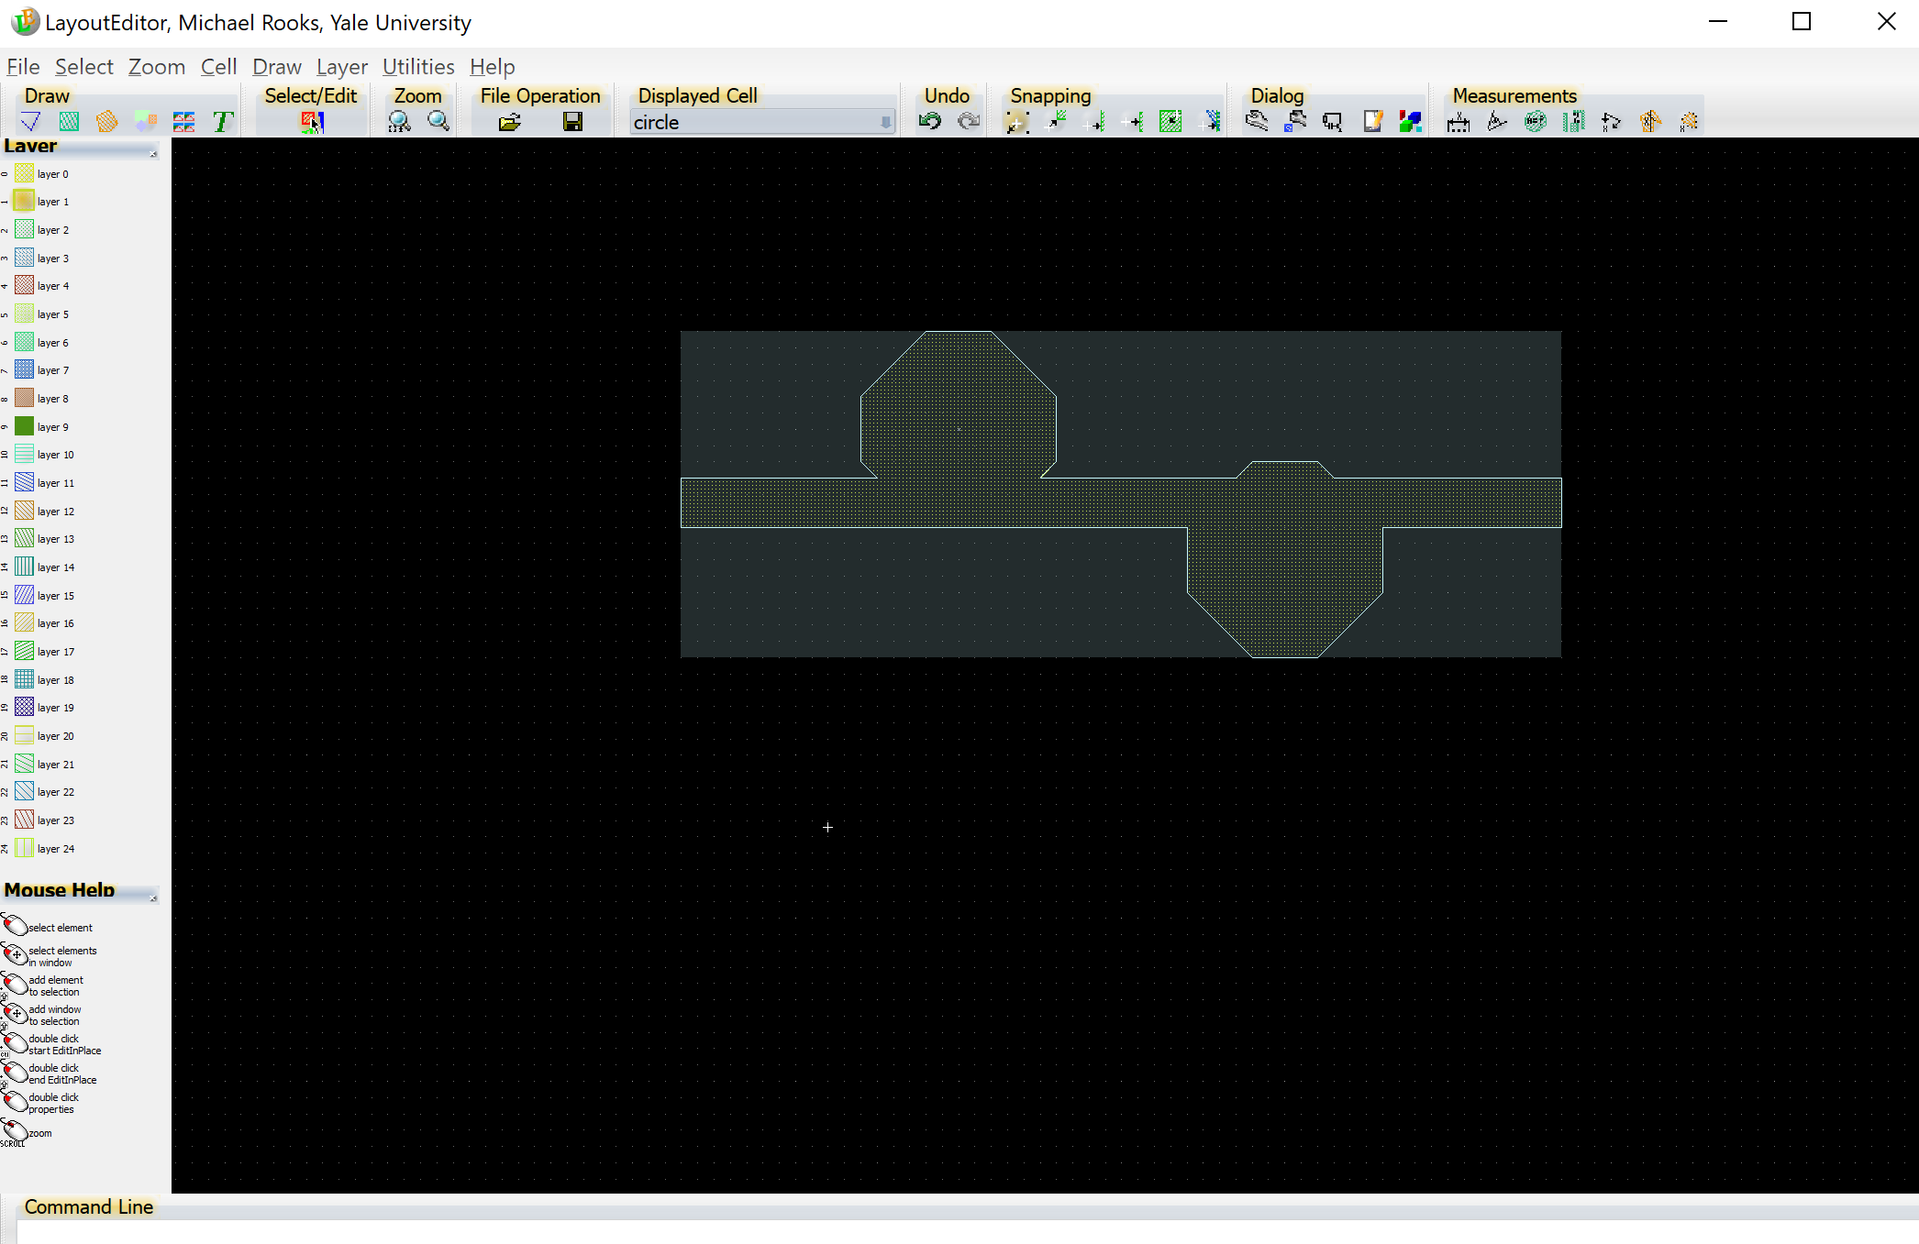
Draw → Merge or ‘V’ removes overlaps. The resulting polygon is on layer 1, and the new shape is now selected. Use Select → Invert Selection then type ‘d’ to delete the original shapes.

Slide 49
Boolean operations
Logical operations such as “and”, “or”, and “not”, as well as +/-, are very useful for designing complex designs.
Layout will let you perform Boolean operations on individual shapes, but this example shows you how to do these operations on entire layers.
First we will assign the label “A” to one layer, and the label “B” to another layer. We will select a third layer to hold the results, and then we will perform an operation such as A – B.

Slide 50
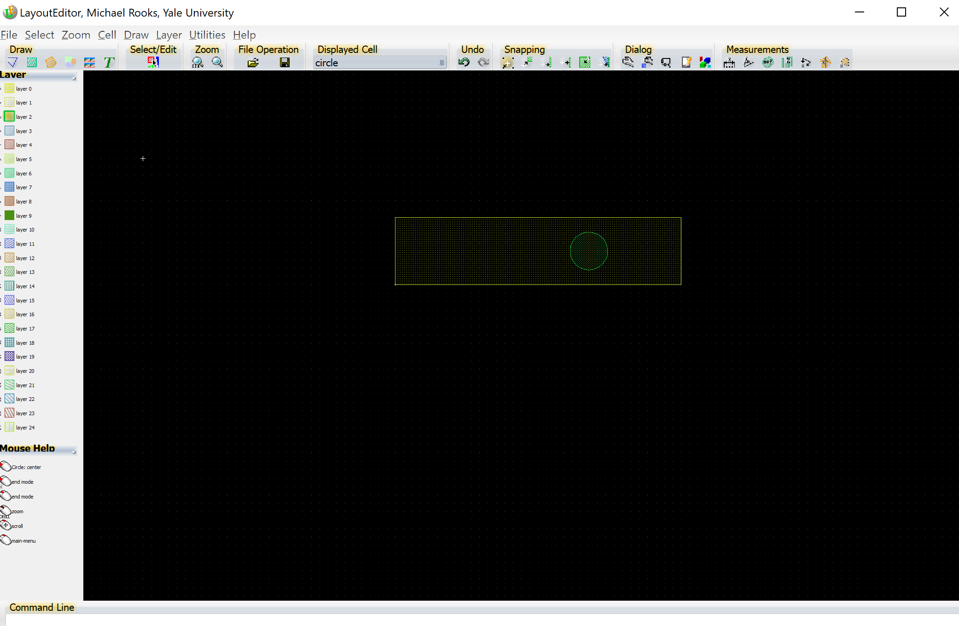
First draw a rectangle on layer 1, and some other shape (such as a circle) on layer 2.

Slide 51
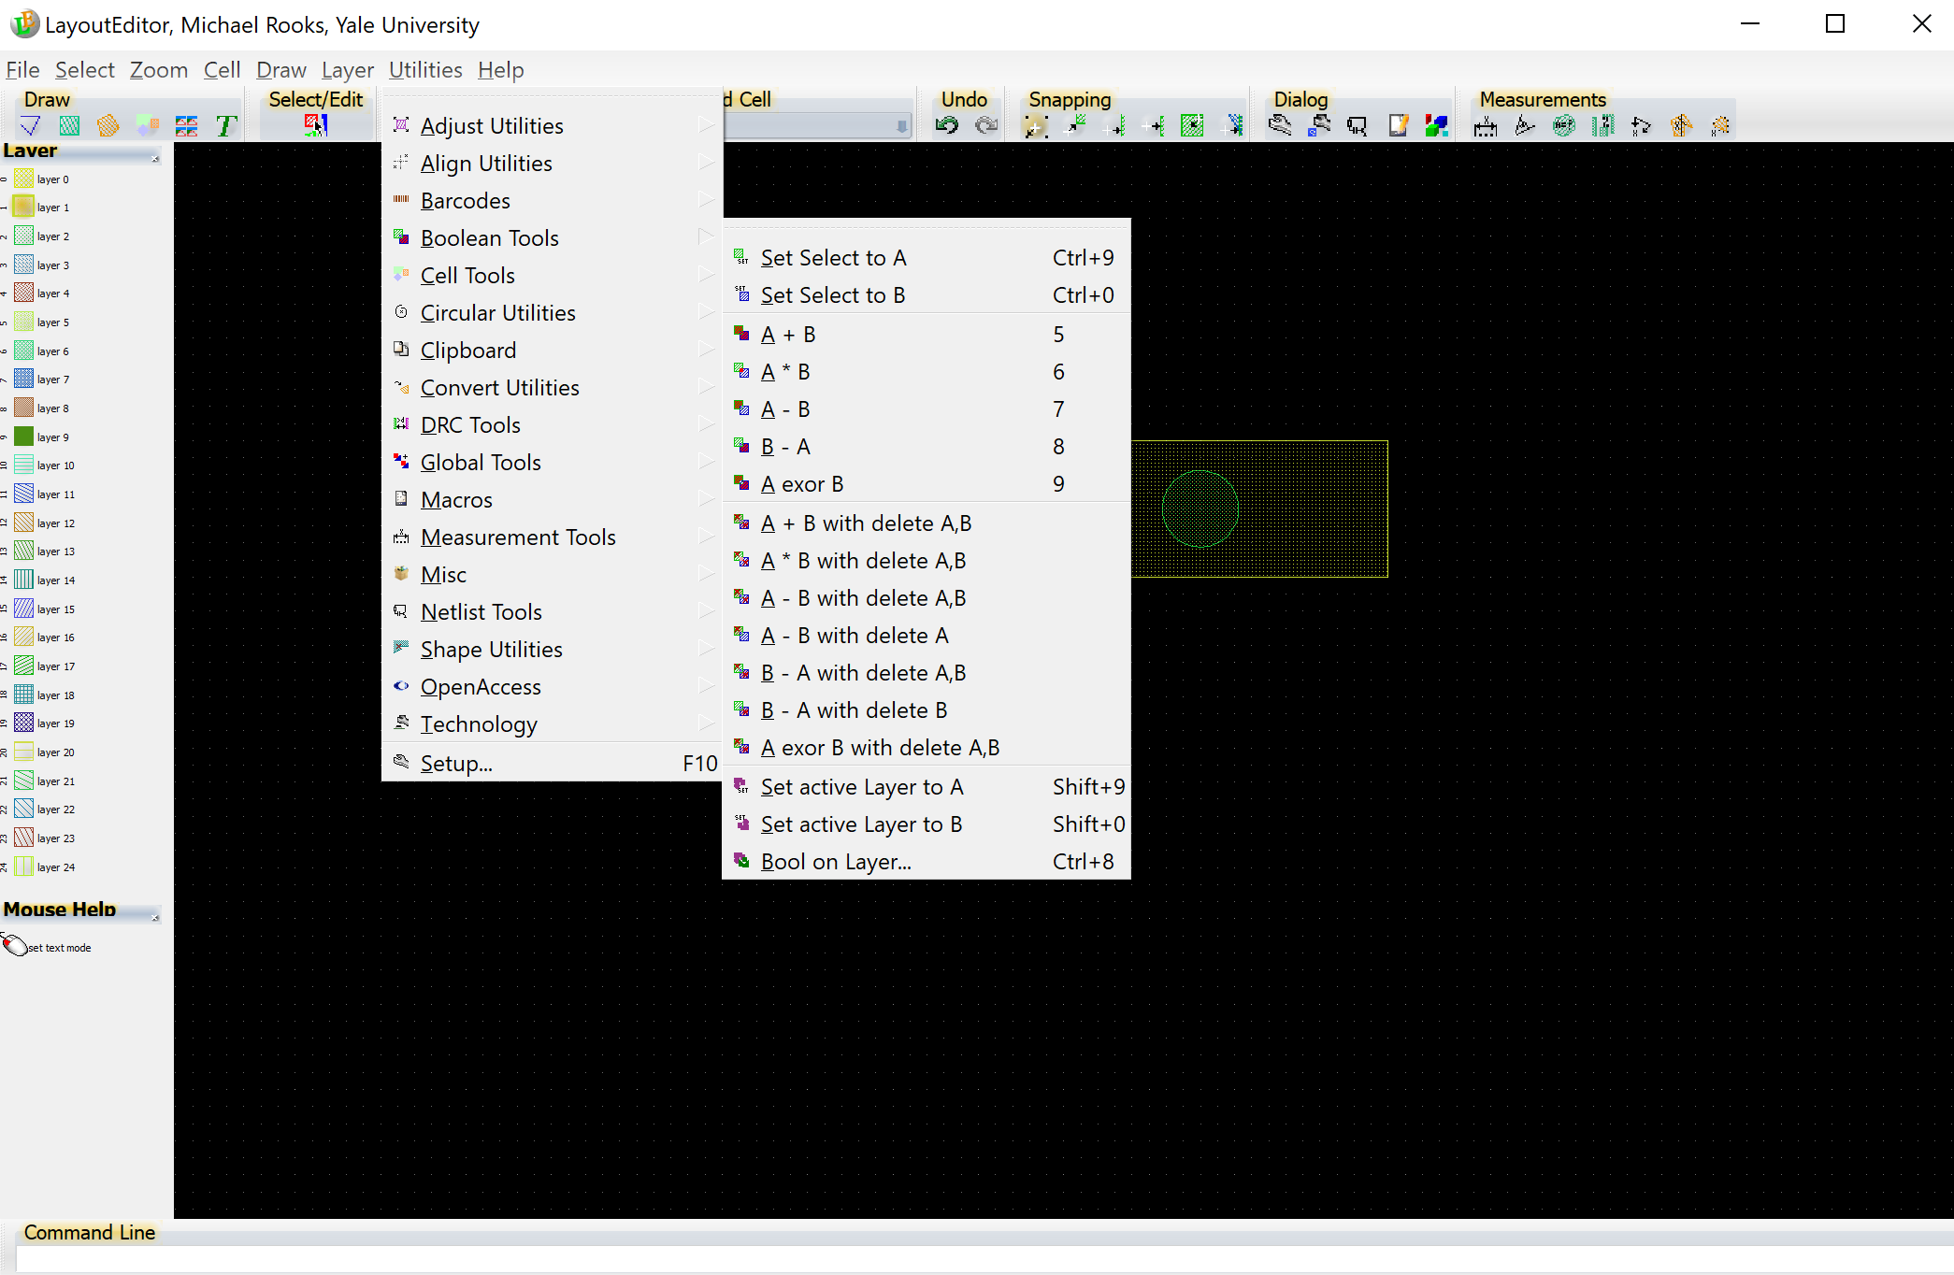
Make layer 1 active (click) then choose Utilities → Boolean → Set active layer to A
Or, use Shift-9

Slide 52
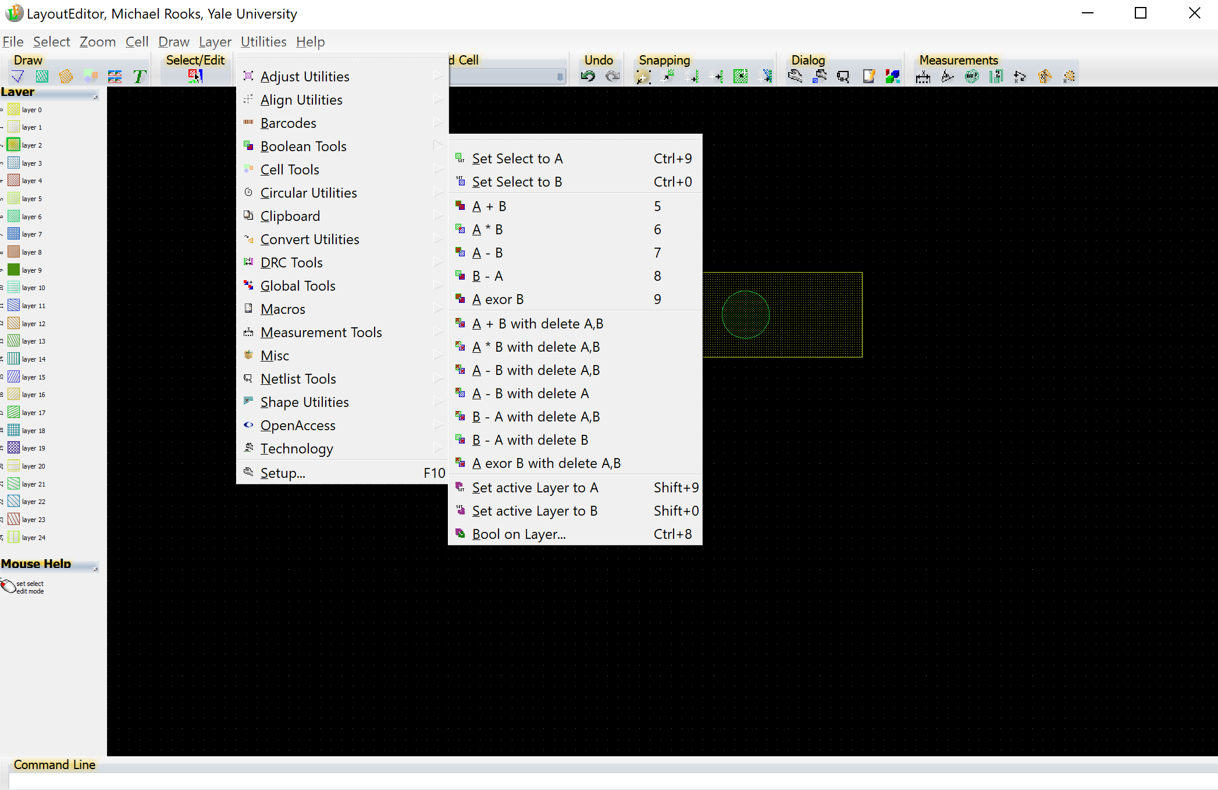
Make layer 2 active (click) then choose Utilities → Boolean → Set active layer to B
Or, use Shift-0

Slide 53
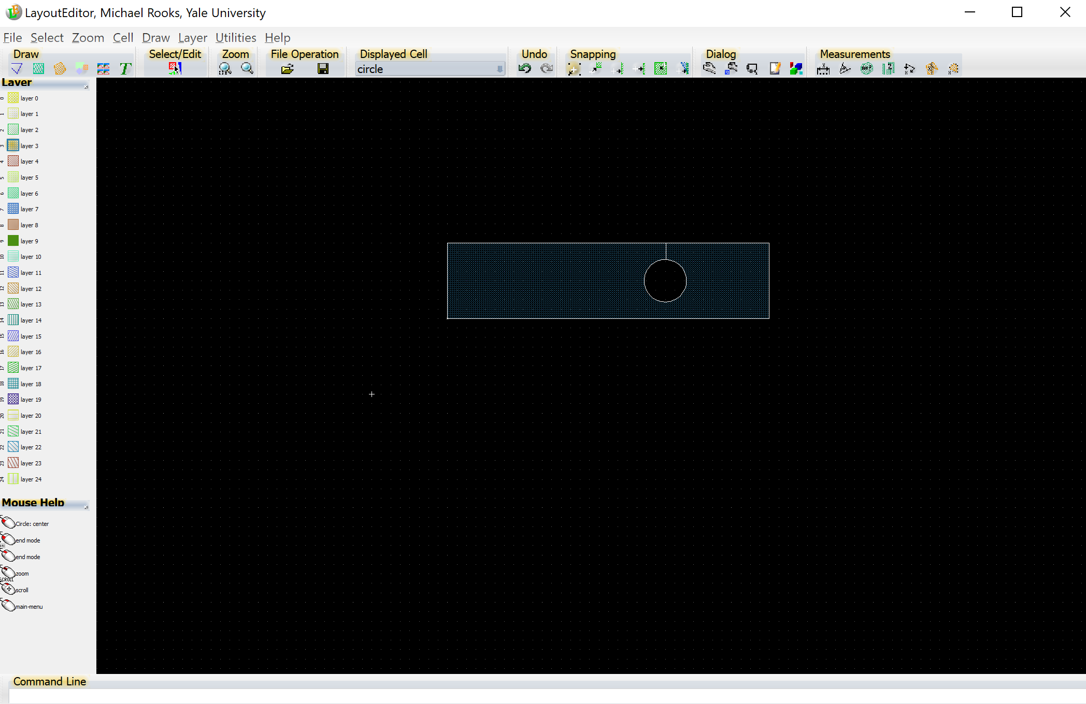
Click on layer 3 to make it the active layer. Now the result of the Boolean operation will go to layer 3.
Choose Utilities → Boolean → A - B with delete A,B

Slide 54
Homework: Design a simple transistor:
Put square alignment marks on layer 0.
Draw the mesa (silicon island) on layer 1.
Source and drain go on layer 2.
Metal pads go on layer 3.
Dopants go on layer 4.
Alignment marks should be 20 um squares, in the corners. The center of each mark should fall on a 10 um grid; that is, the coordinate of each mark should be a multiple of 10 um.
S D
Electrical engineering and physics students: Be sure to get the dopant layer right, or you will look pretty stupid. And you’ll have to do it over.

Slide 55
cell “wafer”
Sometimes it is handy to mock up the full wafer by creating a higher-level cell.
But you would not print this version with the e-beam writer.
Instead, the e-beam writer will step out the unit cell.
Do not start thinking that you can simplify the job by creating one gigantic “chip” that covers the wafer. There are several reasons why this is not a good strategy.

Slide 56
Optional subjects:
Algorithmic pattern generation
Using photos in CAD
(you can stop here if you are not interested)

Slide 57
Algorithmic CAD
You will find an example C program on sizzlorr, in /public
The program
write_gds_examples.c
can be compiled by copying this along with /public/makefile, then
make write_gds_examples

Slide 58
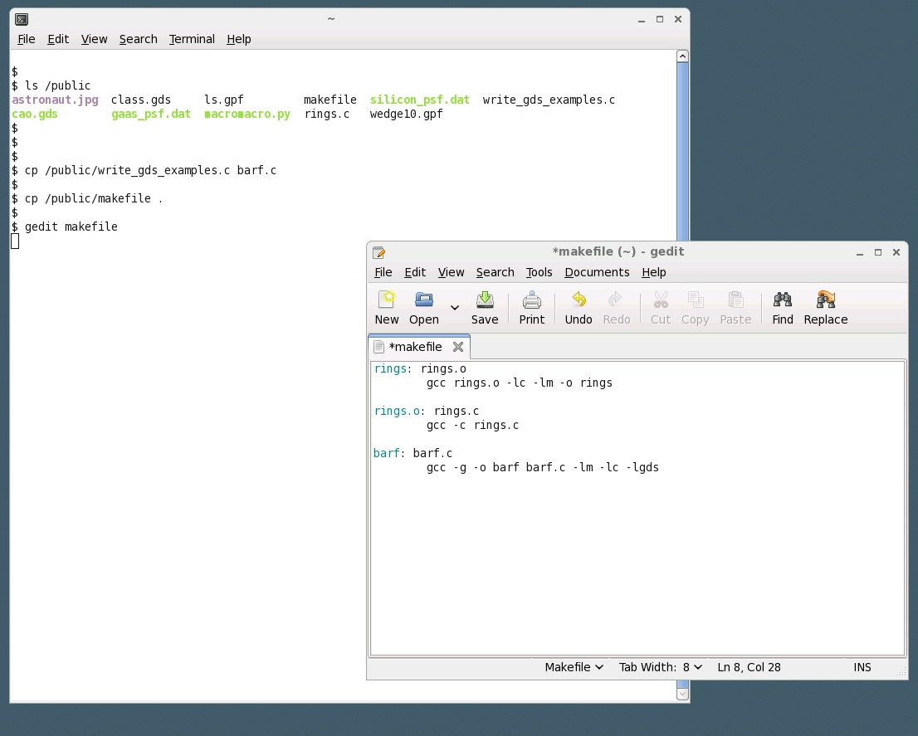
Copy the example to your directory (folder)
Copy the makefile to ‘.’ meaning “here”
Edit the makefile
We can delete these 5 lines
and replace “make_gds_examples”
with “barf”

Slide 59
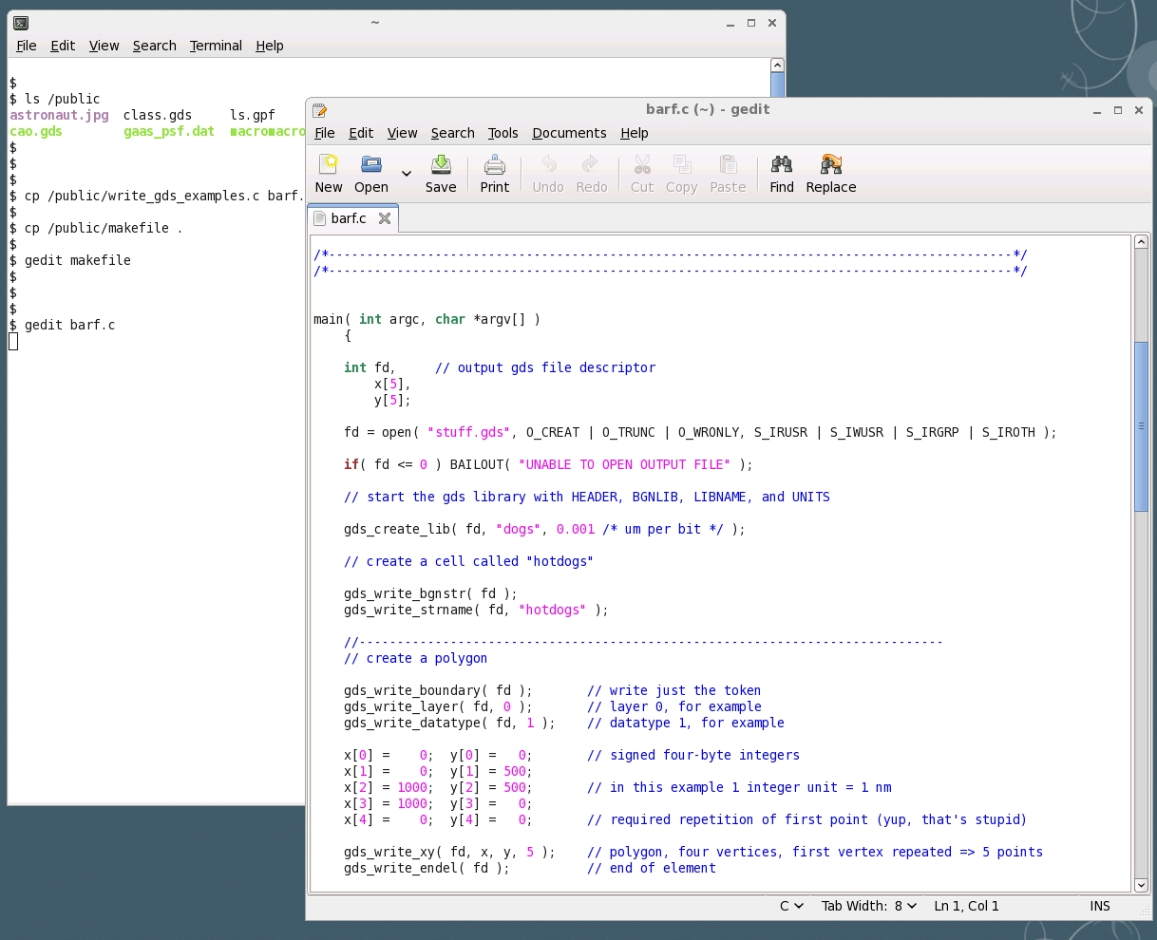
Make whatever changes you like to the C program

Slide 60
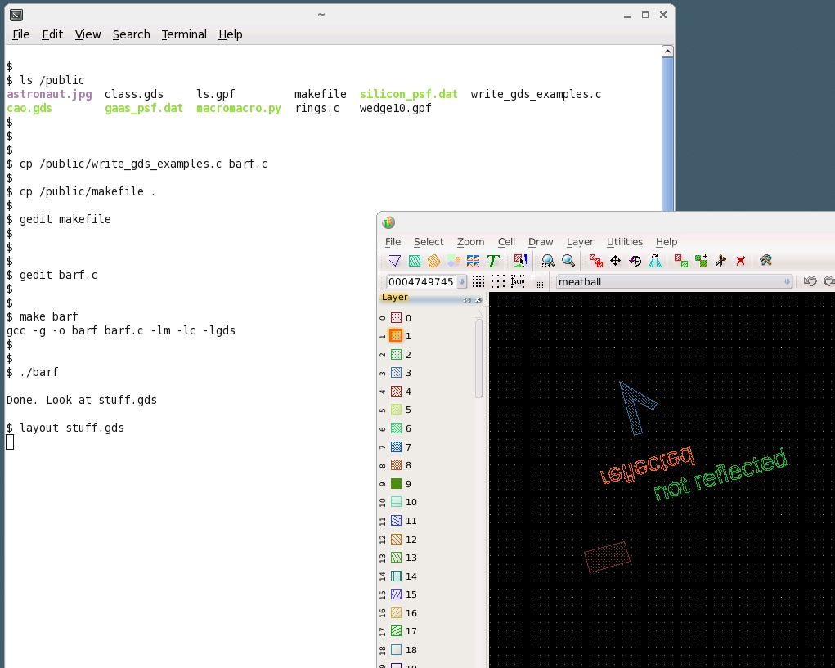
Compile barf.c with the command “make barf”
Run it by typing “barf”
Look at the result with Layout or any other CAD program

Slide 61
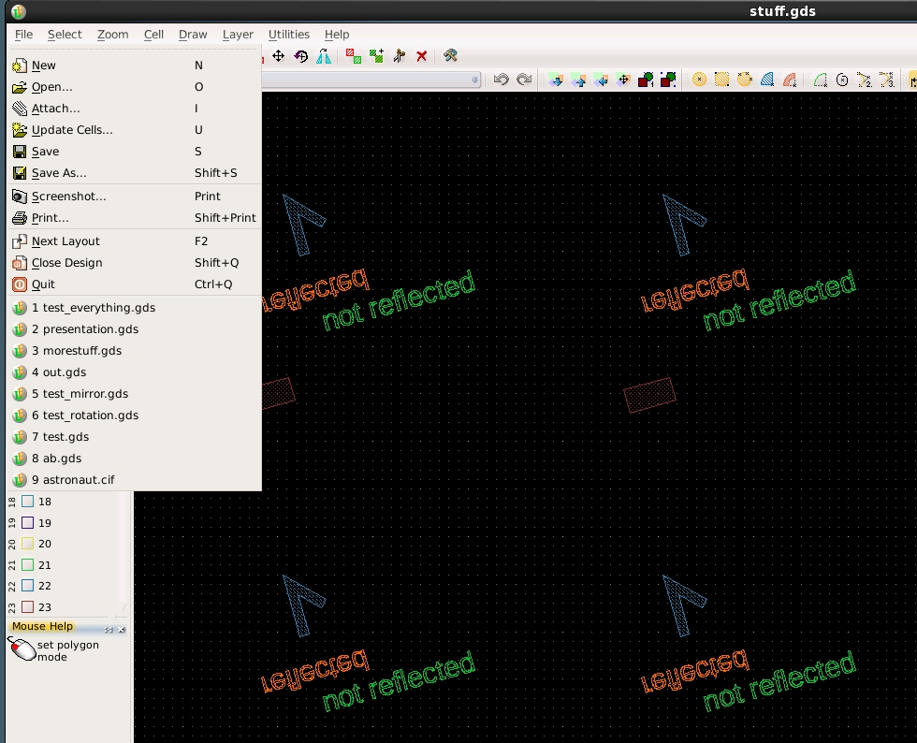
To combine this GDS file with another GDS file, use “attach” in Layout’s File menu

Slide 62
Using microscope images in CAD
If you do not see the “background” panel on the right side, use the menu:
Utilities → Misc → Set background image
Start by adding an image to the background.
Look in /public for an image.
At this step X and Y can be scaled independently, and you can rotate the image.

Slide 63
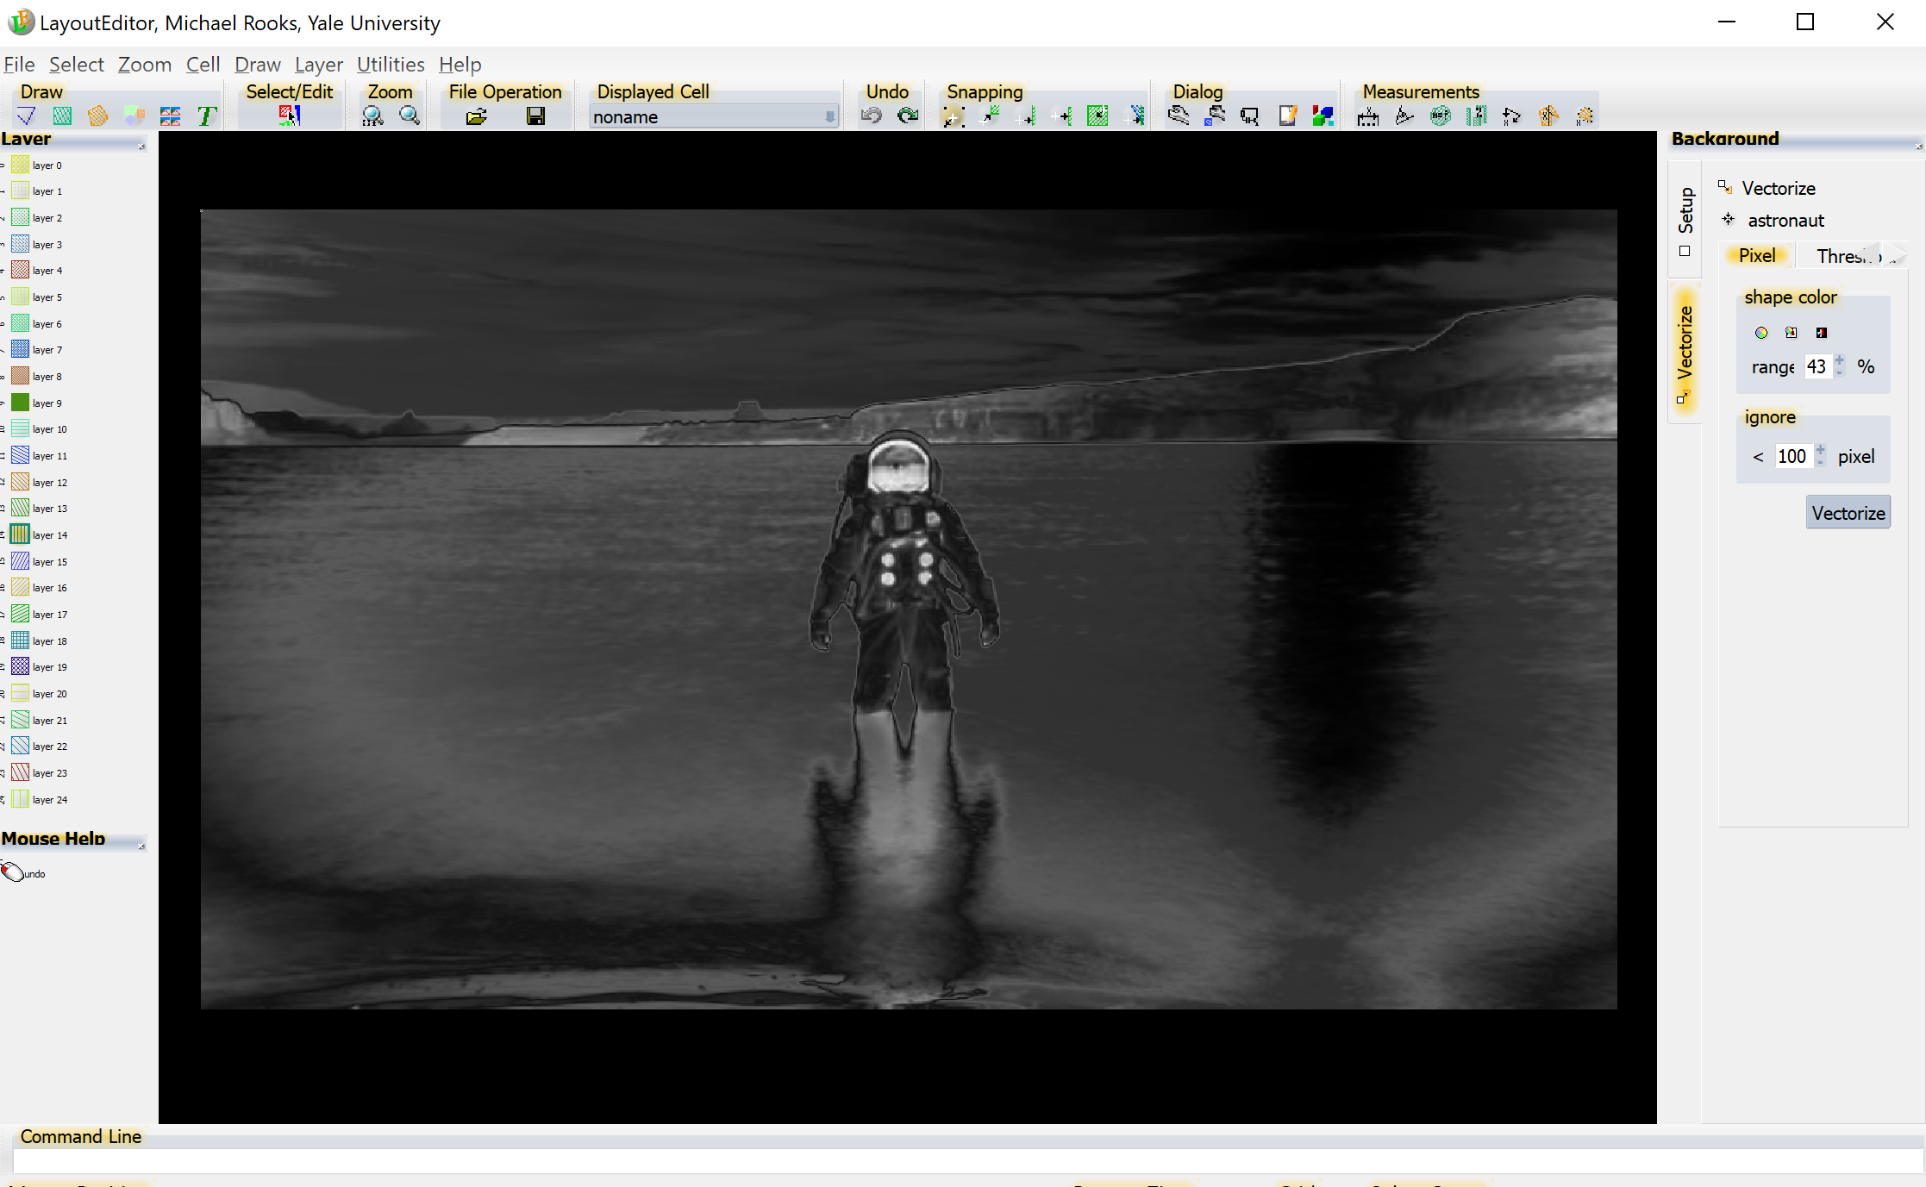
The image can be moved around in the background, but it is not part of the design
and it is not inside any particular cell. Use “vectorize” to turn this image into polygons.

Slide 64
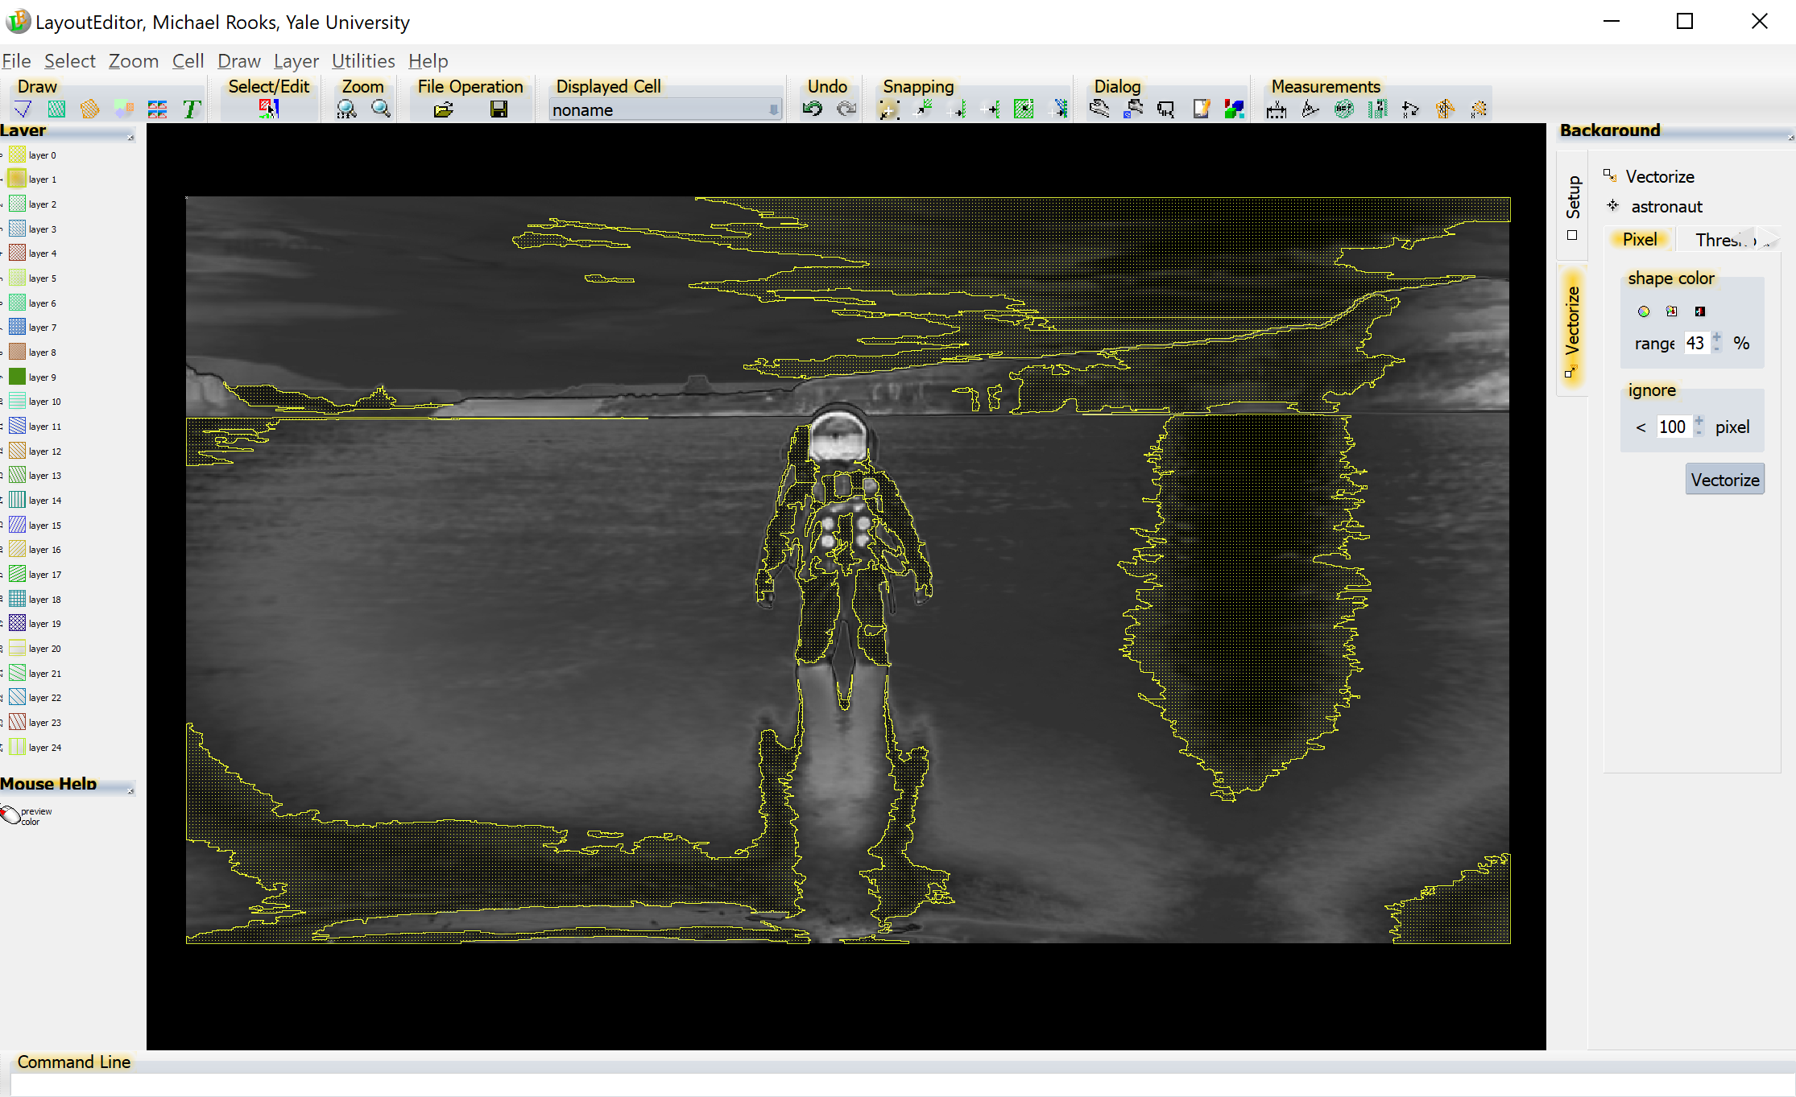
Here is the absurdly tiny PREVIEW button. Press this and then change the range
In the “vectorize” tab, click on the tiny “preview” button and then adjust the parameters.
The chosen threshold (or the chosen color etc) will be used to turn the image into polygons.
Click on “vectorize” to make it happen. Rename the cell, and the original image disappears.

Slide 65
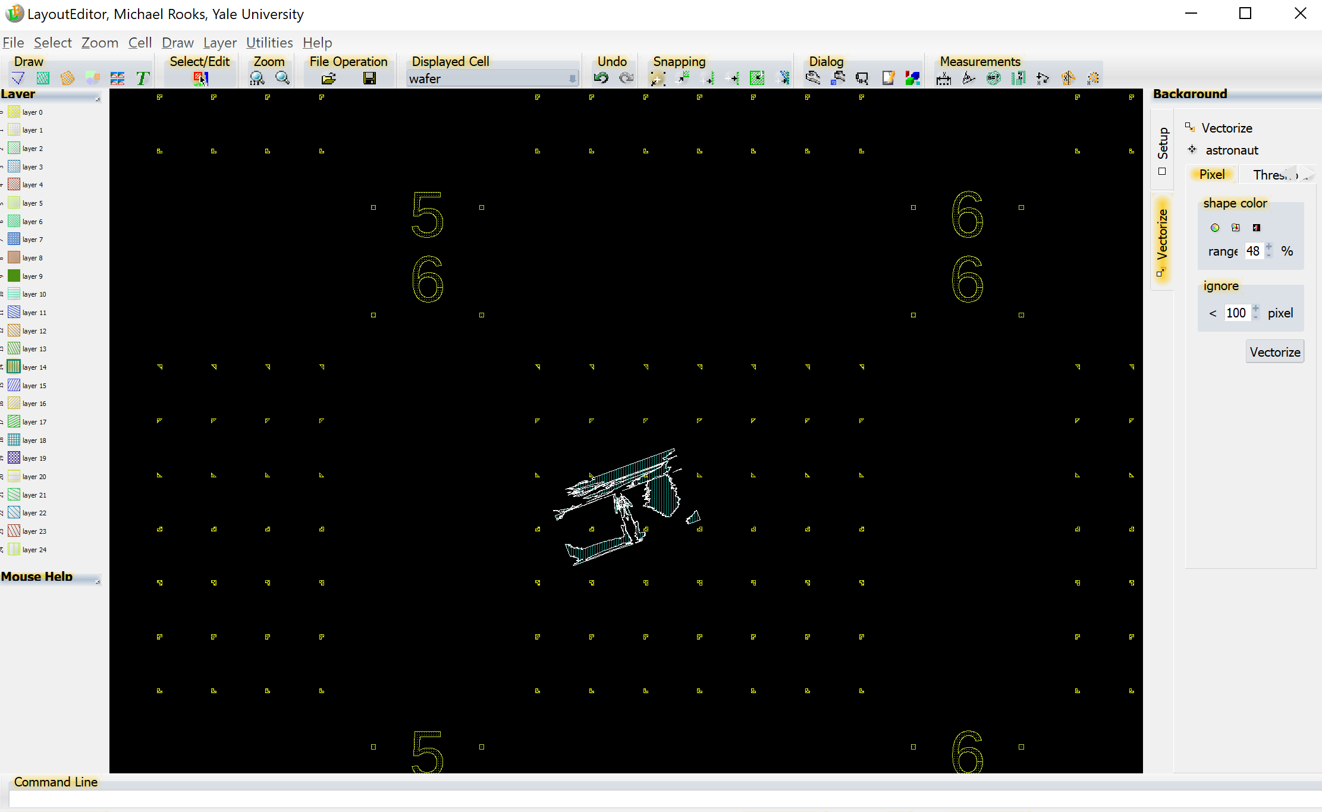
Here we show the image cell placed inside a cell of fiducial marks. We selected the image cell, then right-clicked to change scaling and rotation. We put the image on an unused layer, so we could design contact pads around it.

Slide 66
Converting images to exposable shapes
Simple thresholding, as shown above, is not a good way to prepare images for printing with e-beam or photo-lithography.
Since you are using a binary tone printing process, the image should be converted to grey-scale, and then the grey scales should be represented by different densities of dots. This dot representation is called “half tone” or “newsprint”.
Start by opening an image in gimp. (You could instead use Photoshop, but this tutorial uses gimp, which is free and runs on any operating system.)

Slide 67
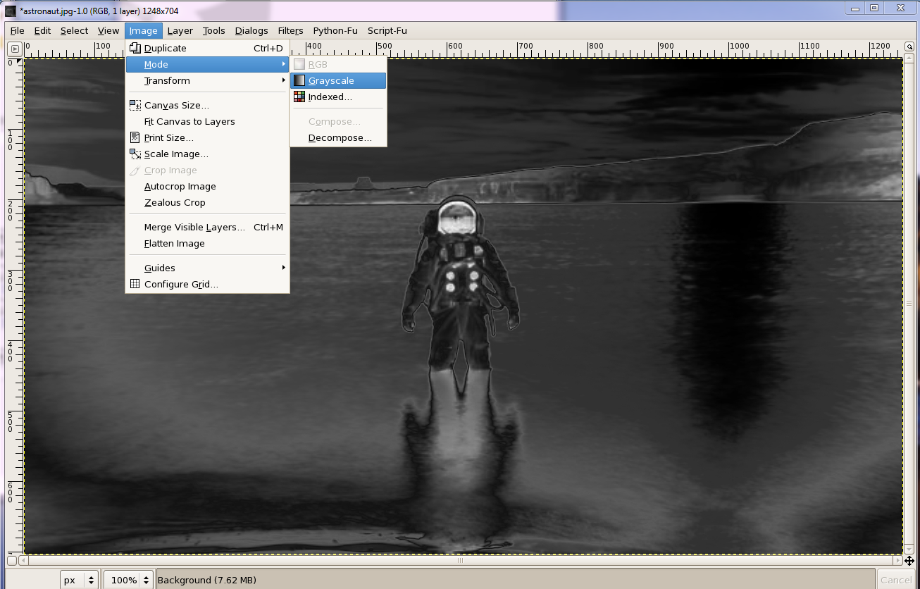
Convert the image to grayscale, using Image → Mode → Grayscale

Slide 68
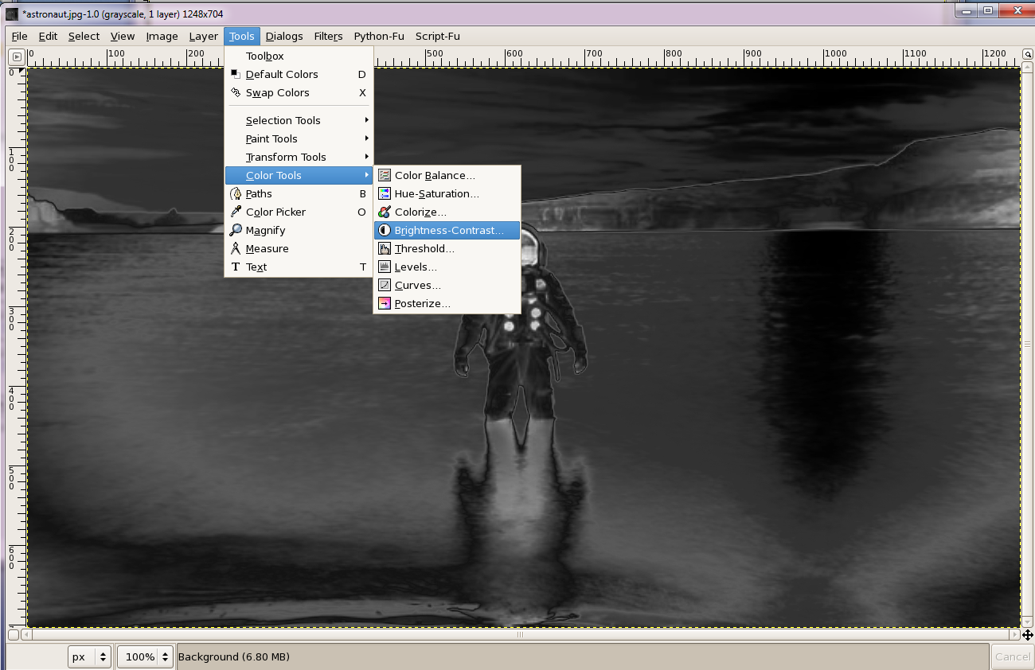
Adjust the brightness and contrast, keeping in mind that the bright parts will be exposed as shapes.
If necessary, invert the tone with colors → invert

Slide 69
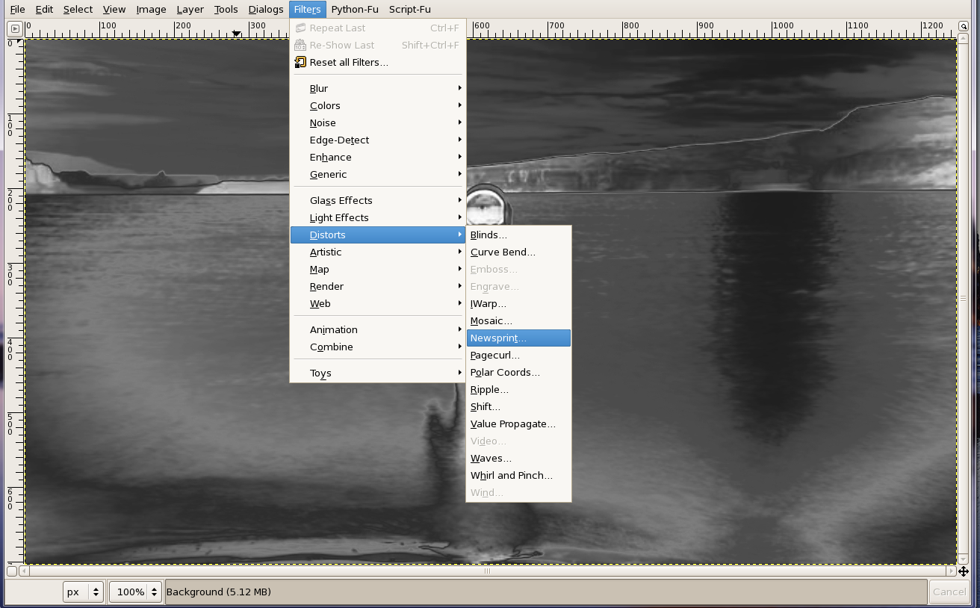
Convert the image to half-tone using gimp’s function “Newsprint”

Slide 70
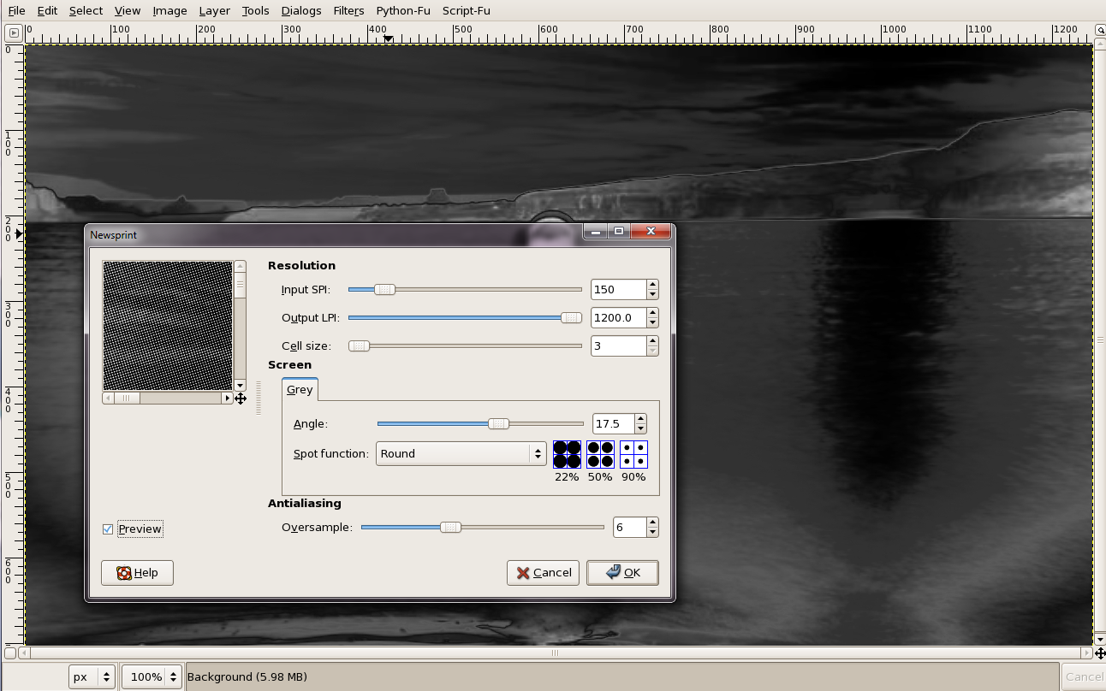
Use a small cell size and oversampling of ~6.
Play with the angle to get the best antialiasing.

Slide 71
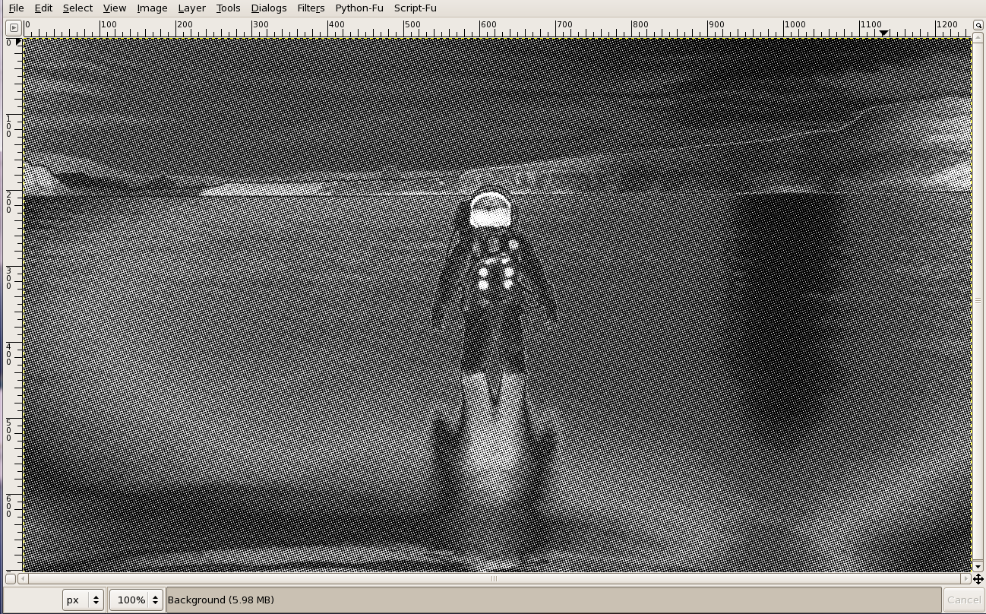

Slide 72
Save the image in TIFF format (filename.tif) then convert the bright pixels to polygons in CIF format.
From a terminal window, use
tif2gds filename
to convert filename.tif to filename.gds
Start the CAD program with the command
layout
then open the file filename.gds

Slide 73
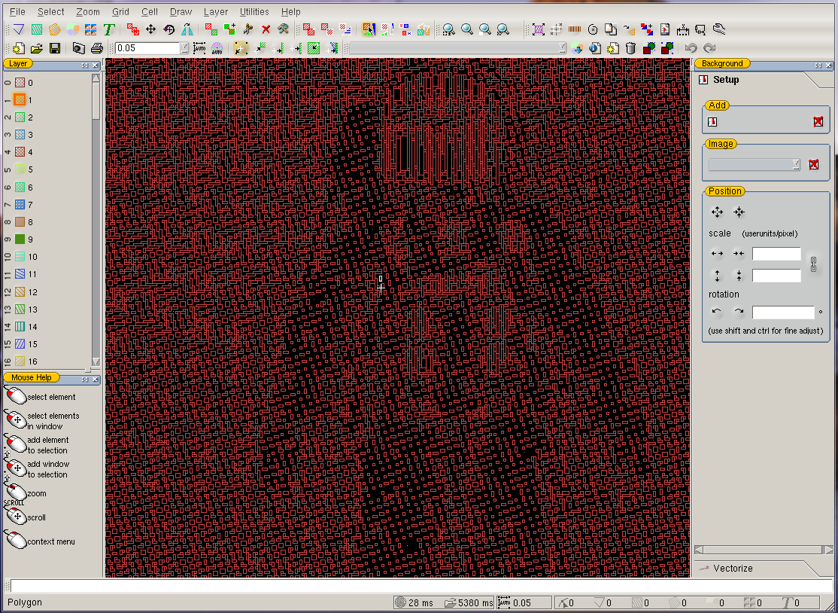
You can merge this file to another GDS file using File → Attach

Slide 74
End of Layout CAD tutorial
Go forth and design something cool.

